Slide 1
NGS Read Mapping
Data Analysis Group
16th August 2019

Slide 2
Overview
Alignment basics
NGS alignment issues
Reference sequences
BWA
File formats
Post-processing
Viewing alignments in genome browsers
Multi-mapping reads
DAG Workflows: map-bwa-mem-pe

Slide 3
Key to slides….
Descriptive text
Example commands – black monospaced text: ls /tmp
Commands to run – red monospaced text
Prompts/STDOUT/STDERR – green monospaced text
e.g.
  -bash-4.1 $ echo $USER
  jabbott
[ENTER] – press enter key
[username] – your username, not '[username]'
\ - command is continued on next line – don't press 'enter' at this point

Slide 4
Before we begin…
Log into the cluster enabling X11 tunnelling
Quick reminder:
  Start Xming
  Start putty (enable SSH X11 forwarding)
  Hostname: login.cluster.lifesci.dundee.ac.uk
Copy example data to your home directory
  ningal:~ $ cp –R /tmp/Read_Mapping ~
Update conda, create a new conda environment and install some packages:
ningal:~ $ conda update –n base conda
ningal:~ $ conda create –n read_mapping
ningal:~ $ conda activate read_mapping
ningal:~ $ conda install bwa samtools \
picard minimap2
We will be using interactive commands, so create in interactive session on a cluster node:
ningal:~ $ qrsh –pe smp 4
c6100-18-1:~ $ conda activate read_mapping
ningal:~ $ cd Read_Mapping

Slide 5
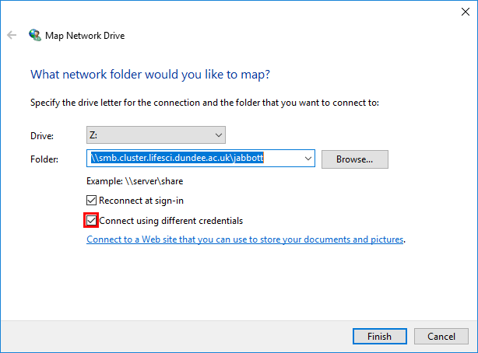
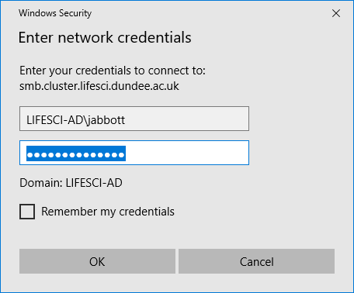
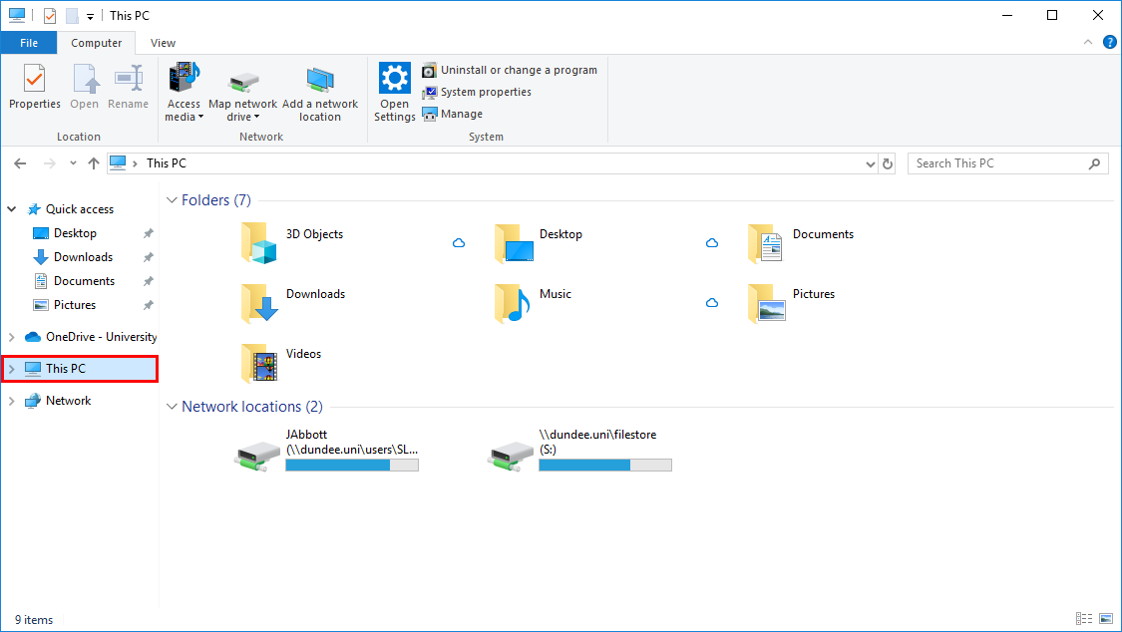
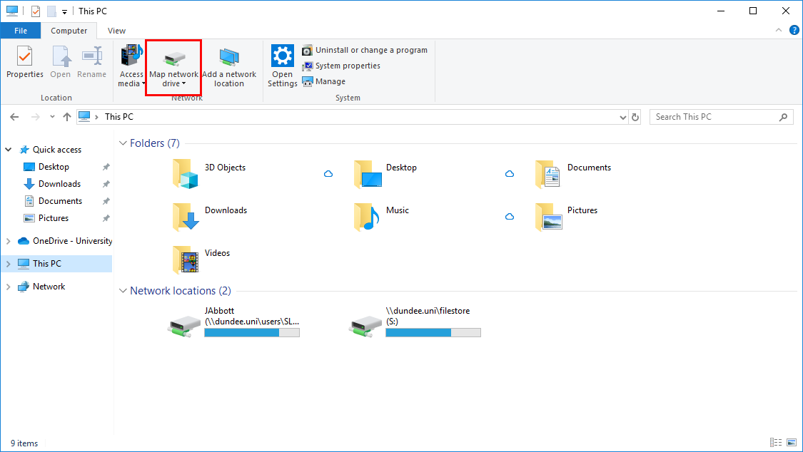
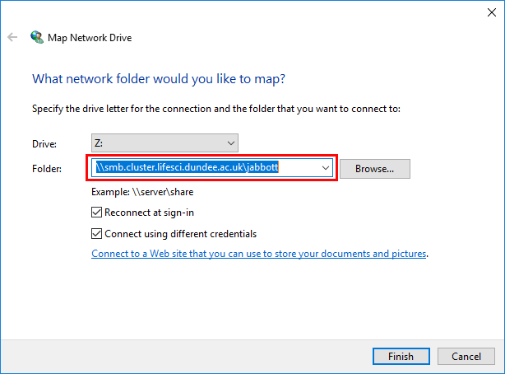
Accessing files: CIFS
The cluster filesystem can be mounted as a network drive
Open file explorer
Select 'This PC'
Click 'Map network drive'
Enter '\\smb.cluster.lifesci.dundee.ac.uk\[username]
Click 'Connect using different credentials'
Click 'Finish'
Enter credentials – LIFESCI-AD\username
You can now drag and drop files to the cluster

Slide 6
Why map reads?
Sequence reads represent isolated regions of sequence out of context
Many analysis approaches require knowledge of
  read locations on reference sequence
  Differences between reads and reference sequence

Slide 7
Sequence alignment basics
Alignment of two sequences originally carried out…
  To identify subsequences which are positionally similar
  To uncover evolutionary relationships
First optimal alignment of two sequences: Needleman and Wunsch (1970)
  Dynamic programming
  Global alignment:
    optimal alignment of full length of sequences
    Attempt to align every base between sequences
    Conserved domains may not be aligned
  --T—-CC-C-AGT—-TATGT-CAGGGGACACG—A-GCATGCAGA-GAC
  | || | || | | | ||| || | | | || |
  AATTGCCGCC-GTCGT-T-TTCAG----CA-GTTATG—T-CAGAT--C
Notes:
Dynamic programming relates optimal alignment of two sequences to optimal alignment of shorter substrings. Subproblems ordered to avoid repeated computation of same data.
Global alignment useful when sequences similar in entirety…local similarities may be missed

Slide 8
Local alignments
Optimal alignment of substring within sequences
Useful for identifying locally conserved regions
ACTACTAGATTACTTACGGATCAGGTACTTTAGAGGCTTGCAACCA
|||| |||||| |||||||||||||||
TACTCACGGATGAGGTACTTTAGAGGC
Smith-Waterman (1981) modification of Needleman-Wunsch

Slide 9

Alignment scoring
How do you asses if one alignment is better than another?
Scoring – reward similarity, penalise differences
    GCATCATCTCCG
    GCTTCATGTCCG
i.e. (from fasta):
  Match: score +5
  Mismatch: score -4
10 matches and 2 mismatches = $\left(10 × 5\right)+\left(2 × −4\right)=42$

Slide 10
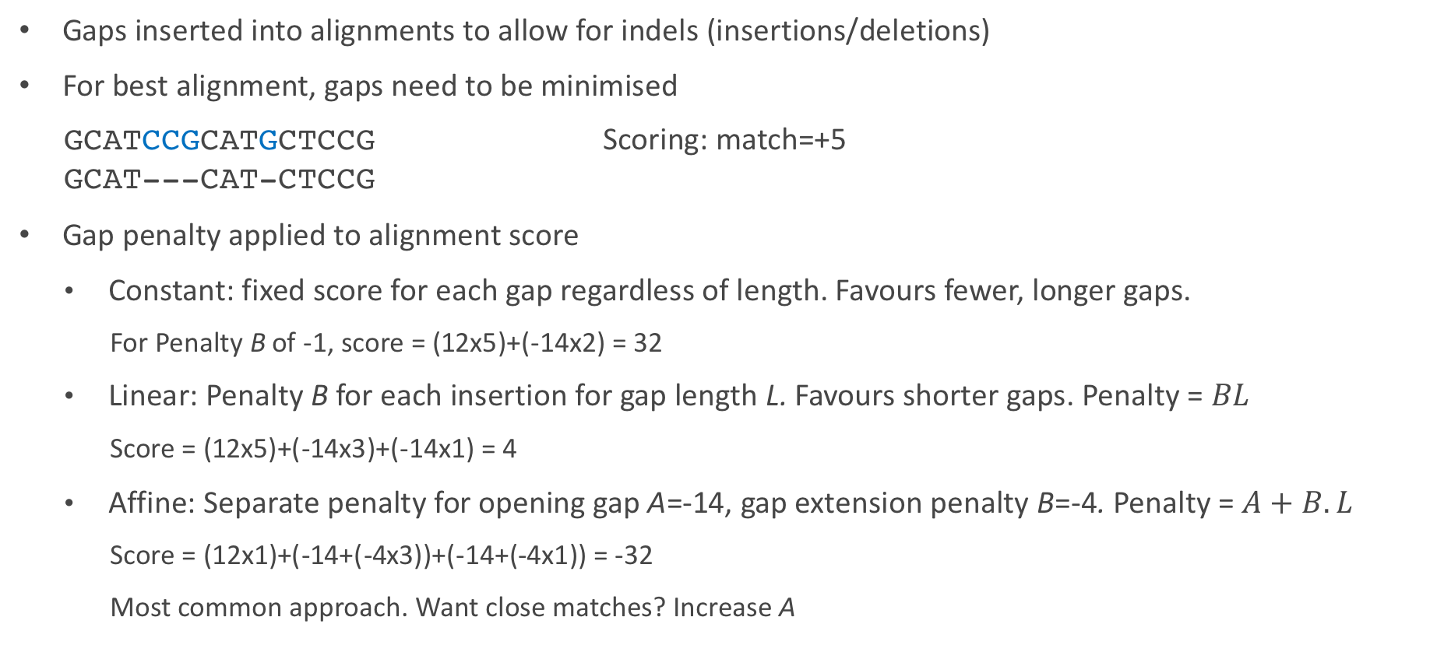
Gap penalties
Gaps inserted into alignments to allow for indels (insertions/deletions)
For best alignment, gaps need to be minimised
    GCATCCGCATGCTCCG Scoring: match=+5
    GCAT---CAT-CTCCG
Gap penalty applied to alignment score
  Constant: fixed score for each gap regardless of length. Favours fewer, longer gaps.
    For Penalty B of -1, score = (12x5)+(-14x2) = 32
  Linear: Penalty B for each insertion for gap length L. Favours shorter gaps. Penalty = $BL$
    Score = (12x5)+(-14x3)+(-14x1) = 4
  Affine: Separate penalty for opening gap A=-14, gap extension penalty B=-4. Penalty = $A+B.L$
    Score = (12x1)+(-14+(-4x3))+(-14+(-4x1)) = -32
    Most common approach. Want close matches? Increase A

Slide 11
k-tuple/word algorithms
Dynamic programming (DP) computationally expensive
Database searching required better performance
Heuristic algorithms:
  not guaranteed to find optimal solution
  exclude large parts of database from DP comparison
  Identify candidates with short stretches of similarity of length k
  Only carry out DP on candidate sequences

Slide 12
NGS Alignments

Slide 13
NGS arrives…
Requirement to align many millions of reads against databases
Existing approaches far too slow
Fresh approaches required
Now >70 NGS read aligners
These differ in
  Speed
  Accuracy
  Approach
  Purpose
Choosing which to use not always straightforward

Slide 14
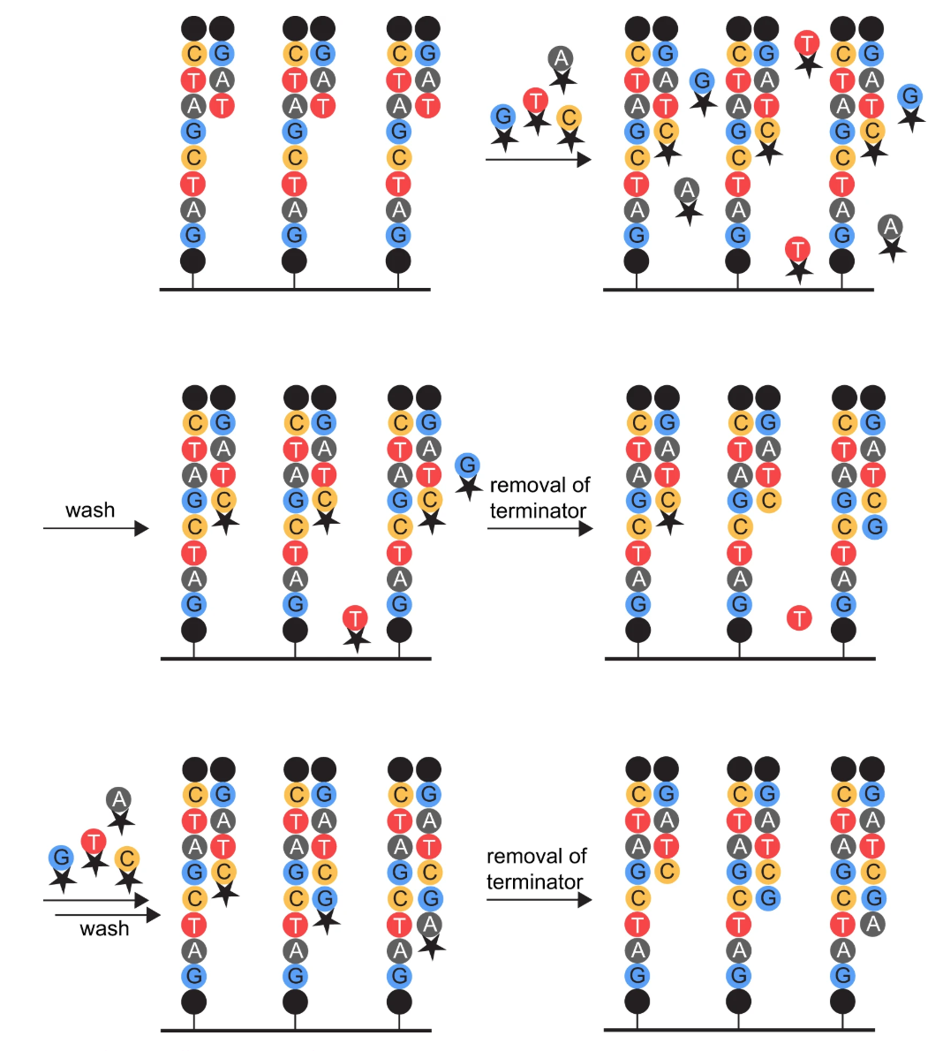
Sequencing errors
Errors can arise due to a number of causes, which differ according to technology and impact
Phasing Issues (Illumina)
Homopolymer Runs
(IonTorrent/454)
DNA damage from laser
PCR errors
Crosstalk between clusters
Sequence context related biases
  Illumina biases:
  towards mis-incorporation of G
  towards error in NGG motif
  Schirmer et al (2016) https://doi.org/10.1186/s12859-016-0976-y
Oxidative damage during library prep
  Guanine -> 8-oxoguanine
  Pairs with C or A: G->T transversions
  Costello et al (2013) https://doi.org/10.1093/nar/gks1443
PacBio/Nanopore: Errors more randomly distributed
Base quality score hopefully reflects these…
G
C
G
C
C
G
C
G
C
G
C
G
C
G
C
G
C
G
T
A
T
C
C
A
G
T
T
A
C
Pfeiffer et al (2018) https://doi.org/10.1038/s41598-018-29325-6
Notes:
Phasing errors: Note incomplete removal of dNTPs during wash, and incomplete removal of terminators, both of which lead to errors
DNA damage due to laser reduces viable copies leading to degradation in signal
Crosstalk between clusters can occur through overloading library on non-patterned flowcells – too many clusters too close together

Slide 15
The mapping problem
Determine location in genome from which read originates
Exact match between read and genome?
  Effect of sequencing error/genome variation
  Need to allow for small number of mismatches, insertions and deletions
Repeat regions – how to handle reads which map equally well to multiple locations?
Paired reads – are the mapped pair of reads
  An appropriate distance apart
  On the correct strands
  In the correct orientation
  …and if not is this due to mismapping, or structural variation?
RNA-Seq? Might the reads span splice sites?

Slide 16
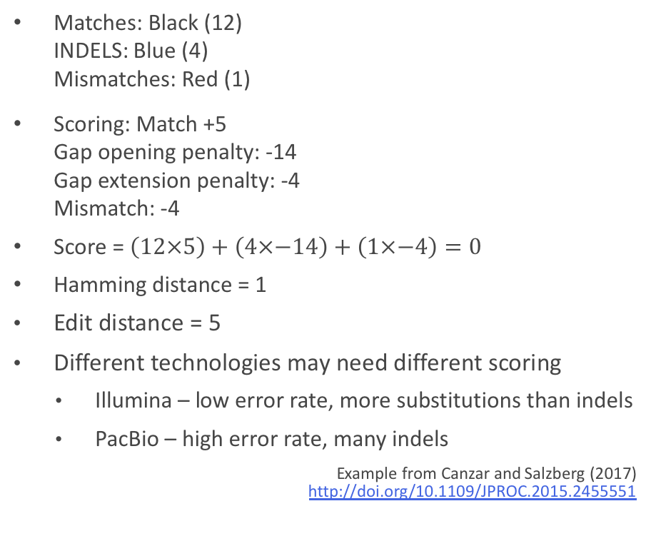
Approximate string matching
AACTAGA-AC-TACTGA
AA-TACAGACTTAC-GA
Want: all approximate matches between sequences where similarity score above threshold, or distance measure below a threshold
Similarity score: defined by optimal alignment which minimises number (or weight) of edits, or has maximum score
Distance threshold between two sequences
  Hamming distance: number of positions at which symbols are different (substitutions only)
  Levenshtein/edit distance: Number of single character deletions, insertions or substitutions required to transform one string into another
  Weighted edit distance: Different penalties for indels and substitutions
Matches: Black (12)
INDELS: Blue (4)
Mismatches: Red (1)
Scoring: Match +5
Gap opening penalty: -14
Gap extension penalty: -4
Mismatch: -4
Score = $\left(12×5\right)+\left(4×−14\right)+\left(1×−4\right)=0$
Hamming distance = 1
  Edit distance = 5
  Different technologies may need different scoring
    Illumina – low error rate, more substitutions than indels
    PacBio – high error rate, many indels
Example from Canzar and Salzberg (2017) http://doi.org/10.1109/JPROC.2015.2455551
Notes:
Scoring shown based on fasta nucleotide scoring model

Slide 17
Approximate string matching: scaling up
Need to handle billions of reads
Two approaches:
  Filtering:
    exclude large sections of reference where no approximate match
    i.e. find matches of perfect seed of length k match and ignore remainder of reference (k-tuple/word match)
  Indexing:
    Preprocess reference, or reads, or both
    Methods:
      Suffix array – linear time in relation to reference length
      FM-index/Burrows-Wheeler Transform - linear time in relation to reference length, economic memory usage
  Gruesome details: Reinert et al (2015) https://doi.org/10.1146/annurev-genom-090413-025358
  Canzar and Salzberg (2017) https://doi.org/10.1109/JPROC.2015.2455551

Slide 18
Choosing a read mapper
What is the best mapper?
There isn't one…
Many options with different capabilities
  Paired ends?
  Read length?
  Gapped alignment?
  Use quality scores?
  Splice aware?
Choice should be guided by your experiment
General recommendations:
  WGS/Exome alignment: BWA/bowtie2
  Long reads: minimap2
  Bisulphite sequencing: bismarck
  RNA-Seq analysis: STAR, HISAT2
  Structural variation analysis: mrFAST
Basic process similar for most mappers
  We'll use BWA today for genomic alignments

Slide 19
Preparing your reference sequence

Slide 20
Choosing a reference sequence
What to align your reads to…
  Genome? Transcriptome?...it depends…
  Think about your particular experiment
  Include full range of sequences likely to be in samples
    EBV?
    Host genome?
Your sample will almost never be identical to the reference sequence
  What is the closest related sequence?
  Is this the most useful? How complete is it?
Starting point is a fasta formatted representation of your reference
Beware of different genome versions
  Version and source should be reported in publications

Slide 21
Genome Reference Consortium
Maintenance of major reference genomes
Major releases
  Infrequent
  Affect co-ordinates
  Moving results between releases requires co-ordinate 'lift-over'
    See https://www.biostars.org/p/65558/
Patch releases
  More frequent
  Allow fixes to be applied without affecting co-ordinates
Naming convention: GRCx00.p0
Genome | GRC Name | Alternative | UCSC
Human | GRCh37 GRCh38 | b37 b38 | hg19 hg38
Mouse | GRCm38 NCBI37 |  | mm10 mm9
Zebrafish | GRCz11 |  | danRer11
Chicken | GRCg6a |  | galGal6
Major version number
Patch number
h=human m=mouse z=zebrafish g=chicken

Slide 22
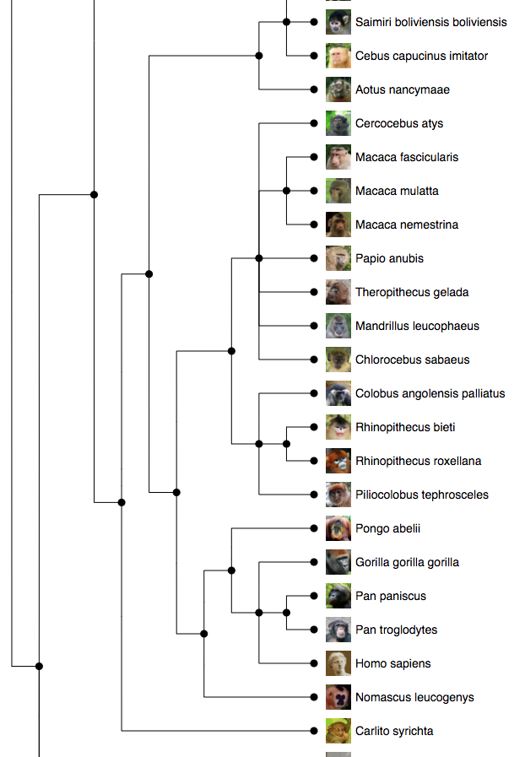
Where to find reference sequences
GRC: https://www.ncbi.nlm.nih.gov/grc
Ensembl: http://www.ensembl.org
  Wide range of annotated genomes
  Non-vertebrates: http://ensemblgenomes.org
  FTP downloads: http://www.ensembl.org/info/data/ftp/index.html
  Many options:
    'dna' – unmasked genomic DNA sequence
    'dna_rm' – Repeats and low complexity regions masked with 'N'
    'dna_sm' – Repeats and low complexity regions in lower case
    'toplevel' – chromosomes, unplaced scaffolds, alternate haplotypes
    'primary assembly' – as above without alternate haplotype
    i.e. Homo_sapiens.GRCh37.dna.toplevel.fa.gz
ENA: http://www.ebi.ac.uk/ena

Slide 23
Downloading our reference: S.pyogenes H293
Point your browser at https://bacteria.ensembl.org/Streptococcus_pyogenes/Info/Index/
Follow the ‘Download DNA sequence’ link
Mouse over the link to the ‘toplevel’ assembly, right-click and select ‘Copy Link Address’
Download using wget
    ningal:read_mapping $ mkdir reference
    ningal:read_mapping $ cd reference
    ningal:reference $ wget –O H293.fa.gz [paste url]
    ningal:reference $ gunzip H293.fa.gz
Click the ‘back’ button in your browser
Follow the ‘GFF3’ link
Right click on the bottom link (‘*Chromosome.gff3.gz’) and select ‘Copy Link Address’
ningal:reference $ wget –O H293.gff3.gz [paste url]
ningal:reference $ gunzip H293.gff3.gz

Slide 24
Creating a BWA index
BWA has multiple subcommands all available within the 'bwa' program
'bwa' will show basic help info
ningal: reference $ bwa index
Usage: bwa index [options] <in.fasta>
Options: -a STR BWT construction algorithm: bwtsw, is or rb2 [auto]
-p STR prefix of the index [same as fasta name]
-b INT block size for the bwtsw algorithm (effective with -a bwtsw) [10000000]
-6 index files named as <in.fasta>.64.* instead of <in.fasta>.*
Warning: `-a bwtsw' does not work for short genomes, while `-a is' and
`-a div' do not work not for long genomes.
ningal: reference $ bwa index –p H293 H293.fa
This is a small genome so indexing is very quick
See what has changed with 'ls'

Slide 25
Further indexes…
Some programs need indexes of the fasta file in different formats
These allow programs to jump to the correct place in a file
We'll create these now as well…
Two different formats: fai and dict
Can be created by samtools
  Run 'samtools' for a list of available commands
  Run 'samtools [commandName]' for help on a command
    ningal:reference $ samtools faidx H293.fasta
    ningal:reference $ samtools dict –o H293.dict H293.fasta
    Check directory contents with 'ls' after running each command
    Both .dict and .fai indexes are plain text, so can be viewed with 'less’
    ningal:reference $ cd -

Slide 26
BWA

Slide 27
BWA
Not recommended for sequences with error rate > 2%
Three different algorithms
  BWA Backtrack (aln)
    Illumina reads <100bp
    Two stage process – find coordinates of read, followed by generation of alignments (either SE or PE)
  BWA-SW
    Outputs alignments directly
    Suitable for reads from 70bp upwards
  BWA-MEM
    Reads from 70bp – 1Mbp
    Considerably faster than BWA-SW
    Normally method of choice…

Slide 28
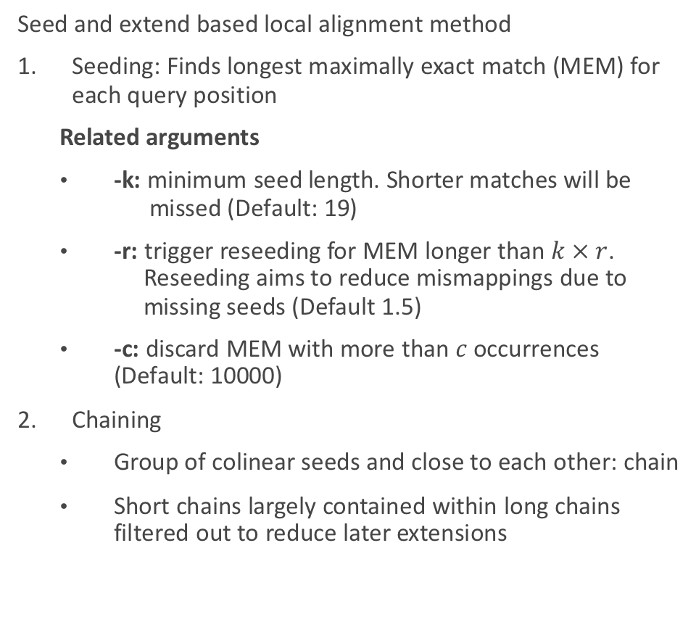
BWA-MEM: How it works…
Seed and extend based local alignment method
Seeding: Finds longest maximally exact match (MEM) for each query position
  Related arguments
  -k: minimum seed length. Shorter matches will be missed (Default: 19)
  -r: trigger reseeding for MEM longer than $k × r$.
  Reseeding aims to reduce mismappings due to missing seeds (Default 1.5)
  -c: discard MEM with more than $c$ occurrences (Default: 10000)
Chaining
  Group of colinear seeds and close to each other: chain
  Short chains largely contained within long chains filtered out to reduce later extensions

Slide 29
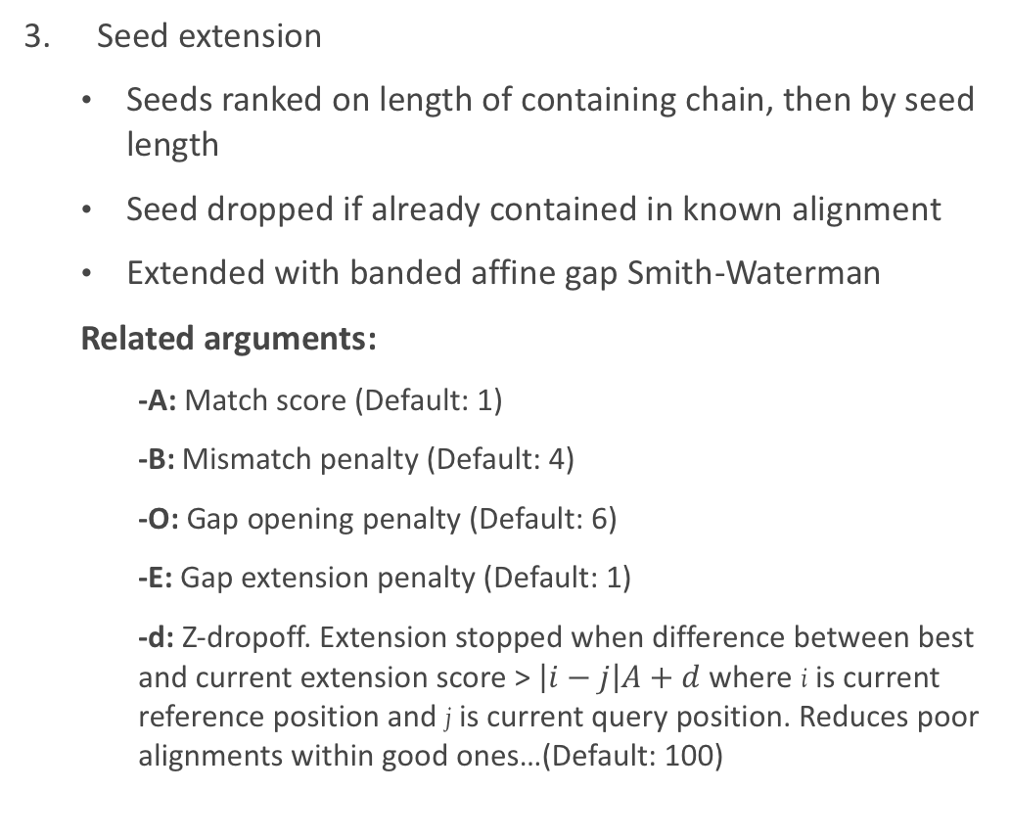
BWA-MEM: How it works
Seed extension
  Seeds ranked on length of containing chain, then by seed length
  Seed dropped if already contained in known alignment
  Extended with banded affine gap Smith-Waterman
  Related arguments:
    -A: Match score (Default: 1)
    -B: Mismatch penalty (Default: 4)
    -O: Gap opening penalty (Default: 6)
    -E: Gap extension penalty (Default: 1)
    -d: Z-dropoff. Extension stopped when difference between best and current extension score > $\left|i−j\right|A+d$ where i is current reference position and j is current query position. Reduces poor alignments within good ones…(Default: 100)

Slide 30
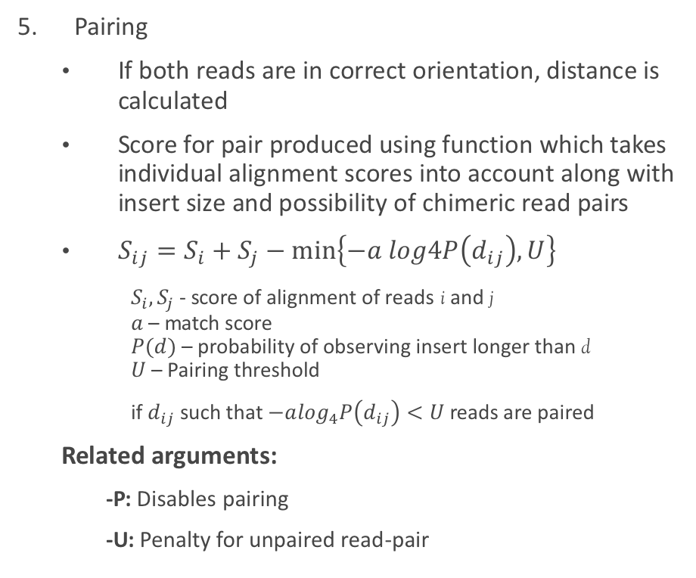
BWA MEM: How it works
Paired end rescue
  In the event that one read of pair maps and second doesn't, rescue of unpaired read attempted using Smith-Waterman alignment, forcing alignment of poorly aligned read
  Related arguments:
    -S: skip mate rescue
Pairing
  If both reads are in correct orientation, distance is calculated
  Score for pair produced using function which takes individual alignment scores into account along with insert size and possibility of chimeric read pairs
  $S_{ij}=S_{i}+S_{j}−min\left\{−a log4P\left(d_{ij}\right),U\right\}⁡$
  $S_{i},S_{j}$ - score of alignment of reads i and j
  $a$ – match score
  $P(d)$ – probability of observing insert longer than d
  $U$ – Pairing threshold
  if $d_{ij}$ such that $−a\log_{4}P\left(d_{ij}\right)<U$reads are paired
  Related arguments:
    -P: Disables pairing
    -U: Penalty for unpaired read-pair
Notes:
Log4 is result of interpreting SW score as odds ratio

Slide 31
BWA-MEM: Other arguments
-t: Number of threads (default: 1)
-p: Input is interleaved fastq
-T: Don't output alignments with score < T (default: 30)
-a: Output all found alignments for single-end/unpaired reads
-M: Mark shorter split hits as secondary alignments.
  Results from using local alignment so may produce multiple alignments for different regions of read.
  Required for compatibility with some tools (i.e. picard)

Slide 32
BWA-MEM: Putting it all together
bwa mem help output:
    bwa mem [-aCHMpP] [-t nThreads] [-k minSeedLen] [-d zDropoff]
    [-r seedSplitRatio] [-c maxOcc] [-A matchScore] [-B mmPenalty]
    [-O gapOpenPen] [-E gapExtPen] [-U unpairPen] db.prefix reads.fq [mates.fq]
So a simple command would look like:
    bwa mem –t 8 –M reference/H293 reads/xxx.fq.gz reads/yyy.fq.gz
  Changing some default parameters:
    bwa mem –t 8 –M –k 25 –O 8 –E 2 reference/H293 reads/xxx.fq.gz reads/yyy.fq.gz
  No output file name argument?
    Output written to STDOUT
    Need to redirect to a file

Slide 33
A BWA wrapper script…
N.B. Don't copy and paste! '-' characters get changed by powerpoint…
#!/bin/bash
#$ -cwd
#$ -V
#$ -pe smp 8
cp –v reference/H293.* $TMPDIR
cp –v reads/H395_* $TMPDIR
bwa mem –t 8 –M $TMPDIR/H293 $TMPDIR/H395_1.fq.gz $TMPDIR/H395_2.fq.gz > $TMPDIR/H395.sam
cp –v $TMPDIR/H395.sam .
Save your script as 'bwa.sh'
Submit it to the cluster: 'qsub bwa.sh'
Monitor your job with qstat
Did it work? Do you have an H395.sam file in your directory? What do the jobs STDOUT and STDERR logs show?

Slide 34
Alignment file formats

Slide 35
Formats
Three main formats used for storing alignments
SAM (Sequence Alignment Map)
  plain text
  uncompressed
BAM (Binary Alignment Map)
  binary equivalent of SAM
  Compressed
  Can be indexed to allow random access
CRAM
  Uses Reference-based compression
  45-50% space saving over BAM
  Not as well supported by tools

Slide 36
SAM Format
Official definition document: https://samtools.github.io/hts-specs/SAMv1.pdf
File contains two sections: header (optional) and alignments
Human readable(ish) text format
Header lines start with an '@'
H293.sam contains two header lines:
@SQ SN:Chromosome LN:1726248
@PG ID:bwa PN:bwa VN:0.7.17-r1188 CL:bwa mem -v 0 -t 8 -M H293 H395_1.fq.gz H395_2.fq.gz
SQ: Reference sequence dictionary
SN: Sequence name
LN: Sequence length
Two letter record type code
PG:Program
PN: Program name
CL: Command line
ID:Unique identifier
VN: Program Version

Slide 37
SAM Format: Other headers
@HD: The header line – must be first line in file
  @HD VN:1.0 SO:coordinate
@CO: One line text comment. Multiple @CO lines allowed
@RG: Read Group…more on these later
Many other tags may be found for lines described
See format specification for details
Tag | Description | Valid values
VN | Format version (required) | Number i.e. 1.0
SO | Sort order | unknown, unsorted, coordinate, queryname

Slide 38
SAM format: Alignment section
M00368:16:000000000-A0JCH:1:1:15079:1345 83 Chromosome 322231 60 151M = 322032 -350 CACAA C@CCA NM:i:0 MD:Z:151 MC:Z:151M AS:i:151 XS:i:0
Each line represents alignment of segment
11 (or more) tab-delimited fields
Beware 1-based vs 0-based coordinates…
Additional optional fields
Field | Type | Description
QNAME | String | Query template name
FLAG | Integer | bitwise flag – more later
RNAME | String | Reference sequence name
POS | Integer | 1-based leftmost mapping position
MAPQ | Integer | Mapping quality
CIGAR | String | CIGAR string – more later
RNEXT | String | Ref name of paired read
PNEXT | Integer | Position of paired read
TLEN | Integer | Template length
SEQ | String | Segment sequence
QUAL | String | Sequence quality (Phred)
Coordinate comparison figure by Obi Griffith, Biostars
Notes:
MAPQ: Phred scaled probability mapping position is wrong
Template length is number of bases from left most mapped base to right most mapped base

Slide 39
SAM Format: SAM Flags
A diversion in binary and bitwise operations…
A byte stores 8 bits in data allowing a value up to 255 to be stored
Why am I telling you this?
SAM flag field is combination of 12 bitwise flags…
Allows alignments to be filtered to isolate reads meeting particular criteria
128 | 64 | 32 | 16 | 8 | 4 | 2 | 1 | Decimal value
0 | 0 | 0 | 0 | 0 | 1 | 0 | 1 | 4+1=5
1 | 0 | 1 | 0 | 1 | 0 | 1 | 1 | 128+32+8+2+1=171
1 | 1 | 1 | 1 | 1 | 1 | 1 | 1 | 128+64+32+16+8+4+2+1=255

Slide 40
SAM Format: SAM flags
Bit | Description
1 | Read paired
2 | Read mapped in proper pair
4 | Read unmapped
8 | Mate unmapped
16 | Read on reverse strand
32 | Mate on reverse strand
64 | First in pair
128 | Second in pair
256 | Secondary alignment
512 | Does not pass filters i.e. QC
1024 | PCR/optical duplicate
2048 | Supplementary alignment
First read on our SAM file: Flag is 83
Only one way to make 83
64+16+2+1=83
Read is paired, mapped in a proper pair, on the reverse strand and is first in pair
Next read (pair): Flag is 163
128+32+2+1=163
Read is paired, mapped in a proper pair, is on the reverse strand and is second in pair
Fortunately: https://broadinstitute.github.io/picard/explain-flags.html

Slide 41
SAM Format: CIGAR string
CIGAR string defines how read compares with reference
Concise Idiosyncratic Gapped Alignment Report
Sequence of count and operators combined
    151M: 151 matches
  CACGATCA**GACCGATACGTCCGA
  CGATCAGAGA*CGATA
    Cigar string: 6M2I2M1D5M
  Limit of 65535 operations
Operator | Description | Consumes query | Consumes reference
M | Alignment match | Yes | Yes
I | Insertion to reference | Yes | No
D | Deletion from reference | No | Yes
N | Skipped region from reference | No | Yes
S | Soft clipping | Yes | No
H | Hard clipping | No | No
P | Padding | No | No
= | Sequence match | Yes | Yes
X | Sequence mismatch | Yes | Yes

Slide 42
SAM Format: CIGAR string
Clipped alignments
Local alignments may not be aligned for full length of sequence
Subsequences at end may be clipped off
GCTTAATGCGTGTGACAGTCGATGTACTGAC
gtaGCGTGTGACAGTCGATca
CIGAR string: 3S16M2S
Spliced alignments
cDNA to genomic alignments need to differentiate spanning introns from deletions
N: Skipped region from reference
GCTTAATGCGTGTGACAGTCGATGTACTGAC
AATG.........GTCGAT
CIGAR string: 4M9N6M

Slide 43
SAM Format: Additional tags
NM:i:0 MD:Z:151 MC:Z:151M AS:i:151 XS:i:0
Additional fields can be appended to each alignment line
Take the format of TAG:Type:Value
Tag is string of two letters
Standard tag definitions:
https://samtools.github.io/hts-specs/SAMtags.pdf
Type | Description
A | Character
B | Array
f | Real number
H | Hexadecimal array
i | Integer
Z | String
Tag | Description
NM | Edit distance
MD | String for mismatching positions
MC | CIGAR string for mate
AS | Alignment score
XS | Score of second best alignment (BWA specific tag)

Slide 44
SAM Format: Read groups
Read groups allow combination of reads from different sources within one file
Map individual reads to e.g. sample
Required by some tools
Entry in header for each read group
Additional RG tag on each alignment mapping to read group i.e. RG:Z:1
@RG ID:1 PL:ILLUMINA PU:1 BC:CGCTCAGTTC SM:H293
@RG ID:2 PL:ILLUMINA PU:1 BC:TATCTGACCT SM:H355
Tag | Description
ID | Unique identifier
PL | Platform
PU | Platform unit i.e. lane
BC | Barcode
SM | Sample

Slide 45
Adding read groups to a SAM file
Read groups can be added by some aligners at run-time
BWA: -R argument
    bwa –R "@RG\tID:1\tSM:H293\tPL:ILLUMINA\tPU:1" H293 H395_1.fq.gz H395_2.fq.gz
  Picard tools: set of utilities for manipulating NGS data
    (read_mapping) ningal:~ $ picard - List available tools
    (read_mapping) ningal:~ $ picard AddOrReplaceReadGroups – show usage info
    (read_mapping) ningal:~ $ picard AddOrReplaceReadGroups I=H395.sam O=H395_RG.sam \ RGID=1 RGLB=Lib1 RGPL=ILLUMINA RGSM=H395 RGPU=1
  Examine the H395_RG.sam file with 'less'

Slide 46
BAM Format
Binary equivalent of SAM
Much more compact – should always be used in preference to SAM
Not human readable
Samtools view can be used to convert SAM/BAM/CRAM files
ningal:read_mapping $ samtools view
ningal:read_mapping $ samtools view -b -o H395_RG.bam -@ 4 H395_RG.sam
ningal:read_mapping $ du –hs H395_RG.*
84M H395_RG.bam
294M H395_RG.sam
Samtools view outputs on STDOUT by default
Can be used to view BAM files as SAM
ningal:read_mapping $ samtools view –H H395_RG.bam – view headers only
ningal:read_mapping $ samtools view H395_RG.bam – view alignments
Output filename
Output bam format
Run 4 threads

Slide 47
BAM Format
Samtools can also read from STDIN
Can use with pipes to avoid writing SAM output from BWA to disk
Update your bwa.sh script:
#!/bin/bash
#$ -cwd
#$ -V
#$ -pe smp 8
cp -v reference/H293.* $TMPDIR
cp -v reads/H395_?.fq.gz $TMPDIR
bwa mem -t 8 -M $TMPDIR/H293 $TMPDIR/H395_1.fq.gz $TMPDIR/H395_2.fq.gz | samtools view -b -o $TMPDIR/H395.bam -
cp -v $TMPDIR/H395.bam .
Now rerun it and look for your H395.bam file appearing
Take a look at this with ‘samtools view’
‘-’ in place of input filename - read from STDIN

Slide 48
Post-processing

Slide 49
BAM files: sorting and indexing
BAM files generally need to be sorted by co-ordinate
Output of aligners will not generally be sorted
Coordinate sorted file sorted first by reference name followed by base position
    ningal:~ $ samtools sort
    ningal:~ $ samtools sort --threads 4 –o H395.sorted.bam H395.bam
  Check the headers of H395.bam and H395.sorted.bam
    ningal:~ $ samtools view –H H395.bam
    ningal:~ $ samtools view –H H395.sorted.bam
  Now look at the sorted alignments – pay attention to the POS column
    ningal:~ $ samtools view H395.sorted.bam|less

Slide 50
BAM Format: Indexing
Indexes allow software to randomly access data within a BAM file
Index is binary file with .bai filename suffix
A BAM index can be created with samtools index
    ningal:~ $ samtools index
    ningal:~ $ samtools index -@ 4 H395.sorted.bam
  Check the index is created (H395.sorted.bam.bai) with 'ls’
    ningal:~ $ rm H395.sorted.bam*
Update bwa.sh to sort and index our bam file as we create it…
    #!/bin/bash
    #$ -cwd
    #$ -V
    #$ -pe smp 8
    cp -v reference/H293.* $TMPDIR
    cp -v reads/H395_?.fq.gz $TMPDIR
    bwa mem -t 8 -M $TMPDIR/H293 $TMPDIR/H395_1.fq.gz $TMPDIR/H395_2.fq.gz \
    | samtools sort -O bam -o $TMPDIR/H395.sorted.bam -
    samtools index -@ 4 $TMPDIR/H395.sorted.bam
    cp -v $TMPDIR/H395.sorted.* .

Slide 51
Some basic statistics
(ngs_tools) ningal:read_mapping $ samtools flagstat H395.sorted.bam
678903 + 0 in total (QC-passed reads + QC-failed reads)
593 + 0 secondary
0 + 0 supplementary
0 + 0 duplicates
655750 + 0 mapped (96.59% : N/A)
678310 + 0 paired in sequencing
339155 + 0 read1
339155 + 0 read2
644638 + 0 properly paired (95.04% : N/A)
652476 + 0 with itself and mate mapped
2681 + 0 singletons (0.40% : N/A)
0 + 0 with mate mapped to a different chr
0 + 0 with mate mapped to a different chr (mapQ>=5)

Slide 52
BAM files: marking duplicates
Duplicate reads may occur due to
  Optical duplicates: One cluster being called as two
    Not a problem with patterned flowcells on newer instruments
  Clustering: Occupying two adjacent wells during cluster generation
    Only a problem on newer instruments with patterned flowcells
  PCR duplication: from amplification in sample prep.
    Commonly a problem if insufficient complexity present in library
    Not a problem with PCR-free library preps
Duplicate reads can bias some analysis i.e. SNV identification
Don't provide any additional information
Can be either marked as duplicates (via the SAM flag 1024), or removed
ningal:read_mapping $ picard MarkDuplicatesWithMateCigar I=H395.sorted.bam \ O=H395.sorted.nodup.bam M=H395.duplicate_metrics.txt
Take a look at H395.duplicate_metrics.txt
use 'samtools flagstat' to compare the H395.sorted.nodup.bam stats with H395.sorted.bam

Slide 53
BAM files: filtering
BAM files can be filtered to separate reads meeting particular criteria
Interested in the set of reads in your data which didn’t align?
Flags: Read unmapped = 4, Mate unmapped = 8
  Therefore to extract read pairs where neither read is mapped: 8+4=12
Samtools view can filter with the following arguments:
    -f INT only include reads with all of the FLAGs in INT present [0]
    -F INT only include reads with none of the FLAGS in INT present [0]
    -G INT only EXCLUDE reads with all of the FLAGs in INT present [0]
  We want to only include reads with our flag present…
    ningal:read_mapping $ samtools view –f 12 –h –b –o H395.unmapped.bam H395.sorted.bam
  Check the contents of the new bam file with ‘samtools flagstat’
  We can convert these reads back to fastq format with picard
    ningal:read_mapping $ picard SamToFastq I=H395.unmapped.bam \
    F=H395.unmapped_1.fq F2=H395.unmapped_2.fq

Slide 54
BAM files: filtering
Want to separate alignments into chunks to allow parallel analysis?
    Usage: samtools view [options] <in.bam>|<in.sam>|<in.cram> [region ...]
Region defined as
  REF – select all alignments to specified reference
  REF:start-end – select all alignments spanning coordinates on specified reference
  Select the reads from our alignment from between coordinates 1000-2000:
  ningal:read_mapping $ samtools view H395.sorted.bam ‘Chromosome:1000-2000’
  See ‘samtools view’ for list of other filtering options

Slide 55
Other statistics of interest…
Picard can report stats on the library insert size distribution:
ningal:read_mapping $ picard CollectInsertSizeMetrics
ningal:read_mapping $ picard CollectInsertSizeMetrics H=H395.pdf I=H395.sorted.bam O=H395.txt
  Find H395.pdf via your network mount and view…
  H395.txt includes stats such as median insert size, median absolute deviation
WGS metrics (coverage)
ningal:read_mapping $ picard CollectRawWgsMetrics R=reference/H293.fa \
I=H395.sorted.bam O=H395.wgs_stats.txt

Slide 56
Viewing alignments in a genome browser

Slide 57
Genome browsers
Various browsers freely available
Differ in capabilities
Popular choices
  IGV (https://software.broadinstitute.org/software/igv/)
  IGB (http://bioviz.org)
  Tablet (https://ics.hutton.ac.uk/tablet/)
Available through Apps Anywhere
Search for tablet and start it up….
Typically require:
  Reference sequence: fasta format and faidx indexed
  Reference annotations: gff3 format
  Bam format alignments

Slide 58

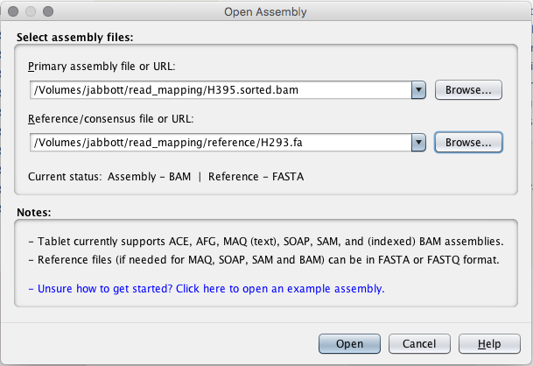
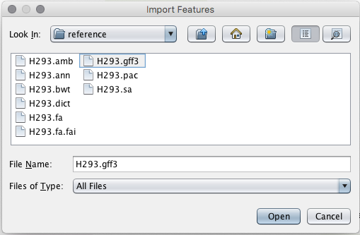

Tablet – loading your data
Indexed, sorted bam file
faidx indexed fasta reference

Slide 59
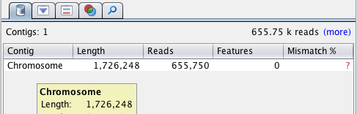
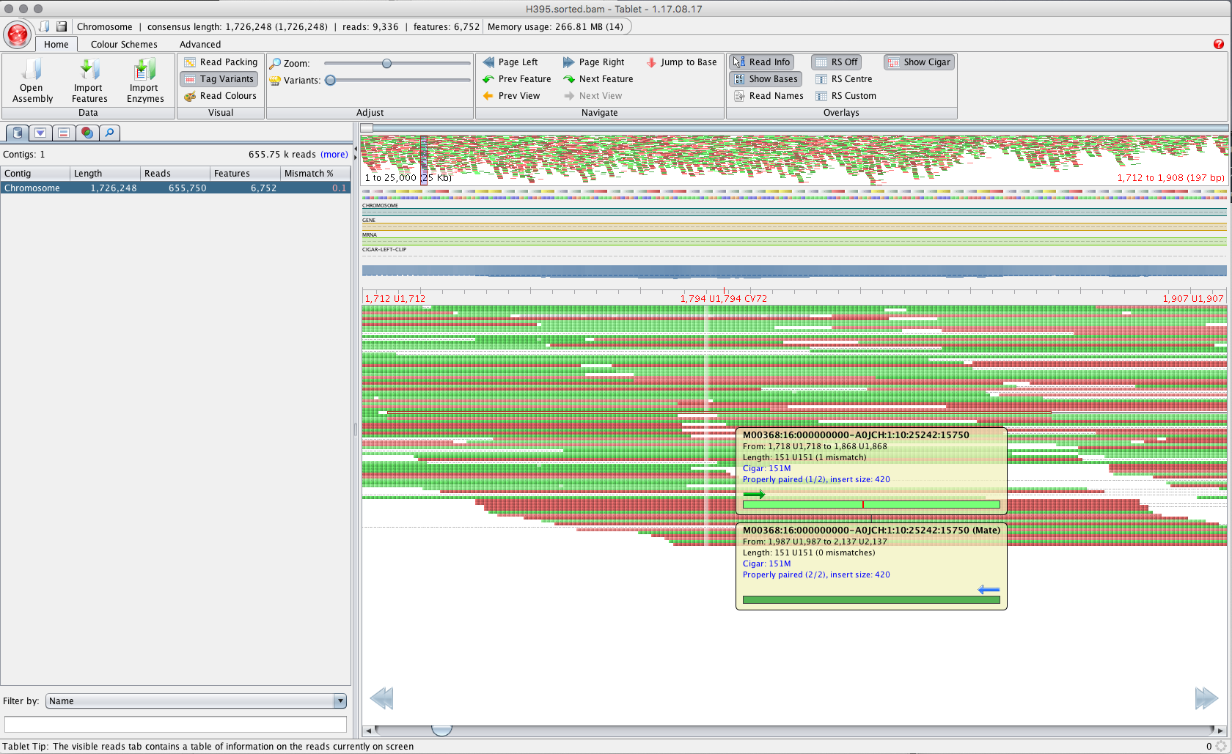
Tablet - browsing

Slide 60
Multimapping Reads

Slide 61
Sequence repeats
Interspersed repeats constitute
  ~50% of human genome
  Up to ~80% of graminae genomes
How can an aligner determine which copy of an identical repeat a read originates from?
  It can’t…
Provide measure of confidence of mapping being correct – MAPQ
  Phred-scaled likelihood
  Distinct from alignment score

Slide 62
Multimapping reads
Behavior of aligners differs when handling multimapping reads
For BWA:
  One mapping better scoring than others?
    MAPQ reduced accordingly
  Identically scoring mappings?
    MAPQ set to 0
    Additional tags added to alignment line
    Which mapping reported? Chosen at random…
HWI-ST1398:100:C43B8ACXX:7:2207:16475:95789 163 1 152276198 0 100M = 152276256 158 ACTCA ?@=A? X0:i:2 X1:i:0 XA:Z:1,+152280086,100M,0; MD:Z:100 XG:i:0 AM:i:0 NM:i:0 SM:i:0 XM:i:0 XO:i:0 MQ:i:0 XT:A:R
X0: number of best hits
XA: Alternative hits
REF,POS,CIGAR,NM;

Slide 63
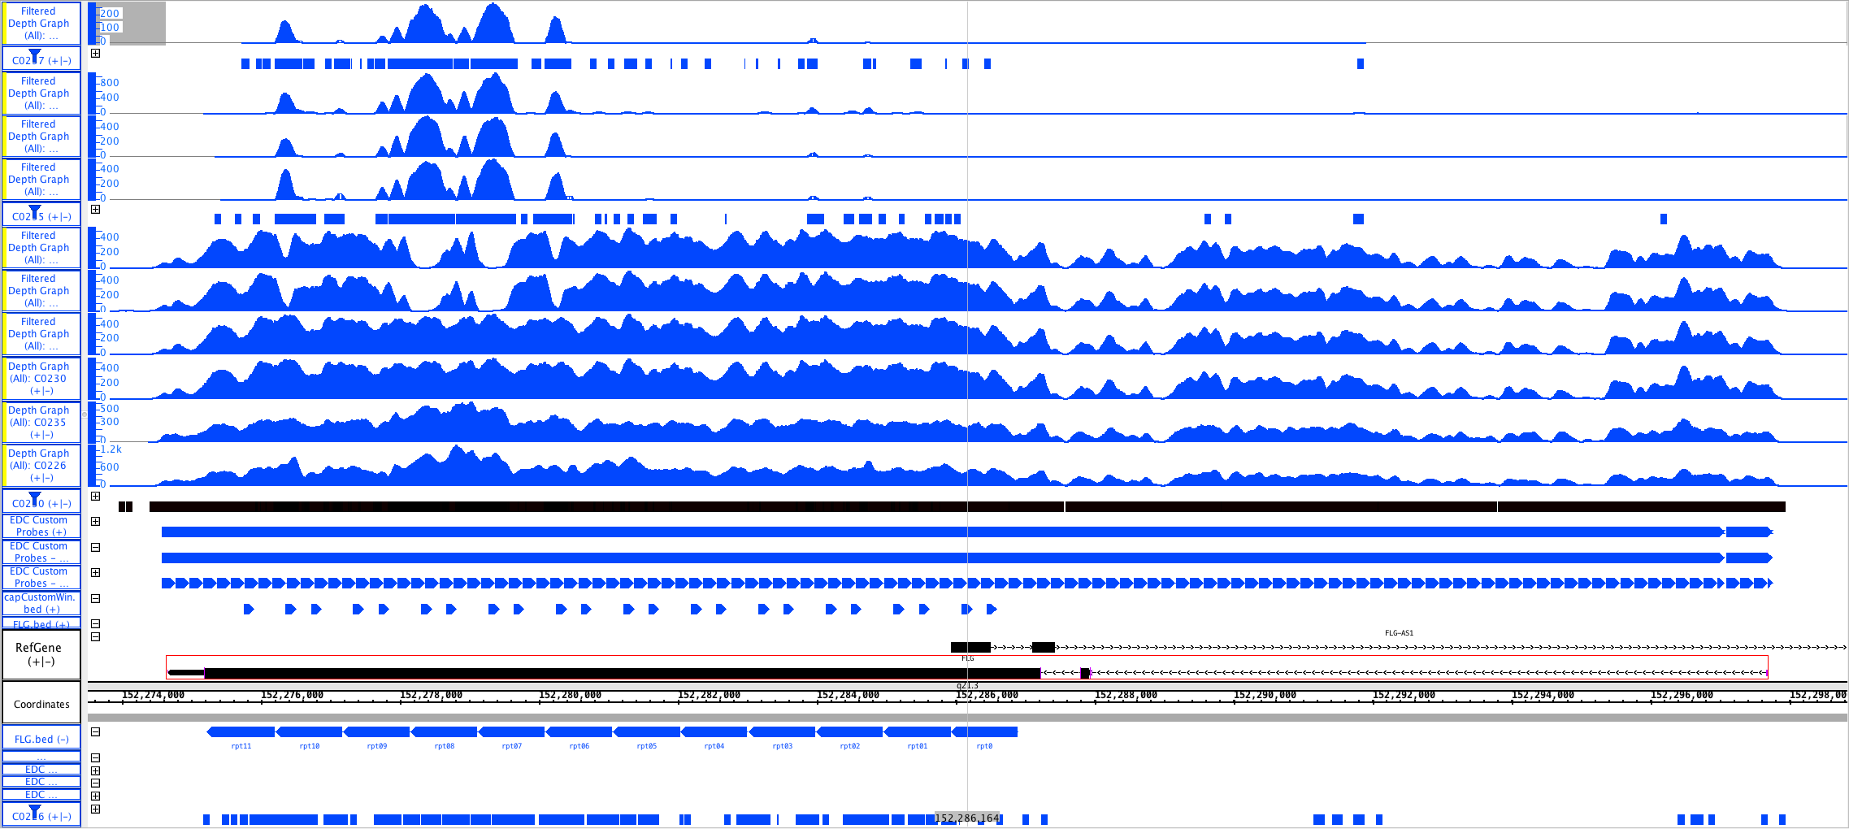
Multimapping reads: A real world example…

Slide 64
Multimapping reads: Other Aligners
Bowtie2
  Default: Search for multiple alignments, report best
    Random selection of reported alignment
  -k: Search for one to k alignments, report each
    Additional alignments flagged as secondary
    Alignments not found in particular order – not necessarily finding ‘best’ alignment before stopping
  -a: Search for and report all alignments
    Reported in descending order by alignment score
    Slow…
mrFAST:
  Designed to find all mappings as primary aim
  Works with TARDIS SV detection package

Slide 65
Mapping PacBio/Nanopore Reads
BWA MEM can handle align sequences up to 1Mb
  But doesn’t handle the high error rate…
Minimap2 specifically designed with long reads in mind
Can carry out indexing with same command as running mapping
Preset combinations of arguments optimized for different technologies:
  -x map-pb: Pacbio
  -x map-ont: Oxford Nanopore
Default output format: PAF
  -a: output SAM
  (read_mapping) fc-019:read_mapping $ minimap2 -ax map-ont -t4 reference/H293.fa \ minion/SRR6917534_1.fastq.gz | samtools sort -O bam -o minion.bam -
Take a look at minion.bam with ‘samtools view’

Slide 66
There’s a workflow for that…

Slide 67
DAG Workflows: map-bwa-mem-pe
Workflow for alignment of paired-end Illumina style reads
  Creation of BWA/fasta indices
  Per-sample:
    alignment with BWA-MEM
    Duplicates marked with Picard MarkDuplicates/MarkDuplicatesWithMateCigar
    Gather alignment metrics (Picard):
      AlignmentSummaryMetrics
      BaseDistributionByCycle
      GcBiasMetrics
      InsertSizeMetrics
      OxoGMetrics
      WgsMetrics
  Create MultiQC report
  Create summary HTML report

Slide 68
DAG Workflows: setup
You probably already have this setup from a previous module, but if not…
Add DAG conda channel to configuration
    ningal:~ $ conda config --add channels \ https://dag.compbio.dundee.ac.uk/conda
  Check channel added correctly
    ningal:~ $ conda info
  If you have a previous installation…
    ningal:~ $ conda env remove –n dag-wf
  Create and activate a new environment
    ningal:~ $ conda create –n dag-wf
    ningal:~ $ conda activate dag-wf
  Install the DAG workflow package
    ningal:~ $ conda install dag-wf

Slide 69
DAG map-bwa-mem-pe workflow setup
Directory to create for running workflow
Job name
Setting up a workflow – dag-wf-setup:
(dag-wf) ningal:Read_Mapping $ dag-wf-setup -i reads -d dag-wf-mapping -n Strep_mapping \
-w map-bwa-mem-pe -r reference/H293.fa
Creating dag-wf-map-bwa-mem-pe conda environment
<snip>
Populating dag-wf-mapping/fastq directory with data files...
/homes/jabbott/read_mapping/reads/H395_1.fq.gz -> dag-wf-mapping/fastq/H395_1.fq.gz
/homes/jabbott/read_mapping/reads/H395_2.fq.gz -> dag-wf-mapping/fastq/H395_2.fq.gz
/homes/jabbott/read_mapping/reads/H411_1.fq.gz -> dag-wf-mapping/fastq/H411_1.fq.gz
/homes/jabbott/read_mapping/reads/H411_2.fq.gz -> dag-wf-mapping/fastq/H411_2.fq.gz
reference/H293.fa -> dag-wf-mapping/reference/H293.fa
Please inspect the Snakefile in the 'dag-wf-mapping' directory and modify as required.
The workflow can be run by running 'cd dag-wf-mapping; dag-wf-run'
Directory containing fastq reads
Workflow required
Reference sequence fasta file

Slide 70
DAG map-bwa-mem-pe workflow: running
(dag-wf) ningal:read_mapping $ cd dag-wf-mapping
(dag-wf) ningal:dag-wf-mapping $ dag-wf-run
Typically takes ~7 mins to run
An HTML report file should be created in dag-wf-mapping
Browse to this via your network mount and double-click to open in a web browser

