Slide 1


Introduction to Linux
Data Analysis Group
24th January 2019

Slide 2



The Data Analysis Group
James Abbott
Bioinformatics/Data Analysis Group Manager
Background: Genomes, variants, interface and workflow development
Provide advice and assistance on
  Experimental design
  Programming
  Statistics
  Bioinformatics
  Data analysis
Collaborate on projects
  Funded through joint grant application
  'Pay-as-you-go' hourly rates
http://dag.compbio.dundee.ac.uk
Marek Gierlinski
Bioinformatician
Background: Statistics, RNA-Seq, CHiP-Seq, Lapsed astrophysicist§
William Nicholson
PRDA – Bioinformatics (co-supervised with Prof. Sara Brown)
Background: Genomic data analysis, image processing and many things in between

Slide 3
What is Unix
Multi-user operating system
  Acts as interface between user and hardware
  Provides secure access to resources
Original release 1969, AT & T labs
Linux: Free Unix implementation by Linux Torvalds, 1991
MacOS: Based upon BSD Unix implementation
A complex history...

Slide 4
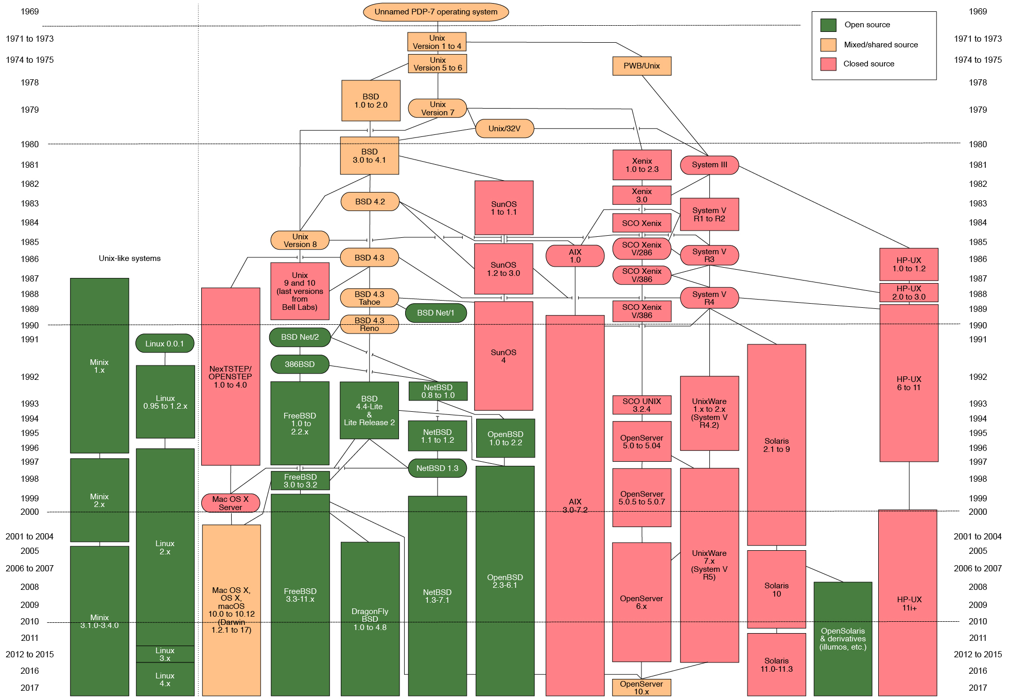
Unix History (simplified... )
By Eraserhead1, Infinity0, Sav_vas - Levenez Unix History Diagram, Information on the history of IBM's AIX on ibm.com, CC BY-SA 3.0, https://commons.wikimedia.org/w/index.php?curid=1801948
Notes:
Many things missing from figure…IRIX, OSF

Slide 5
Linux
  Linux can be found running on
  Servers
  HPC systems
  Desktops
  Laptops
  Mobile Devices
Today we will be connecting to a linux server over the network

Slide 6
Logging in

Slide 7



Requirements
Account credentials
An SSH client
    PuTTY
    Terminal and OpenSSH
An X11 server (optional, for GUI tools)
    Xming
    Xquartz
    XFree86

Slide 8
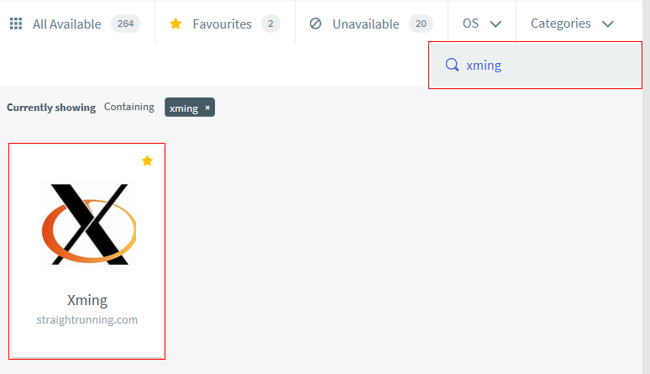
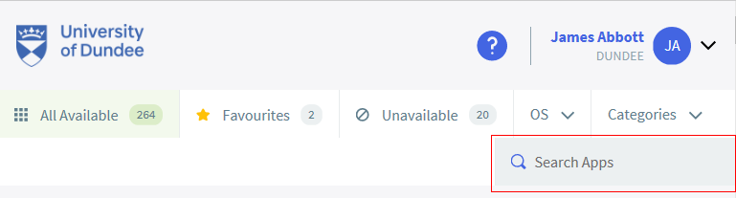

Finding Software on Training Machines
Software made available through ‘Apps Anywhere’
Login with UoD credentials
Type name of software in ‘Search Apps’ field
Mouse-over package and click ‘Launch’

Slide 9
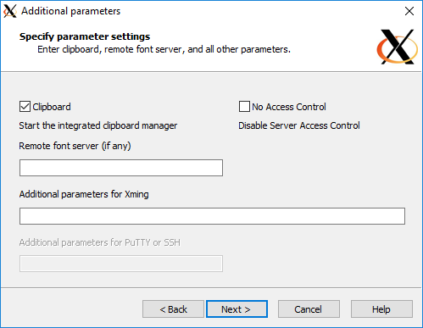
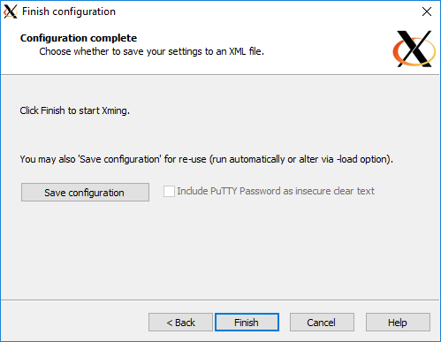
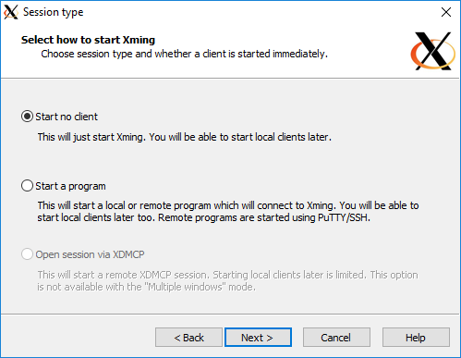
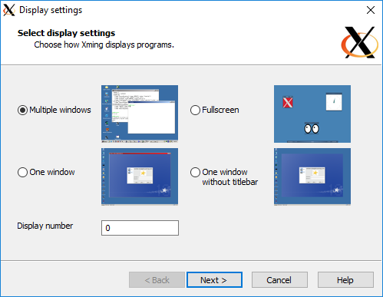
WINDOWS - starting Xming
Start Xming
Step through series of preferences dialogs
Nothing obviously running but…

Slide 10
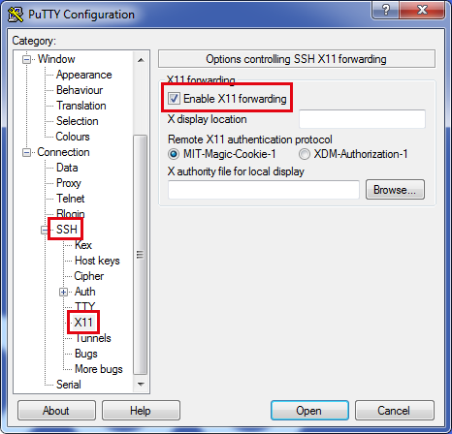
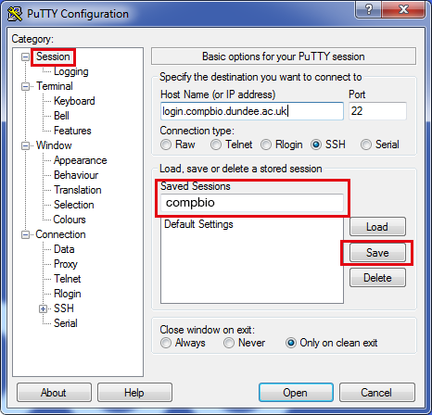
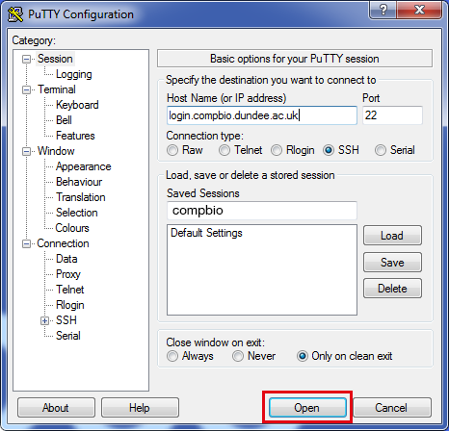
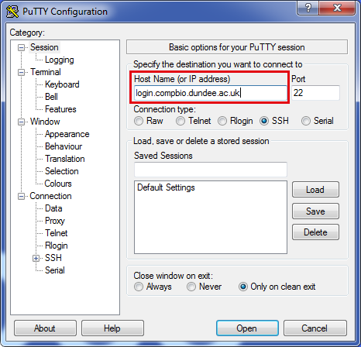
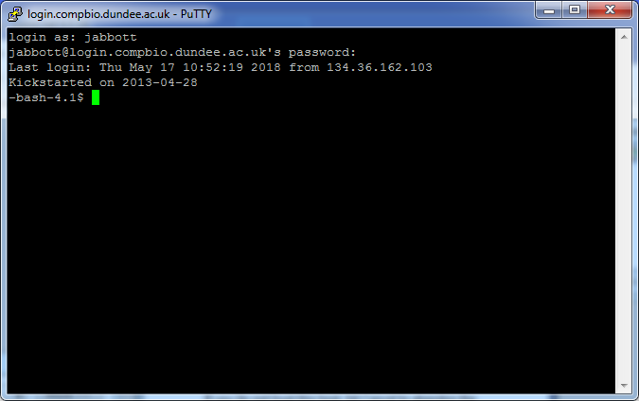
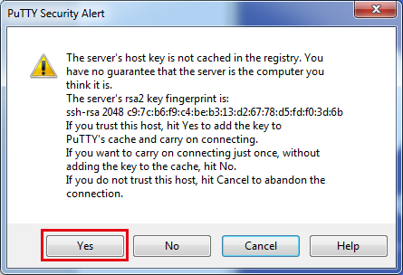
WINDOWS - PuTTY
Start PuTTY:
Enter ‘login.compbio.dundee.ac.uk’ in ‘Host Name’ field
Open ‘SSH’ menu, select ‘X11’ and check ‘Enable X11 Forwarding’
Select ‘Session’ (at top)
  Normally: Type ‘compbio’ in ‘Saved Sessions’ field and click ’Save’ button
  Don’t do this now – it won’t work on training machines
  Click ‘Open’ button
Acknowledge security alert
Enter username followed by ‘Enter’
Enter password followed by ‘Enter’

Slide 11
MACOS/Linux
Start XQuartz:
Finder -> Applications -> Utilities -> Xquartz
Open a terminal session
  Finder -> Applications -> Utilities -> Terminal
  Terminal/Konsole icon in utilities group
In terminal window, type:
    ssh -X -l username login.compbio.dundee.ac.uk
    Or ssh -X username@login.compbio.dundee.ac.uk
Your username!

Slide 12
First time login…
LS27911:~ jabbott$ ssh -X -l jabbott login.compbio.dundee.ac.uk
The authenticity of host 'login.compbio.dundee.ac.uk (::1)' can't be established.
ECDSA key fingerprint is SHA256:nJ2BGgjZcKLewMnQPEgoih4K+mTcCX+mLyGfbwDFCNg.
Are you sure you want to continue connecting (yes/no)? yes
Warning: Permanently added 'login.compbio.dundee.ac.uk' (ECDSA) to the list of known hosts.
Password:
-bash-4.1$

Slide 13
What am I looking at?
-bash-4.1$
This is the command prompt
Anything you type appears after the '$' character
Displays the shell name and version
Prompts can be customised
Common format:
LS27911:~ jabbott$

Slide 14
Entering Commands

Slide 15

Running a Simple Command
Linux programs are run by typing commands
The command is the name of a program available on the computer
Try these as we go along…commands to type highlighted in blue
Linux is case-sensitive...'date' is not the same as 'Date'
After typing the command, press to run it...
    -bash-4.1 $ date
    Tue 27 Feb 2018 13:34:40 GMT
  ls command lists contents of current working directory.

Slide 16
Some example files…
Type the following, pressing ‘enter’ after each line:
-bash-4.1$ cp –R /tmp/Intro_to_linux .
-bash-4.1$ cd Intro_to_linux
-bash-4.1$ pwd
You should see something like:
/homes/jabbott/Intro_to_linux
-bash-4.1$ ls
list1.txt list2.txt list3.txt

Slide 17
Command Arguments
An argument to a command provides data for the command to use
Commonly a filename
Arguments follow the command name
    -bash-4.1$ wc names.txt
    4945 4950 35148 names.txt
Notes:
wc produces a word count for the specified file(s). It reports no of lines, words and bytes.

Slide 18
Command Options
Options modify the behaviour of a command
Single character options: '-’
  -bash-4.1 $ date -R
  Tue, 27 Feb 2018 13:40:22 +0000
An option may require an argument
    -bash-4.1$ date -r names.txt
    Fri 23 Feb 2018 15:22:17 GMT
Multi-character options: '--’
    -bash-4.1$ Rscript –-version
    R scripting front-end version 3.3.3 (2017-03-06)
Notes:
date –R uses RFC2822 date/time format
date –r filename prints last modification time of file

Slide 19
Combining Options and Arguments
Options (and their arguments) should precede command arguments
    -bash-4.1 $ wc -l names.txt
Some commands accept multiple arguments
    -bash-4.1 $ wc -l names.txt places.txt
Multiple single-character arguments can be combined
    -bash-4.1 $ wc -w -l names.txt places.txt
    -bash-4.1 $ wc -wl names.txt places.txt
Notes:
wc –l reports number of lines
wc –w reports number of words

Slide 20
Wildcards
Wildcards are special characters which will match range of characters in commands
Can be use to fine-tune arguments
*: Match zero or more of any character
    ls *.txt
    wc *.txt
  ?: Match any single character
    ls l?st.txt
  []: Match specified range of characters
  ls l[io]st.txt
  {}: Match multiple ',' separated terms
  ls {*.txt,*.py}
  [!]: Match any character not specified
    ls list[!12].txt
Notes:
ls lists files in the current directory. Try it first without any arguments….

Slide 21
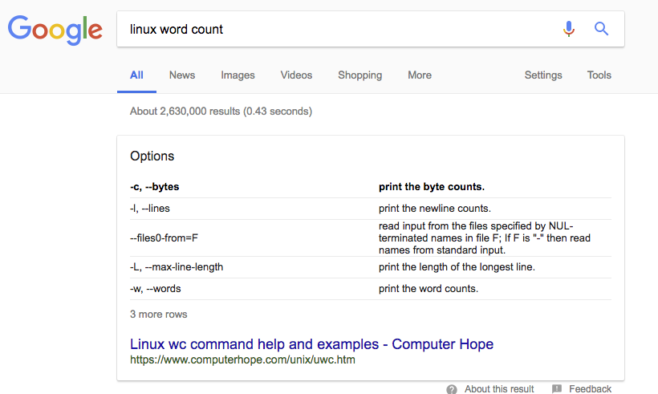
Getting Help
Most commands offer some brief help explaining their usage:
  -h, --help
  wc --help
More extensive documentation available in a man page
  man wc
Some more complex programs provide even more extensive documentation in ‘Texinfo’ format
  info coreutils 'wc invocation'
  How to access this will be described in a ‘SEE ALSO’ section of the man page
If you don’t know the command you need:
  apropos word count
Man pages etc tend to be very formal, dry and not always easy to find what you want
Notes:
Use space to view next page in texinfo, and 'q' to quit

Slide 22
Files and Directories

Slide 23
Files
Data is stored on disk in files.
  Text files: data in plain text which can be viewed directly
  Binary files: binary data in application specific format requiring software to access
The 'file' command can tell you what type of data a file contains...
    -bash-4.1 $ file names.txt
    names.txt: ASCII text
    -bash-4.1 $ file lists.tar
    lists.tar: POSIX tar archive (GNU)
  A text file can be viewed on the terminal
    cat list.txt
  Don’t try to view a binary file…

Slide 24
File Naming
File names can contain pretty much any character
BUT...
  Some characters may have special meaning
  These need to be escaped (prefixed with '\'), or the name surrounded in quotes
Safest to stick to A-Za-z0-9._-
File names starting with '.' are hidden files
File names may include a suffix i.e. '.txt’
Suffix is for the user's benefit - no meaning to the system

Slide 25
Directories
Act as containers to group related files together
Can contain many files, or directories
Directory naming follows same conventions as file naming
Directories are in fact special files…
Many commands which work on files also work on directories
Too many files in one directory problematic...
  Think about a sensible way of arranging your files

Slide 26
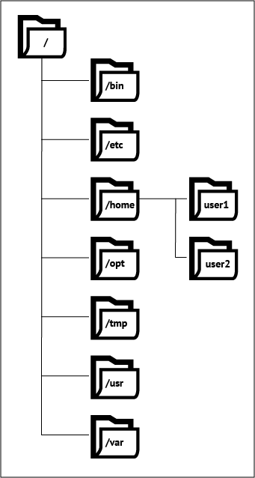
The Linux Filesystem Layout
Filesystem has tree structure
Contained within root (/) directory
Directories within a directory are known as subdirectories
Root directory contains many subdirectories
    Most are part of the OS itself
Certain directories will be available for data storage
  /cluster mountpoint on UoD cluster

Slide 27
Paths
A file or directory can be addressed by it's path
A path lists sequence of directories to traverse to find file
Directories on path separated by '/'
    /tmp/mytempfile.txt
  A path can be absolute or relative
  Path can also refer to:
    Current working directory (‘.’)
    Parent of current working directory (‘..’)
Absolute Path | Relative Path
How to find file from filesystem root | How to find file from cwd
Starts with '/' | Does not start with '/'
Always same for given file | Changes according to cwd

Slide 28
Your Home Directory
Every user has a private directory known as 'home' directory
Normally found in '/homes/your_username'
This is your current working directory on logging in
Home directory can be referred to in paths by ‘~’
Don't store large amounts of data here – these should go in /cluster/groupname

Slide 29
Navigating the Filesystem
Command | Action | Example Command
pwd | Print Working Directory | pwd
ls | List directory contents | ls
cd/chdir | Change Directory | cd Intro_to_linux
mkdir | Make Directory | mkdir mydirectory
rmdir | Remove Directory | rmdir mydirectory

Slide 30
ls - Many Options to Tailor Output
Command | Result
ls | List contents of cwd
ls path | List contents of specified directory
ls -a | Include hidden entries starting with '.'
ls -l | Long format listing
ls -S | Sort files by size
ls -t | Sort files by modtime
ls -r | Reverse sort order
ls -lart | Combining multiple options...

Slide 31
Disk usage reporting
Need to be aware of disk usage
May be restrictions due to:
  Available space on filesystem
  Disk quotas
How full is the filesytem? | df -h path
How much space does my directory use? | du -hs path
How much of my quota have I used? (Most linux systems) | quota
How much of my quota have I used? (Cluster filesystem) | lsquota -j groupname --block-size=G cluster
Notes:
N.B. quotas on the cluster use mmlsquota command rather than standard ‘quota’

Slide 32
Users and Permissions

Slide 33
Users and Groups
All users have a user id and group id
Your username identifies you to the system
You will also be a member of one or more groups
Groups allow management of a collection of users
Useful commands:
id | Display user and group details
groups | Display list of groups for user

Slide 34
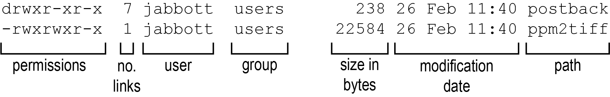
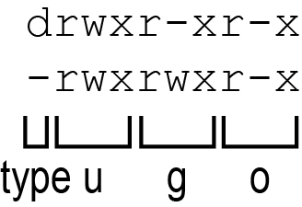
File and Directory Permissions
File permissions allow granular access control
Standard permissions: Read, Write eXecute
Permissions can be applied for a user (u), group (g) or other (o) users
Permissions can be seen with ls -l
type: - = file, d = directory, l = symlink
u: user (owner) permissions: rwx
g: group permissions: rwx
o: other permissions: rwx

Slide 35
What Permissions Allow
Permission | Effect on File | Effect on Directory
read | allow file contents to be read | Directory contents can be shown
write | Allows file modification | Allows modification of contents. Requires execute permissions
execute | allows file to be executed | Allows directory to be accessed with cd

Slide 36
Changing Permissions
Change mode: chmod command
Permissions can be added (+) or removed (-)
Add read permissions for group:
chmod g+r /path/to/file
Remove write permissions from others:
chmod o-x path /path/to/file
Allow read, write and execute permissions for user:
chmod u+rwx /path/to/file
Try these with some files in your directory, and see how the the permissions are changed with 'ls -l'

Slide 37
Working with files

Slide 38
Basic File Operations
Command | Action | Example
cp filepath newpath | Copy file to newpath | cp names.txt names2.txt
mv filepath newpath | Move file to newpath | mv names2.txt names3.txt
rm filepath | Remove file | rm names3.txt
cat filepath | Concatenate and print file | cat names.txt
tac filepath | Concatenate and print file in reverse | tac names.txt
head filepath | Display first 20 lines of file | head –n 20 names.txt
tail filepath | Display last 20 lines of file | tail –n 20 names.txt

Slide 39
Viewing Text Files
cat shows file contents on display
If contents longer than screen, will scroll off top
less command shows one screen of text at a time
Interactive commands within less:
  space: show next page
  j/↑: scroll up one line
  k/↓: scroll down one line
  /searchterm: search forward for searchterm
  q: quit
Remember: Don’t try to view a binary file with cat/less

Slide 40
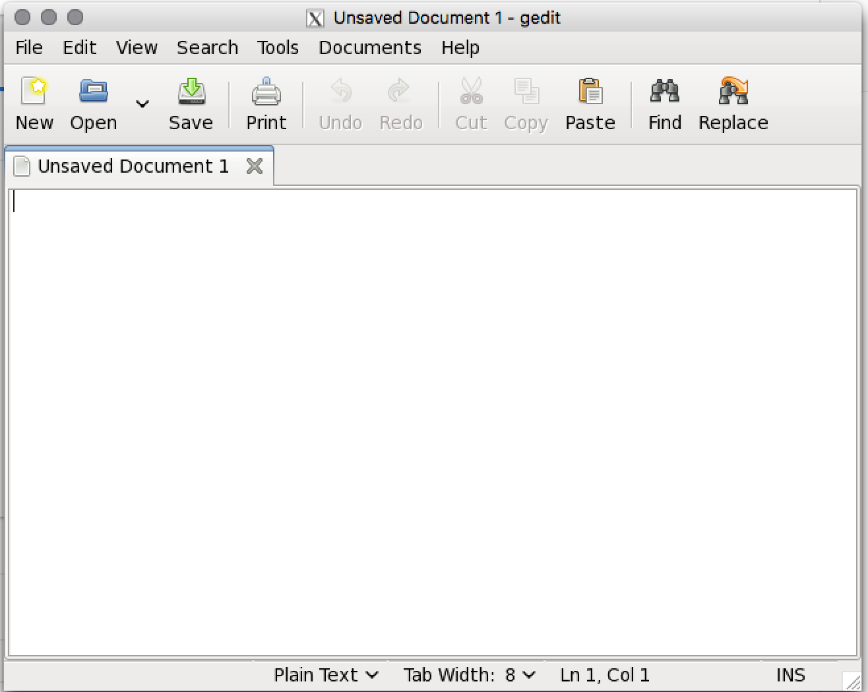
Editing Text Files
Many editors available...
Some don't need X11
Vi/emacs extremely powerful
But…
Gedit easier to get to grips with…
gedit | Open new empty file
gedit list.txt | Open existing file
ctrl-o | open file
ctrl-n | new file
ctrl-s | save file
ctrl-q | quit

Slide 41
Compressing and Uncompressing Files
Files can be compressed to
  save disk space
  improve network transfer times
Most common: gzip, More efficient but slower: bzip2
Type | Suffix | Compressing | Uncompressing
compress | .Z | compress filename | uncompress filename.Z
gzip | .gz | gzip filename | gunzip filename.gz
bzip | .bz2 | bzip2 filename | bunzip2 filename.bz2

Slide 42
Tar Archives
-c | create archive
-t | list archive contents
-f | filename
-x | extract archive contents
-v | verbose output
-z | gzip compression
-j | bzip2 compression
tar allows combining of many files and directories into single file
Optionally may be compressed with compress, gzip or bzip2
-f takes filename as argument
 | No compression | gzip compression | bzip2 compression
Create archive | tar -cvf archive.tar path | tar -cvzf archive.tar.gz path | tar -cvjf archive.tar.bz2 path
List archive contents | tar -tvf archive.tar | tar -ztvf archive.tar.gz | tar -jtvf archive.tar.bz2
Extract archive contents | tar -xvf archive.tar | tar -zxvf archive.tar | tar -jvf archive.tar

Slide 43
Managing Command Outputs

Slide 44
In, Out and Error Streams
Every linux process opens three streams
Associated with terminal by default
    Standard input (0): input typed in terminal presented to process as input
    Standard output (1): Output from process printed to terminal
    Standard error (2): Errors encountered may also be printed to terminal
  A well behaved Unix program is quiet…
These streams can be associated with other files if required: redirection

Slide 45
Redirection
Under bash shell:
These operators can also be combined
    myprogram < data > out.txt 2> err.txt
  ./redirection.py – reads STDIN and writes to STDOUT
  ./redirection.py < list1.txt > out.txt 2> err.txt
Operator | Effect | Example
> | Write STDOUT to new out.txt file | myprogram > out.txt
>> | Append STDOUT to out.txt file | myprogram >> out.txt
2> | Write STDERR to new err.txt file | myprogram 2> err.txt
2>> | Append STDERR to err.txt file | myprogram 2>> err.txt
&> | Redirect STDERR and STDOUT to all_out.txt file | myprogram &> all_out.txt
< | Send output from data to STDIN | data < myprogram
Notes:
redirection.py produces STDOUT, STDERR and will print STDIN…type text followed by ^D, or run redirection.py < test_file
N.B. Need to add ./ to redirection.py since cwd is not on default path

Slide 46
Pipes
Pipes allow output of one program to be sent to the input of another
  Chain multiple commands together
  Increased efficiency: save writing data to disk and rereading
| symbol denotes use of pipe on command line
Now try it: send the output of the date command to redirection.py
  date|./redirection.py

Slide 47
Process Management

Slide 48
Foreground and Background Jobs
Multiple jobs can be started from same shell
Job currently attached to terminal: foreground
Job detached from terminal: background
Jobs are started in foreground by default
Starting a job in the background: add ‘&’
  mycommand &
Putting a running foreground job into the background: CTRL-Z and bg
    -bash-4.1$ ./sleepy.py
    ^Z
    [1]+ Stopped ./sleepy.py
    -bash-4.1$ bg
    [1]+ ./sleepy.py &

Slide 49
Managing Background Jobs
What jobs are running in this shell? : jobs
Each job is given a job id when started
    -bash-4.1$ jobs
    [1]- Running rstudio &
    [2]+ Stopped vim
  To bring a specific job to the foreground: fg
    -bash-4.1$ fg %2
    -bash-4.1$ %2
  Ending a job: kill
    -bash-4.1$ kill %1
    -bash-4.1$
    [1]+ Terminated: 15 ./sleepy.py

Slide 50
Keeping Jobs Running...
Exiting the shell will kill running jobs
Some options to keep jobs running
Don’t do this on the cluster login node!
Method | Description | How?
nohup | Prevents HUP (hangup) signal from affecting job. Job needs to be started with nohup command. Stdout written to nohup.out file by default | nohup mycommand &
disown | Backgrounded job detached from terminal. Stdout lost unless already redirected to file. | disown %jobid

Slide 51
Viewing Running Processes…
A running program creates a process on the system
Every process is recorded in the process table
This can be interrogated using the ps command
    -bash-4.1$ ps
    PID TTY TIME CMD
    27934 pts/1 00:00:00 bash
    27956 pts/1 00:00:00 ps
  ps takes many options: -f: full output
    -bash-4.1$ ps –f
    PID PPID C STIME TTY TIME CMD
    27934 27933 0 Mar01 pts/1 00:00:00 bash
    27956 27953 0 Mar01 pts/1 00:00:00 ps

Slide 52
Killing Processes
Sometimes it is necessary to kill a running process
You need to know its PID
  Find from ps output
  Use pidof progname
The kill command sends a signal to a process
  Each signal is given a number – there are 31 signals available…
  Default: SIGTERM (15) - stop in orderly fashion
  SIGKILL (9) - Kill abruptly by force
Only use SIGKILL if SIGTERM doesn't work
    -bash-4.1$ kill 29734
    -bash-4.1$ kill -9 29734
    -bash-4.1$ kill –s KILL 29734

Slide 53
Process Management – Now Try It…
Open a second terminal window and login again
Start the ./sleepy.py script in one terminal
In the other terminal, use ps to view your processes and find the PID for sleepy.py
ps –eaf|grep –e sleepy –e username
Try killing sleepy.py
  what happened?
  If that didn't work, what do you do next?
Notes:
Sleepy.py includes a signal handler which intercepts SIGTERM and prevents it’s death…it can only be killed with SIGKILL

Slide 54
Transferring Data

Slide 55
Beware of Line Endings…
Windows and Linux/MacOS encode line endings differently
Unix: \n
Windows: \r\n
Remember this when moving files between machines
Unix text file on Windows - appear all on one line
Use dos2unix and unix2dos to convert between formats

Slide 56
Downloading via HTTP
Data often made available on webservers via HTTP
Preferable to use https - encrypted
    Run web browser (needs X11)
    wget/curl
      curl -O http://www.myserver.org/path/to/myfile.gz
      wget http://www.myserver.org/path/to/myfile.gz
wget also supports recursive retrieval
    wget -r -A.gz http://www.myserver.org/path/to/gzips

Slide 57
Uploads/Downloads with FTP
File Transfer Protocol
unencrypted - credentials exposed
Often used for anonymous downloads
Interactive client: ftp
Also supported by wget & curl
    curl -u username:password ftp://myserver.org/path/to/dir
    curl -u username:password ftp://myserver.org/path/to/file
    curl -T file.zip -u username:password ftp://myserver.org/path/to/file
    wget ftp://username:password@myserver.org/path/to/file
    wget -r ftp://username:password@myserver.org/path/to/dir

Slide 58
SCP/SFTP
Secure CoPy and Secure FTP based on SSH protocol
Can typically be used to any machine supporting SSH
Fully encrypted
    scp filename username@myserver.org:/path/to/upload
    scp username@myserver.org:/path/to/download filename
    scp -r username@myserver.org:/path/to/dir .

Slide 59
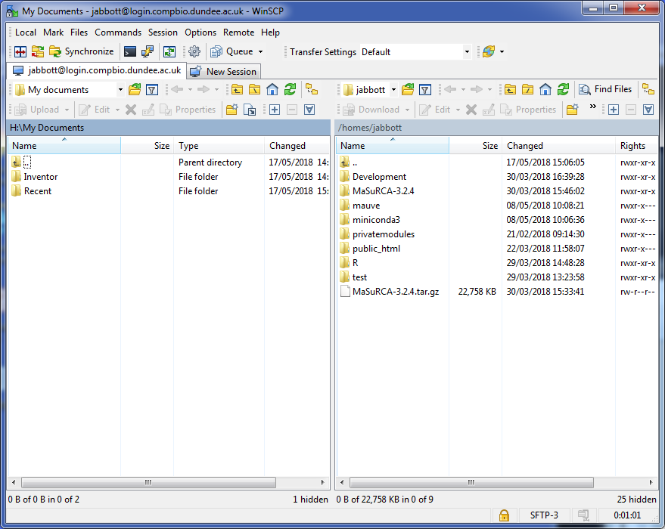
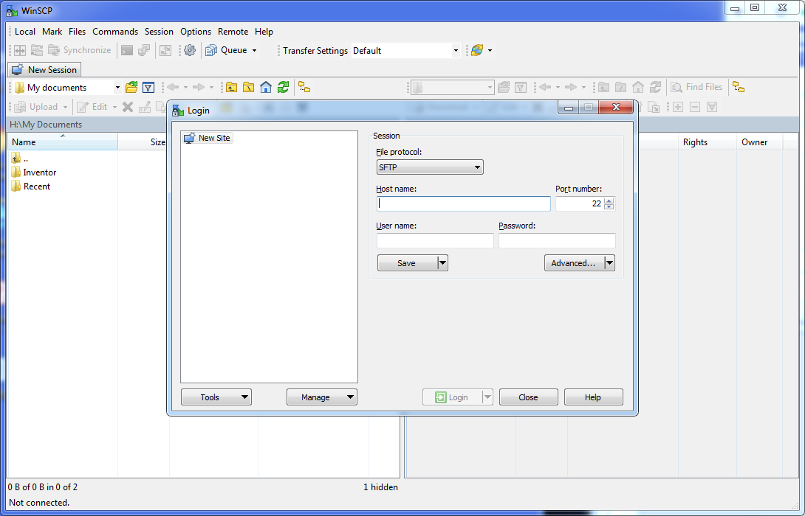
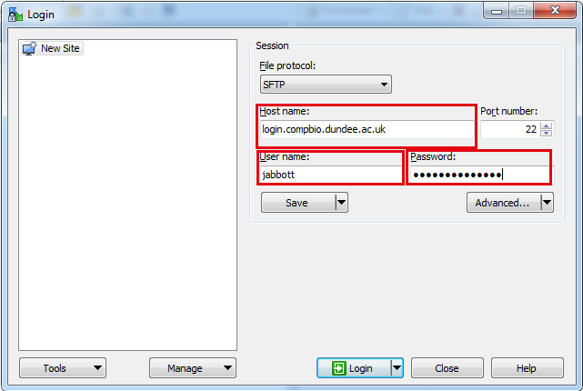
SCP Client for Windows:WinSCP
Start WinSCP from Apps Anywhere
Enter hostname and credentials
Click ‘Login’ button
Accept key request
Left hand pane: Local directory
Right hand pane: Remote directory
Navigate in each pane to required directories
Drag and drop files in either direction

Slide 60
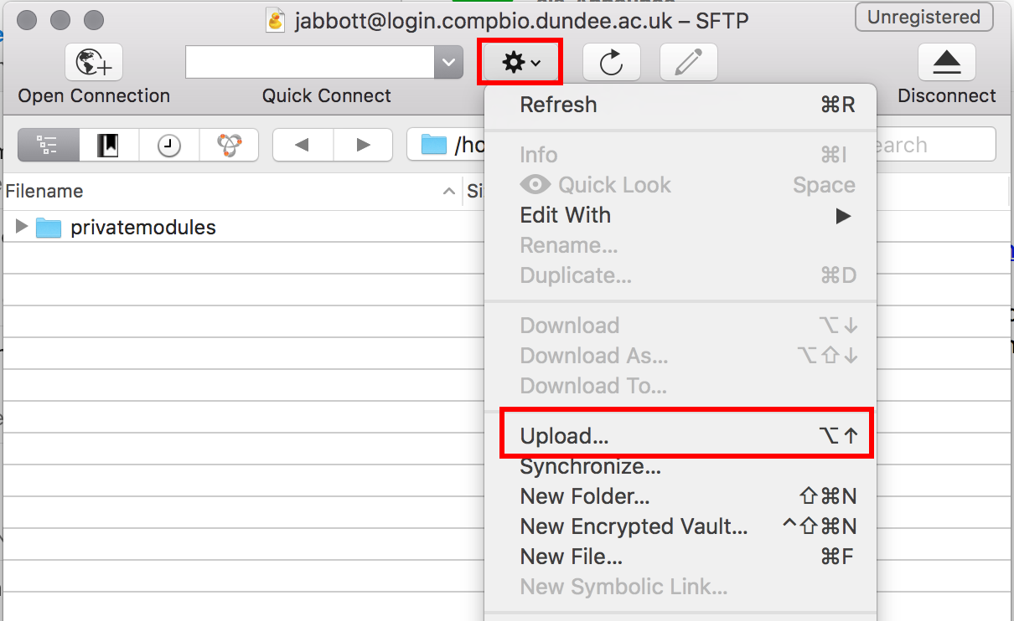
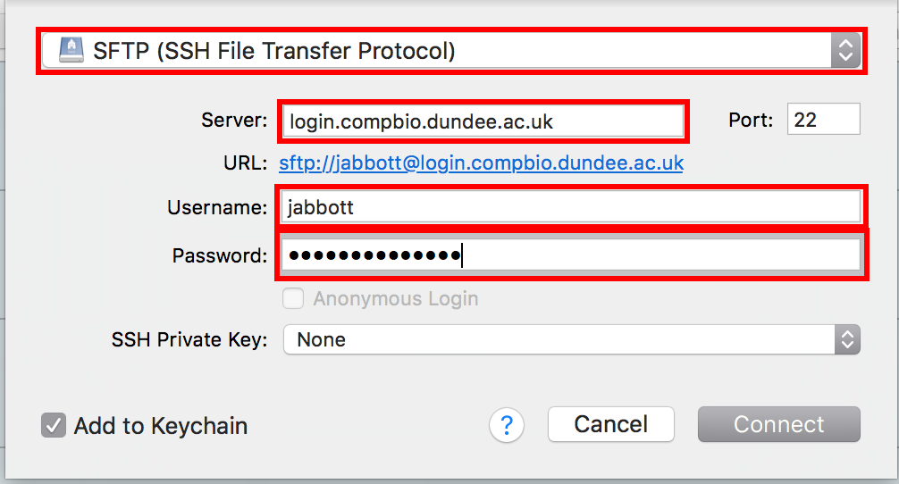
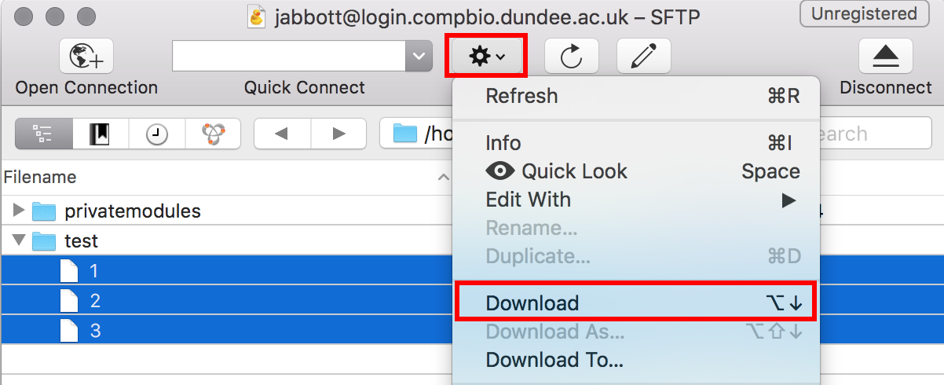
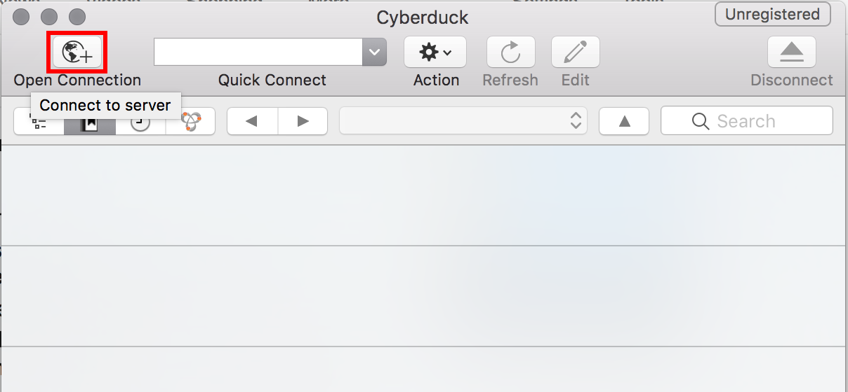
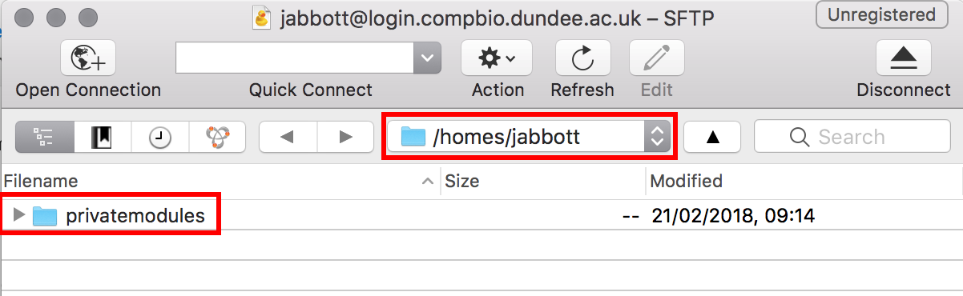
SCP GUI for MacOS: Cyberduck

Slide 61
Summary
We have covered:
What linux is
How to login to a server
How to enter commands
How to navigate the filesystem
Users and permissions
Basic file operations
Managing command output
Managing processes
Transferring data

Slide 62
Any Questions?

