Slide 1
Introduction to NGS
Data Analysis Group
2nd August 2019

Slide 2
Outline
Sequencing history
Current sequencing approaches
File formats
Quality assessment
Read trimming
DAG workflows
The Sequence Read Archive

Slide 3
Key to slides….
Descriptive text
Example commands – black monospaced text: ls /tmp
Commands to run – red monospaced text
Prompts/STDOUT/STDERR – green monospaced text
e.g.
  -bash-4.1 $ echo $USER
  jabbott
[ENTER] – press enter key
[username] – your username, not '[username]'
\ - command is continued on next line – don't press 'enter' at this point

Slide 4
Before we begin…
Log into the cluster enabling X11 tunnelling
Quick reminder:
  Start Xming
  Start putty (enable SSH X11 forwarding)
  Hostname: login.cluster.lifesci.dundee.ac.uk
Copy example data to your home directory
  (base) ningal:~ $ cp –R /tmp/Intro_to_NGS ~
  (base) ningal:~ $ cd Intro_to_NGS
Create a new conda environment and install some packages:
(base) ningal:~ $ conda create –n NGS_intro
(base) ningal:~ $ conda activate NGS_intro
(base) ningal:~ $ conda install fastqc bbmap \
multiqc seqtk trim-galore readfq
If conda reports a new version on conda is available, then also run:
(base) ningal:~ $ conda update –n base conda

Slide 5
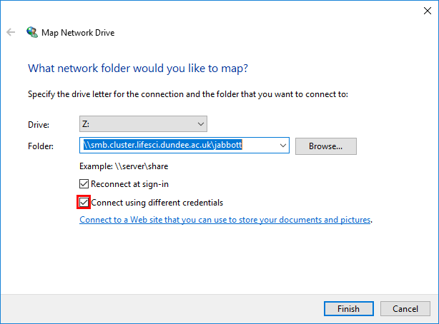
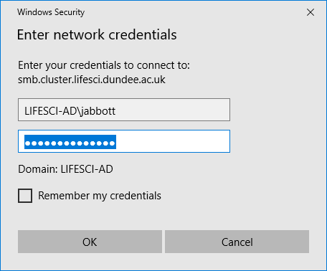
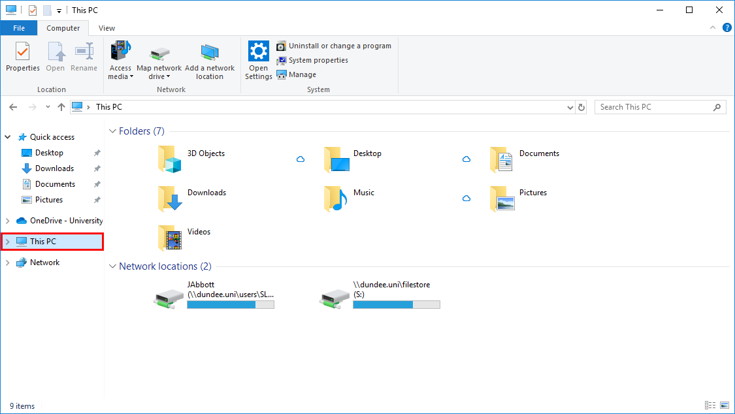
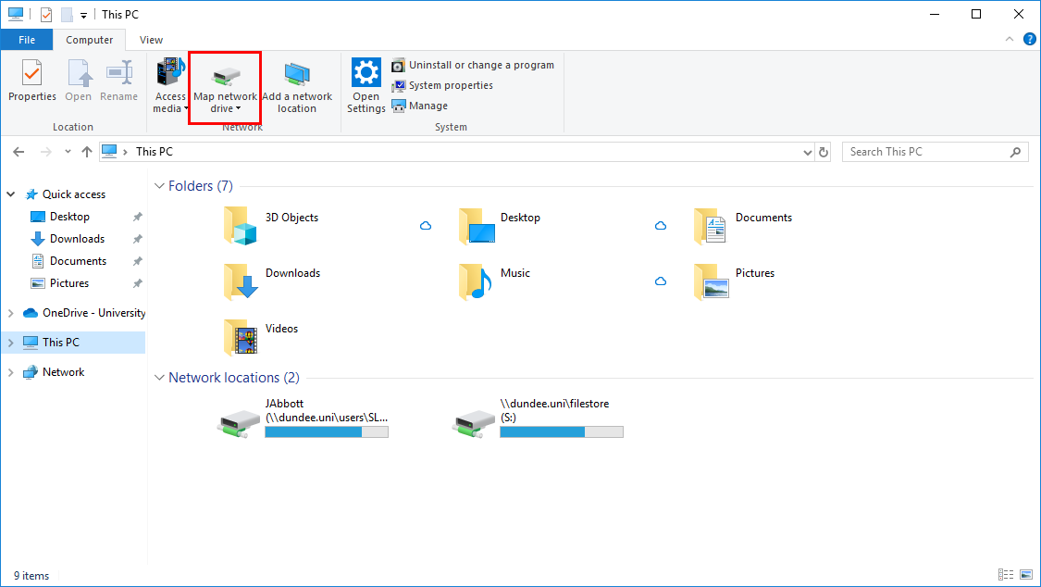
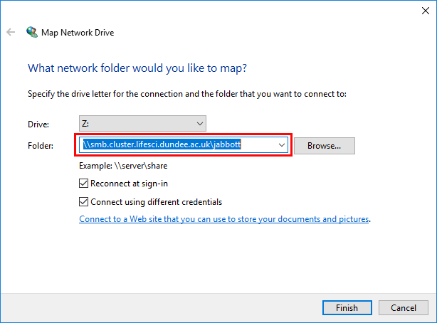
Accessing files: CIFS
The cluster filesystem can be mounted as a network drive
Open file explorer
Select 'This PC'
Click 'Map network drive'
Enter '\\smb.cluster.lifesci.dundee.ac.uk\[username]
Click 'Connect using different credentials'
Click 'Finish'
Enter credentials – LIFESCI-AD\username
You can now drag and drop files to the cluster

Slide 6
An Abridged History of Sequencing

Slide 7




Sanger Sequencing
Developed by Fred Sanger, 1977
Selective incorporation of radio-labelled chain-terminating di-deoxynuclotides during DNA replication
4 separate reactions, one labelled ddNTP per reaction
T7 DNA polymerase replicates DNA from primer
Products separated by gel electrophoresis & blotted
Read sequence from shortest fragment at bottom of gel
Sequenase v2.0 – up to 3kb per ‘read’. 700 bp average, in 6-8 hours
A
C
G
T
Template
DNA Polymerase
G
G
G
G
G
C
G
G
C
T
G
G
C
T
A
G
G
C
T
A
T
G
G
C
T
A
T
A
G
G
C
T
A
T
A
C
G
G
C
T
A
T
A
C
C
G
G
C
T
A
T
A
C
C
T
G
G
C
T
A
T
A
C
C
T
A
G
G
C
T
A
T
A
C
C
T
A
T
G
G
C
T
A
T
A
C
C
T
A
T
C
G
G
C
T
A
T
A
C
C
T
A
T
C
C
G
G
C
T
A
T
A
C
C
T
A
T
C
C
A
G
G
C
T
A
T
A
C
C
T
A
T
C
C
A
G
G
G
C
T
A
T
A
C
C
T
A
T
C
C
A
G
T
G
G
C
T
A
T
A
C
C
T
A
T
C
C
A
G
T
T
G
G
C
T
A
T
A
C
C
T
A
T
C
C
A
G
T
T
A
G
G
C
T
A
T
A
C
C
T
A
T
C
C
A
G
T
T
A
C
G
G
C
T
T
A
C
C
T
A
T
C
C
A
G
T
T
A
A
C

Slide 8
Automated Sanger Sequencing
Dye-terminator sequencing
  fluorescent labelled ddNTPs
  Laser excitation produces different wavelength emission from each dye
  allow use of single sequencing reaction
Capillary electrophoresis
Produces chromatogram showing peak for included bases
Parallelised: up to 384 samples per run
Read length: ~700bp
Automated
ABI 377/3700 – used to sequence Human genome
Still used for small-scale targeted sequencing
Template
DNA Polymerase
G
G
G
G
G
C
G
G
C
T
G
G
C
T
A
G
G
C
T
A
T
G
G
C
T
A
T
A
G
G
C
T
A
T
A
C
G
G
C
T
A
T
A
C
C
G
G
C
T
A
T
A
C
C
T
G
G
C
T
A
T
A
C
C
T
A
G
G
C
T
A
T
A
C
C
T
A
T
G
G
C
T
A
T
A
C
C
T
A
T
C
G
G
C
T
A
T
A
C
C
T
A
T
C
C
G
G
C
T
A
T
A
C
C
T
A
T
C
C
A
G
G
C
T
A
T
A
C
C
T
A
T
C
C
A
G
G
G
C
T
A
T
A
C
C
T
A
T
C
C
A
G
T
G
G
C
T
A
T
A
C
C
T
A
T
C
C
A
G
T
T
G
G
C
T
A
T
A
C
C
T
A
T
C
C
A
G
T
T
A
G
G
C
T
A
T
A
C
C
T
A
T
C
C
A
G
T
T
A
C
G
C
T
T
A
C
C
T
A
T
C
C
A
G
T
T
G
A
A
C

Slide 9
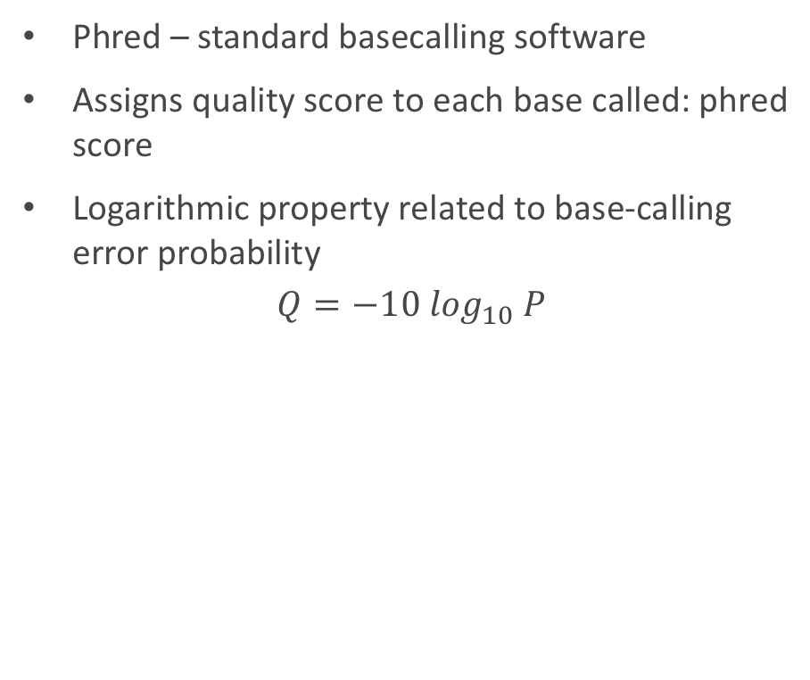
Base Quality
Base calling - Interpreting chromatogram to identify incorporated base
Not all bases are created equal
Somewhat idealistic representation
Real data isn’t so clean…
Phred – standard basecalling software
Assigns quality score to each base called: phred score
Logarithmic property related to base-calling error probability
$$Q=−10 \log_{10} P$$
G
C
T
T
A
C
C
T
A
T
C
C
A
G
T
T
G
A
A
C
Phred Score | Prob. of incorrect base | Accuracy
10 | 1 in 10 | 90%
20 | 1 in 100 | 99%
30 | 1 in 1000 | 99.9%
40 | 1 in 10000 | 99.99%
50 | 1 in 100000 | 99.999%
60 | 1 in 1000000 | 99.9999%

Slide 10
Early NGS Techniques/Dead Ends
Pyrosequencing/454
Sequencing by synthesis method
Incorporation of dNTP releases pyrophosphate
ATP sulfurylase converts PPi -> ATP
ATP substrate for luciferin -> oxyluciferin conversion by luciferase
Gives off light, detected by CCD
Read lengths:
  GS20: 168 bp
  FLX: 400 bp
  FLX Titanium: 800 bp
Homopolymer runs problematic
Source: atdbio

Slide 11
Early NGS Techniques/Dead Ends
AB SOLiD
Radically different approach
Mix of labelled oligos. Bases from 3’:
  1-2: one of 16 dinucleotides
  3-5: degenerate
  6-5’ end: degenerate with fluorescent label
7 ligation cycles with different primer
Each base queried by 2 different oligos
Very high accuracy
Sequence represented in colour-space, rather than bases

Slide 12
Current Sequencing Approaches

Slide 13
Illumina
Sequencing by synthesis method
Sample preparation:
  Sample randomly fragmented and adapters ligated
  Adapters bound to ss oligo fragments on flowcell surface
  Bridge amplification – free end of fragment bound to complementary oligo on flowcell -> ds bridges
  Denature -> ss templates
  Dense clusters result from repeated cycles
  Reverse strands removed leaving only forward strands
Notes:
Generic process – some modifications in newer instruments – no bridge amplification with patterned flowcells.

Slide 14
Illumina - Sequencing
Labelled reversible nucleotide terminators to prevent multiple additions
First cycle – add nucleotides, primers and DNA
Primers bind to forward strands
One labelled nucleotide incorporated
Each nucleotide label has distinct emission wavelength
Image captures fluorescence from each cluster
Following cycles repeat addition of one labelled base, with image capture
Basecalling depends upon tracking location within image and change in fluorescence over time
C
G
C
C
G
C
C
G
T
A
A
T
T
A
G
A
C
C
T
A
T
A
C
C
A
G
T
T
T
A
C
A
Notes:
NextSeq and MiniSeq use 2 colour chemistry

Slide 15
Illumina – Library types
Single end sequencing
Read from one end of fragment only
May be 5’ or 3’
Paired end sequencing
Two reads from opposite ends of fragment
Reads are known distance apart – insert size
Allow spanning of short repetitive regions
Increased mapping accuracy
Insert size up to 800 bp
Stranded protocols available
Mate-Pair Sequencing
Long insert paired end reads (1kb-12kb)
Allow spanning of long repetitive regions
Useful in de-novo genome assembly and SV identification
2-12kb fragments
Biotinylated adapters
Fragment: 200-600 bp
Isolate biotinylated fragments
Insert size

Slide 16

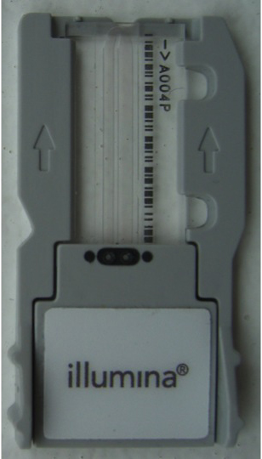
Illumina Flowcells
Microfluidic devices where sequencing reactions occur
Glass slide containing channels covered in oligos complimentary to adapter sequences
HiSeq instruments – 8 lanes
Miseq - 1 lane
Latest instruments use patterned flowcells
  Clusters formed in ‘nanowells’ laid out on flowcell
  Eliminates need to map cluster sites
  Higher cluster density
Lanes divided up into tiles in 2 columns per lane

Slide 17
Illumina Multiplexing
A flowcell lane frequently offers far more capacity than required
Multiplexing allows multiple samples to be run in each lane
  ‘barcoded’ adapters added to each sample
  Samples pooled and run on lane
  Reads computationally ‘demultiplexed’ into separate samples according to presence of barcodes

Slide 18
Long Read Technologies
Short read sequencing produces vast data volumes
Backward step compared to Sanger sequencing
  De-novo assembly limited
  RNA sequencing – splice detection harder
  SV detection more difficult
Long reads generated from single molecules help
  Resolve repeats in de-novo assembly
  Sequence entire RNA molecules to reveal splicing
  Aid SV identification
Downsides
  High error rates

Slide 19
Pacific Biosystems (PacBio)
Single Molecule Realtime Sequencing (SMRT)
Realtime detection of fluorescent nucleotide incorporation
Label on phosphate chain rather than base
Released upon cleavage of phosphate chain
DNA polymerase bound to template in Zero-mode waveguide (ZMW)
Laser shone through base of ZMW results in excitation of captured nucleotides
RSII – 1G bases per flowcell (150000 ZMWs)
Sequel – 5-8G bases (1000000 ZMWs)
N50 = 30kb

Slide 20
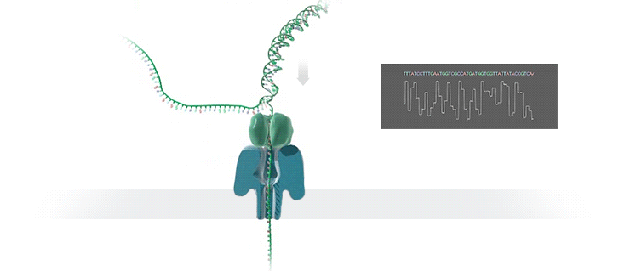
Oxford Nanopore Technologies
Cell-membrane pores act as channels for molecule transport
Measure change in ionic current as molecules pass through pore
Different signal produces by A,C,T and G
Reads >1Mb possible
MinIon: up to 512 nanopores
1D² offers sequencing of both strands - ~95% accuracy

Slide 21
File Formats

Slide 22
Fasta
Format for any sequence data
Unannotated
Very loose format
  Entry starts with ‘>’ followed by ID
  Description may be present – any further text on header line
  Sequence on following lines
  Sequence may be wrapped, or may be all on one line
  May be multiple sequences in the file
No base quality data
>id1
GCTAGTAAATCGTAGCTAGTCGATGTCGATG
TGTTTAGCTYACGTCAGTGTGTNNTGCA
>id2 Sequence 2 description
GCTAGTCGACTAGCTGATGTGTGTAGCTGATCGGCTAGTGTACGTAGTCAGTAGCTGACTGCTAGCATGATCGTAGTGA
Sequence 1 description

Slide 23
Fasta quality files
Base quality scores in separate file
Fasta-like format
  Header starts with ‘>’
  Sequence ID follows, matching that in fasta file
  Space-delimited quality scores on following line(s)
Bulky
Awkward to handle
>id1
15 18 21 25 24 23 11 18 22 24 27 31 31 29 33 32
>id2
39 37 38 40 40 40 39 40 37 38 38 39 40 40 40 40 33 31 22 18

Slide 24
NGS Base Quality Scores
Most technologies produce base quality scores
  Similar to Phred scores
  Quality scores can aid mapping, SNV discovery etc.
Illumina
Number of ‘quality predictor’ cluster properties assessed
  Intensity profile
  Signal-to-noise ratio
  Correlated with empirically determined qualities
Quality model lists combinations of predictors with quality scores
PacBio
Older instruments (RS/RSII) generate quality score
Sequel does not produce quality scores
  Set to lowest value of scale instead (0)
  Software making use of quality scores will discard all the reads…
Oxford Nanopore
Phred-like scores produced with different methods
  Originally: Hidden markov model (HMM)
  Currently: Recurrent Neural Network (RNN)
HMM-based calls observed not to reflect real base quality

Slide 25
Fastq format
Merges sequence and quality in one file (.fastq/.fq)
De-facto standard for NGS read data
Normally gzip compressed (.fastq.gz/.fq.gz)
Base quality encoded as ASCII character
  Allows numeric range to be represented by single byte (character)
Four lines per sequence
  ‘@’ followed by ID, and optional description
  Sequence
  ’+’, optionally followed by ID
  Quality values
@SEQ_ID
GATTTGGGGTTCAAAGCAGTATCGATCAAAT
+
!''*((((***+))%%%++)(%%%%).1***

Slide 26
Fastq Quality Encoding
ASCII offset for Illumina quality encoding has changed over time…
SSSSSSSSSSSSSSSSSSSSSSSSSSSSSSSSSSSSSSSSS..................................................... ..........................XXXXXXXXXXXXXXXXXXXXXXXXXXXXXXXXXXXXXXXXXXXXXX...................... ...............................IIIIIIIIIIIIIIIIIIIIIIIIIIIIIIIIIIIIIIIII...................... .................................JJJJJJJJJJJJJJJJJJJJJJJJJJJJJJJJJJJJJJJJ..................... LLLLLLLLLLLLLLLLLLLLLLLLLLLLLLLLLLLLLLLLLL....................................................
!"#$%&'()*+,-./0123456789:;<=>?@ABCDEFGHIJKLMNOPQRSTUVWXYZ[\]^_`abcdefghijklmnopqrstuvwxyz{|}~
| | | | | |
33 59 64 73 104 126
0........................26...31.......40
-5....0........9.............................40
0........9.............................40
3.....9..............................41 0.2......................26...31........41
S - Sanger Phred+33, raw reads typically (0, 40)
X - Solexa Solexa+64, raw reads typically (-5, 40)
I - Illumina 1.3+ Phred+64, raw reads typically (0, 40)
J - Illumina 1.5+ Phred+64, raw reads typically (3, 41)
with 0=unused, 1=unused, 2=Read Segment Quality Control Indicator (bold)
L - Illumina 1.8+ Phred+33, raw reads typically (0, 41)
Source: https://en.wikipedia.org/wiki/FASTQ_format

Slide 27
Illumina Fastq Headers
Header lines of Illumina fastq files contain much embedded metadata
Guess what…
  The format has changed over time
  Cassava v 1.8 onwards:
Filtered?
@K00166:234:HKLGJBBXX:6:1101:1336:1173 1:N:0:NGCGATAG+NTTCGCCT
Run ID
Lane
Tile
Instrument
ID
Flowcell ID
X:Y co-ord
in tile
Member
of pair
Index sequence
Control bits
Notes:
Tile and X:Y co-ord may be reversed
Control bits set if read identified as a control

Slide 28
FastQ Summary Statistics
Key questions
  How many reads are in a file?
  How long are the reads?
  How many bases are there?
Seqtk: toolkit for working with fastq/fasta data
Examine the files in the fastq directory
Count the reads:
(Intro_to_NGS) -bash-4.1$ readfq \ fastq/read1.fastq.gz
or, for the brave:
  (Intro_to_NGS) -bash-4.1$ echo \
  $(zcat fastq/read1.fastq.gz |wc -l)/4|bc
Use the ‘fqchk’ function of seqtk to see basic stats
(Intro_to_NGS) -bash-4.1$ seqtk \
fqchk fastq/read1.fastq.gz
min_len: 150; max_len: 150; avg_len: 150.00; 7 distinct quality values
POS #bases %A %C %G %T %N avgQ errQ %low %high
ALL 3750 34.6 14.2 13.3 37.2 0.7 38.5 23.2 2.5 97.5
1 25 0.0 0.0 0.0 0.0 100.0 2.0 3.0 100.0 0.0
2 25 44.0 4.0 20.0 32.0 0.0 32.0 32.0 0.0 100.0
3 25 32.0 20.0 8.0 40.0 0.0 31.8 31.6 0.0 100.0
4 25 48.0 12.0 4.0 36.0 0.0 36.2 35.7 0.0 100.0
5 2 520.0 12.0 12.0 56.0 0.0 36.0 34.4 0.0 100.0
6 25 36.0. 8.0 8.0 48.0 0.0 39.3 25.8 4.0 96.0

Slide 29
Paired reads in fastq data
Paired reads typically in separate files
  *_1.fq.gz/*_2.fq.gz
Read pairs in same order in each file
Essential to maintain ordering when i.e. trimming/subsetting reads
Older Illumina header formats use /1|/2 to indicate pair
Some tools require ‘interleaved’ read pairs
  One file, alternating between reads 1 & 2
seqtk can interleave paired fastq files
(Intro_to_NGS) -bash-4.1$ seqtk mergepe \ fastq/read1.fastq.gz \ fastq/read2.fastq.gz|gzip –c \
> interleaved.fq.gz
Now examine interleaved.fastq.gz
How can you tell if the reads are correctly paired?

Slide 30
Quality Assessment

Slide 31
Quality Assessment
First thing to do when analysing a dataset
Gain an understanding of quality of data
Identify any problems with the sequencing run
Poor quality data can dramatically affect analysis results
Some issues can be worked round…
FastQC: analyses range of quality metrics
Have a look at the fastqc help:
  fastqc --help
Write a wrapper to run fastqc on the cluster
Sequence files: Intro_to_NGS/Streptococcus
Use 4 threads
Once submitted to the cluster, use 'tail -f' to monitor the error output file
#!/usr/bin/env bash
#$ -V
#$ -cwd
#$ -pe smp 4
cp Streptococcus/* $TMPDIR/
mkdir –p fastqc_outputs
fastqc --threads 4 -o fastqc_outputs $TMPIDR/*.fastq.gz

Slide 32
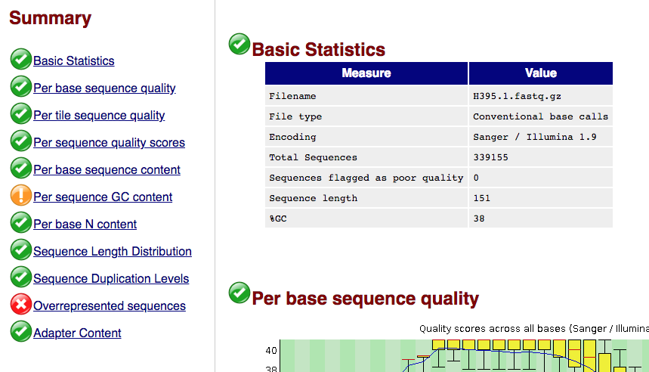
Interpreting FastQC Results
For each fastq file, output directory contains
  fastqname_fastqc.zip
  fastqname_fastqc.html
Zip file contains separate outputs
HTML file provides combined report in single file
Use a web browser on your local machine to open the HTML reports from your mounted network drive
Summary on left pass/warning/fail for each metric
Based on hard-coded values…no knowledge of data type or experiment

Slide 33
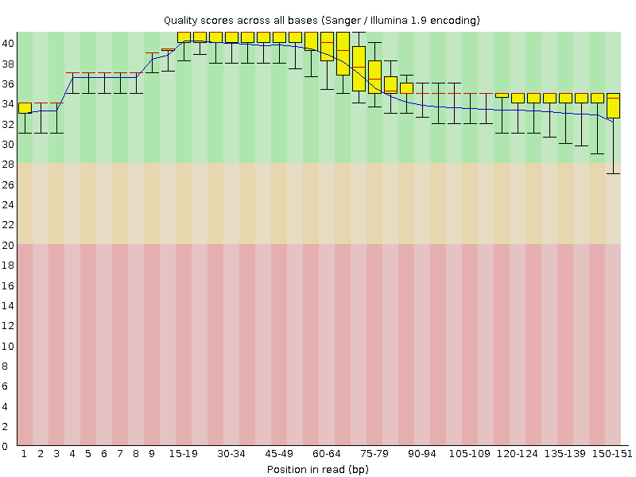
FastQC: Per-base sequence quality
Box plot of quality scores along length or reads
  red line: median
  Blue line: mean
  yellow box: inter-quartile range (25%-75%)
  Whiskers: 10% & 90% range
Quality score (y axis) is Phred-like value
Typical cutoff for usable sequence: 20
  But depends on what you are doing…
NB: X-axis is not linear…
Typically see decrease in quality along read for Illumina sequence
Problem data resolution: Read trimming

Slide 34
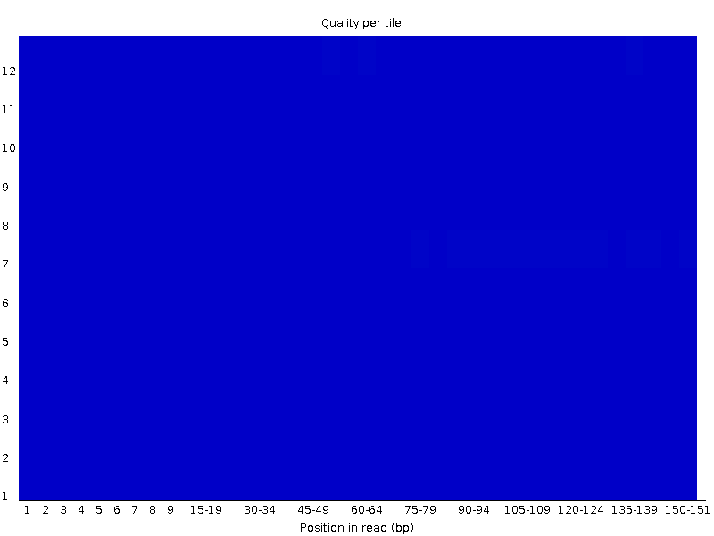
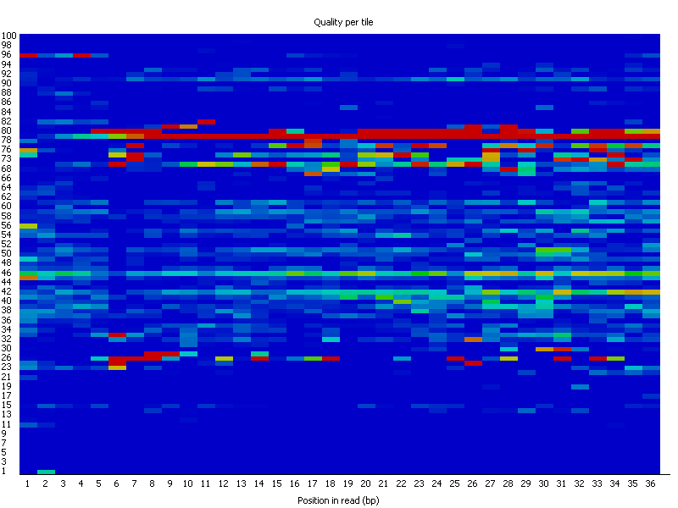
FastQC – Per Tile Sequence Quality
Flowcell position of read determined from fastq ID
Informs on localised problem on flowcell during run
All blue – everything's good
Otherwise…
  Localised region: air bubble?
  Broader region: dirt on flowcell?
Resolution:
  local region: mask region
  Broader region: Tricky…
Notes:
Resolving large scale issues may be though trimming and masking but may lose to much data. Might need to get sequencing repeated

Slide 35
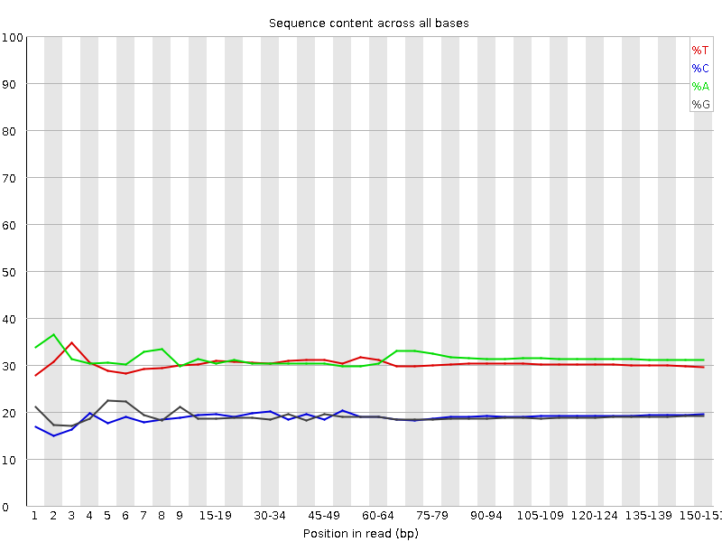
FastQC – Per-base sequence content
Indicates proportion of A,C,T,G across length of read
We seem to have a slightly AT-rich genome
Common to see uneven distribution at beginning of read
  Effect of library prep method
  Technical bias but not a particular problem – affects base proportions but not specific sequences

Slide 36
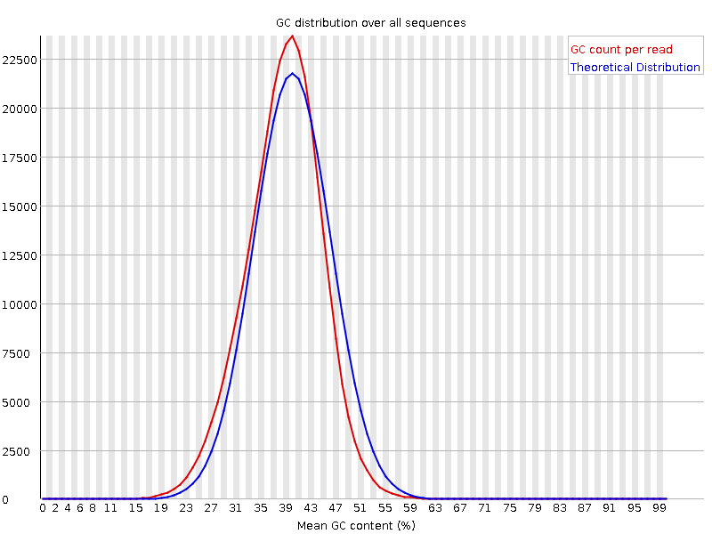
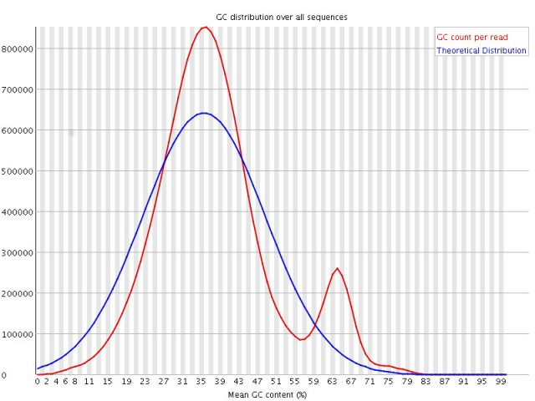
FastQC – Per-sequence GC content
Distribution should be close to Gaussian (normal)
Good indicator of problems with library
  Additional sharp peaks? Primer dimers?
  Bimodal distribution? – contamination?

Slide 37
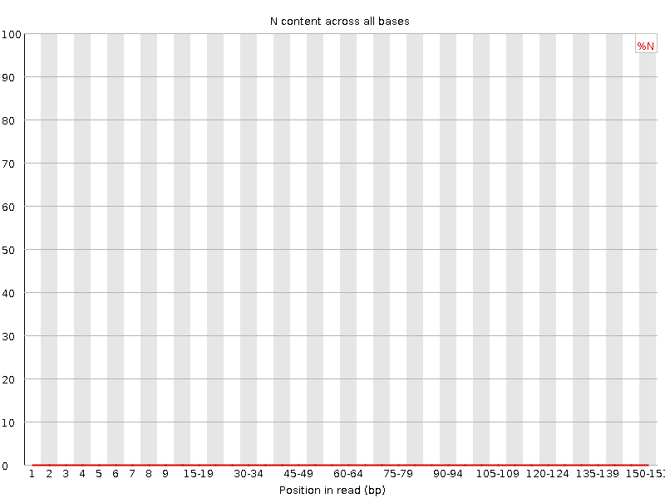
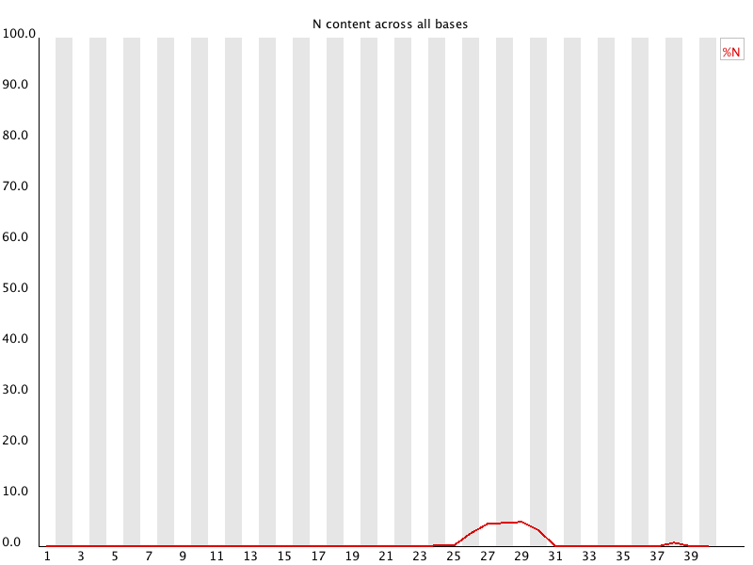
FastQC – Per-base N-content
Indicates proportion of non-callable bases (N’s) along length of read
Small number of N’s expected in all runs
Accumulation at particular points in reads could be associated with poor quality region
Consider along with other quality metrics
Resolution: read-trimming (depending upon severity)

Slide 38
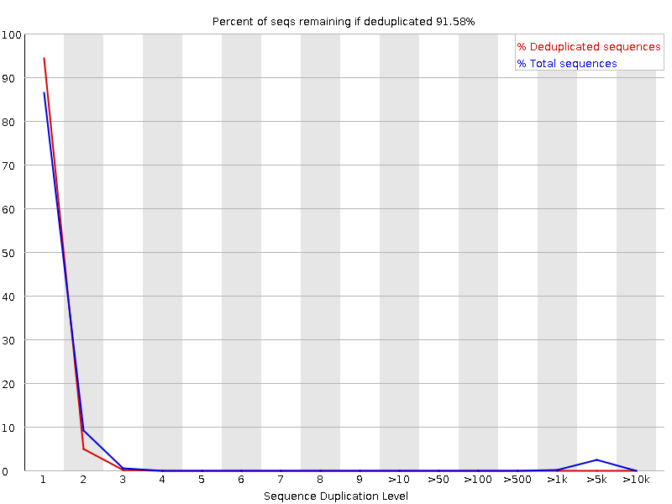
FastQC – Sequence Duplication Levels
Indicates duplication level of sequences
  Y-axis: % sequences
  X-axis: Duplication level
Duplicate sequences can occur through
  Biological duplicates – real instances of replication of sequence
  PCR duplicates – Overamplification of library
    Insufficient diversity in library
  Common in RNA-Seq – deep sequencing to find low abundance transcripts = number of copies of high abundance transcripts
  Problematic for variant calling
  Resolution: Removal of duplicate reads
Notes:
Optical duplicates occur

Slide 39
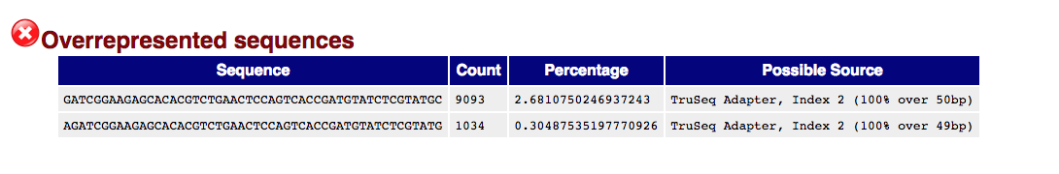
FastQC – Overrepresented sequences
Library should contain range of sequences
Should not be a significant representation of particular sequence
Overrepresented sequences may be
  Contaminants
  Biologically relevant
Sequences of >0.1% of total listed, with attempted identification of source

Slide 40
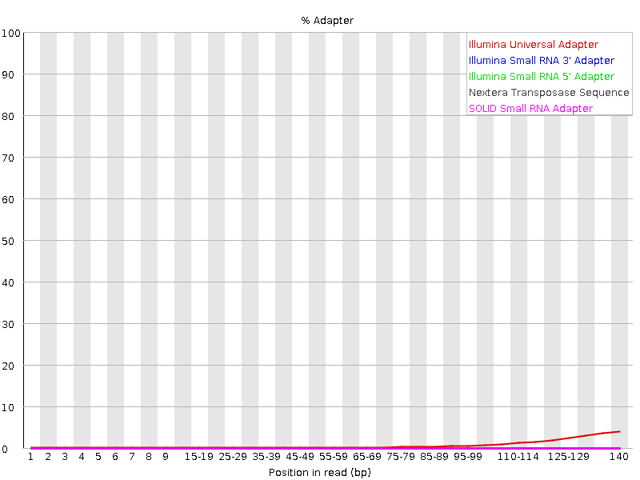
FastQC – Adapter content
Insert size shorter than read-length will result in read-through into adapter
Plot of proportion of reads at each position which consist of adapter sequence
May also be identified in ‘overrepresented sequences’ analysis
Resolution: Carry out adapter trimming

Slide 41
Dealing with many outputs: MultiQC
FastQC produces separate output file for each read pair of each library
Many files to look through and compare
MultiQC reads results from many tools and produces single interactive HTML report
(Intro_to_NGS) -bash-4.1$ multiqc
Usage: multiqc [OPTIONS] <analysis directory>
Error: Missing argument "analysis_dir".
This is MultiQC v1.7
For more help, run 'multiqc --help' or visit http://multiqc.info
Now try it:
Update your fastqc script to run MultiQC after completing fastqc analysis
#!/bin/bash
#$ -V
#$ -cwd
#$ -pe smp 4
cp Streptococcus/* $TMPDIR/
fastqc --threads 4 -o fastqc_outputs \ $TMPDIR/*.fastq.gz
multiqc fastqc_outputs

Slide 42
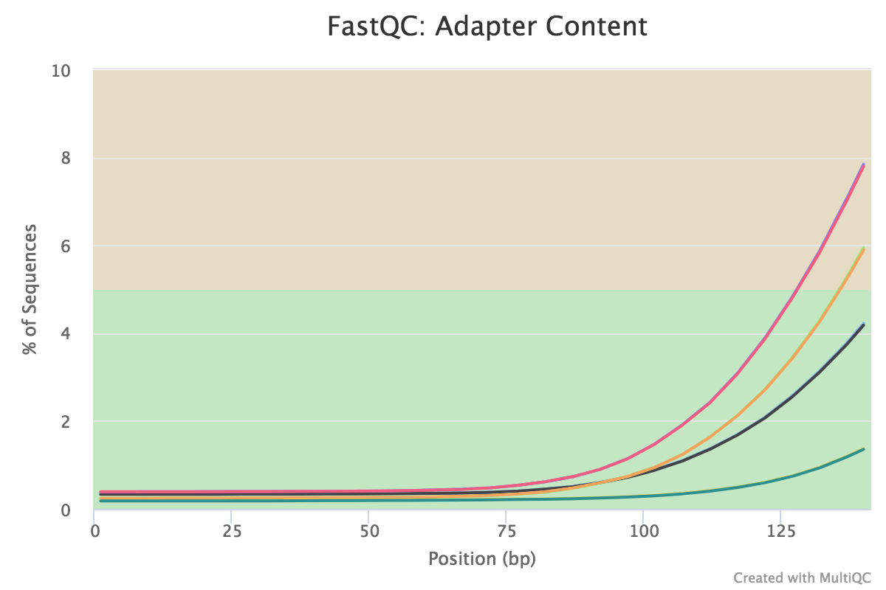
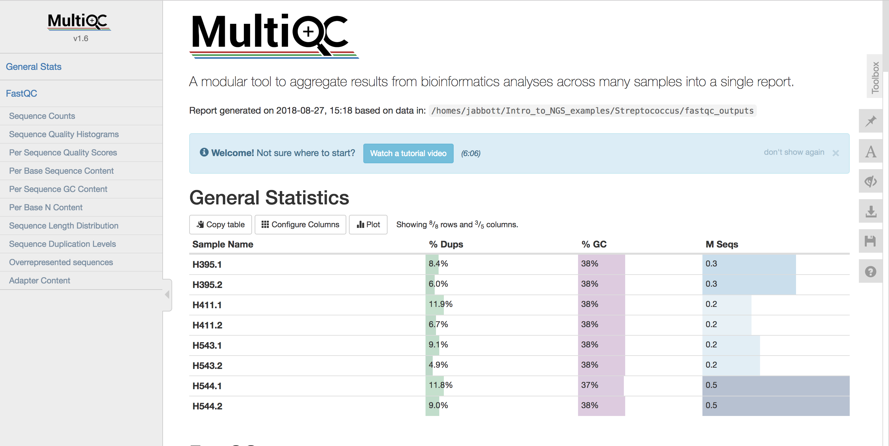
MultiQC Output
Open ‘multiqc_report.html’ with your web browser

Slide 43
Read Trimming

Slide 44
Why trim reads?
Reads can be trimmed to
  Remove low quality sequence
  Remove ambiguous base calls (N’s)
  Remove adapter sequences
Low quality sequence more likely to include incorrect base calls
Adapter sequences not of biological relevance
Removal of these can:
  Improve quality of de-novo assembly
  Improve proportion of mapped reads
  Increase SNV calling accuracy
  Reduce computational time
Trimming has also been shown to affect RNA-Seq differential expression analysis
  Williams et al . 2016 Trimming of sequence reads alters RNA-Seq gene expression estimates. BMC Bioinformatics 17(1):103.
  Shorter reads following trimming more likely to be mis-mapped
  Use minimum length threshold to discard short reads completely following trimming
Treat all libraries in an experiment the same way

Slide 45
Read Trimmers
Many available…with different capabilities
  Adapters? (cutadapt/trimmomatic)
  Quality? (sickle/cutadapt/fastx_trimmer)
  Paired-end support? (sickle/trimmomatic)
  Format detection?
Trim-galore wraps cutadapt and fastqc
  Adapter trimming
  Paired-end support
  Optionally runs fastqc following trimming
  (Intro to NGS) ningal:~ $ trim_galore --help

Slide 46
Exercise: Write a Trim Galore wrapper
Trim the paired-end sequence reads in the ‘Streptococcus’ directory using the following criteria:
  Quality cutoff: 30
  Length cutoff: 100
  Trim N’s from the end of reads
  Gzip compress outputs into new directory
  Output directory is created automatically…
Start by looking at the trim_galore help to work out what parameters you need
Write a script to run trim_galore meeting the criteria described above
Check the trimming_report.txt files
Output file naming:
  Single ended: _trimmed.fq.gz
  Paired end: _val_1.fq.gz, _val_2.fq.gz
How can you check that read pairing has been retained?

Slide 47
Trim-galore scripts
Single job, files processed in series:
#!/usr/bin/env bash
#$ -V
#$ -cwd
trim_galore --paired --trim-n --gzip -o trimmed --retain_unpaired -q 30 --length 100 \ Streptococcus/*.fastq.gz
Array job, libraries processed in parallel
#!/usr/bin/env bash
#$ -V
#$ -cwd
#$ -t 1-4
libs=($(ls Streptococcus/*gz|cut -f1 -d.|uniq))
lib=${libs[${SGE_TASK_ID}-1]}
trim_galore --paired --trim-n --gzip -o trimmed --retain_unpaired -q 30 --length 100 ${lib}*.fastq.gz

Slide 48
Downsampling
In some circumstances, may have too much data
  Excess depth not informative
  Increases computation time
  Can negatively affect results
  Need to think carefully about particular experiment
Seqtk ‘sample’ subcommand
Randomly subsambles from file
Keep seed (-s) the same for paired reads e.g.
    seqtk sample –s100 read1.fq.gz 100 | gzip –c > downsampled.1.fq.gz
    seqtk sample –s100 read2.fq.gz 100 | gzip -c > downsampled.2.fq.gz

Slide 49
Duplicate Removal
Removing duplicates generally done on aligned reads
unaligned reads? clumpify from bbmap package
    clumpify.sh in=H395.1.fastq.gz in2=H395.2.fastq.gz \
    out=dedup.1.fq.gz out2=dedup.2.fq.gz dedupe
Allows for a number of substitutions for sequencing error (2 by default)
  modify with ‘subs=x’
Always check files of paired reads still have matched numbers of reads after any modifications

Slide 50
DAG Workflows

Slide 51
The Reproducibility Crisis…
Many difficulties of reproducibility in analysis
  What software version?
  What arguments?
  How is this recorded?
  How can someone else replicate the analysis
Scaling up analysis is difficult
  Debugging scripts
  Ensuring cluster jobs run appropriately
Many things to consider, before you start thinking about the analysis itself

Slide 52
DAG Workflows
DAG Workflows utilise:
    Conda
    automated package management
    Workflow distribution and version management
      Snakemake
    Allows definition of workflows through the use of rules relating to different tasks and dependancies
    Integrates with Grid Engine to manage job submissions
    Tracks input and output files
      Errors reported if correct output files not produced
      Minimise need to rerun previous stages of analysis
Designed to make efficient use of cluster
Are not 'black-boxes'…all software arguments exposed and need to be understood
Self-documenting

Slide 53
DAG Workflows: initial setup
Add DAG conda channel to configuration
    (Intro_to_NGS) ningal:~ $ conda config --add channels \ https://dag.compbio.dundee.ac.uk/conda
  Check channel added correctly
    (Intro_to_NGS) ningal:~ $ conda info
  Create and activate a new environment
    N.B. naming of this environment matters!
    (Intro_to_NGS) ningal:~ $ conda create –n dag-wf
    (Intro_to_NGS) ningal:~ $ conda activate dag-wf
  Install the DAG workflow package
    (Intro_to_NGS) ningal:~ $ conda install dag-wf

Slide 54
DAG Workflows: Installation
The following packages will be downloaded:
package | build
---------------------------|-----------------
attrs-19.1.0 | py_0 32 KB conda-forge
cffi-1.12.2 | py37h342bebf_0 209 KB conda-forge
cryptography-2.5 | py37hc2b1221_1 589 KB conda-forge
dag-wf-0.01 | 1 2 KB https://dag.compbio.dundee.ac.uk/conda
dag-wf-core-0.03 | 9 6 KB https://dag.compbio.dundee.ac.uk/conda
dag-wf-qc-pe-0.01 | 10 10 KB https://dag.compbio.dundee.ac.uk/conda
dag-wf-qc-se-0.01 | 23 74.8 MB https://dag.compbio.dundee.ac.uk/conda
datrie-0.7.1 | py37h1de35cc_0 133 KB conda-forge
docutils-0.14 | py37_1001 693 KB conda-forge
drmaa-0.7.9 | py_1000 18 KB conda-forge
graphviz-2.38.0 | hc6cc99f_1011 9.5 MB conda-forge
jsonschema-3.0.1 | py37_0 85 KB conda-forge
libcxx-7.0.0 | h2d50403_1 1.2 MB conda-forge
psutil-5.6.0 | py37h1de35cc_0 323 KB conda-forge
pyyaml-3.13 |py37h1de35cc_1001 160 KB conda-forge
ratelimiter-1.2.0 | py37_1000 12 KB conda-forge
snakemake-minimal-5.5.4 | py_0 135 KB bioconda
wrapt-1.11.1 | py37h1de35cc_0 41 KB conda-forge
------------------------------------------------------------
    dag-wf-qc-se: qc = Quality control; se = single ended
    dag-wf-qc-pe: qc = Quality control; pe = paired end
Notes:
dag-wf is metapackage which pulls in all workflows
dag-wf-core contains common components shared across workflows
dag-wf-* are individual workflow packages
Each component individually versioned

Slide 55
DAG Workflows: File naming
Fastq files from sequencing centres can have hugely varying naming conventions:
    101111_620FWAAXX_2_0.solfastq.gz
    SRR5244800_1.fastq
    SRR5244800_2.fastq
    WT_1_ATCACG_L007_R0_001.fastq.gz
    WT_1_ATCACG_L007_R0_002.fastq.gz
We need a more useful naming convention:
  Single ended sequences: samplename.fq.gz
  Paired end sequences: samplename_1.fq.gz, samplename_2.fq.gz
dag-wf-rename-fastq tool allows bulk renaming of fastq files to our convention
Uses ‘mapping file’ to determine new file names
Compresses any uncompressed fastq files

Slide 56
DAG Workflows: dag-wf-rename-fastq
(dag-wf) ningal:~ $ ls -1 bad_names > mapping.txt
Now edit mapping.txt in your favourite editor…
File needs to be tab-delimited:
    i.e. Old_name<tab>samplename<tab>(read[1/2] – paired end only)
      101111_620FWAAXX_2_0.solfastq.gz DAG01
      SRR5244800_1.fastq DAG02 1
      SRR5244800_2.fastq DAG02 2
      WT_1_ATCACG_L007_R0_001.fastq.gz DAG03 1
      WT_1_ATCACG_L007_R0_002.fastq.gz DAG03 2
  Save the file and exit your editor
  You can also create this in excel and export it (file -> save as -> ‘tab delimited text’)
  Remember to correct the line endings when copying to cluster with dos2unix…

Slide 57
DAG Workflows: dag-wf-rename-fastq
(dag-wf) ningal:~ $ dag-wf-rename-fastq
Usage: dag-wf-rename-files [-i inputdir] [-o outputdir] [-m mapping_file] [-h]
Renames batches of files to make them amenable to running through DAG workflows
Symbolic links are created in outputdir with a filename determined by the various fields in the mapping file.
The required mapping file should be a tab delimited file containing the following fields:
Original_filename Sample Read
where:
original_filename: the current name of the file
sample: the sample name to which the file relates
read: either '1' or '2' (not required for single-ended fastq files)
Options:
* -i: path to input directory containing files to rename
* -o: path to output directory in which symlinks will be created
* -m: mapping file of filename to sample mappings
* -h: Display help
So give it a go….

Slide 58
DAG Workflows: dag-wf-rename-fastq
(dag-wf) ningal:Intro_to_NGS $ dag-wf-rename-fastq -i bad_names –o fixed -m mapping.txt
Files will be renamed as follows:
101111_620FWAAXX_2_0.solfastq.gz -> DAG_001.fq.gz
SRR5244800_1.fastq -> DAG_002_1.fq
SRR5244800_2.fastq -> DAG_002_2.fq
WT_1_ATCACG_L007_R0_001.fastq.gz -> DAG_003_1.fq.gz
WT_1_ATCACG_L007_R0_002.fastq.gz -> DAG_003_2.fq.gz
Please check the renaming above is correct
Do you wish to proceed? [y/N] y
`fixed/DAG01.fq.gz' -> `/homes/jabbott/Intro_to_NGS/bad_names/101111_620FWAAXX_2_0.solfastq.gz'
`fixed/DAG02_1.fq' -> `/homes/jabbott/Intro_to_NGS/bad_names/SRR5244800_1.fastq'
`fixed/DAG02_2.fq' -> `/homes/jabbott/Intro_to_NGS/bad_names/SRR5244800_2.fastq'
`fixed/DAG03_1.fq.gz' -> `/homes/jabbott/Intro_to_NGS/bad_names/WT_1_ATCACG_L007_R0_001.fastq.gz'
`fixed/DAG03_2.fq.gz' -> `/homes/jabbott/Intro_to_NGS/bad_names/WT_1_ATCACG_L007_R0_002.fastq.gz'
A log of changes made has been written to fastq_rename.070319_140916.log

Slide 59
DAG Workflows: so what happened?
(dag-wf) ningal:Intro_to_NGS $ ls -l fixed/
total 0
lrwxrwxrwx 1 jabbott lsd 75 Jul 31 13:56 DAG01.fq.gz -> /homes/jabbott/Intro_to_NGS/bad_names/101111_620FWAAXX_2_0.solfastq.gz
lrwxrwxrwx 1 jabbott lsd 61 Jul 31 13:56 DAG02_1.fq -> /homes/jabbott/Intro_to_NGS/bad_names/SRR5244800_1.fastq
lrwxrwxrwx 1 jabbott lsd 61 Jul 31 13:56 DAG02_2.fq -> /homes/jabbott/Intro_to_NGS/bad_names/SRR5244800_2.fastq
lrwxrwxrwx 1 jabbott lsd 75 Jul 31 13:56 DAG03_1.fq.gz -> /homes/jabbott/Intro_to_NGS/bad_names/WT_1_ATCACG_L007_R0_001.fastq.gz
lrwxrwxrwx 1 jabbott lsd 75 Jul 31 13:56 DAG03_2.fq.gz -> /homes/jabbott/Intro_to_NGS/bad_names/WT_1_ATCACG_L007_R0_002.fastq.gz
Symbolic links are created in 'fixed' with workflow-friendly names, which point to the old files
No filenames were harmed in the making of this slide

Slide 60
DAG Workflows: workflow setup
(dag-wf) ningal:~ $ dag-wf-setup
Usage: dag-wf-setup [-n name] [-d directory] [-w workflow] [-i inputdir]
Options:
* -n: Name of workflow job
* -d: Directory to create for containing workflow files
* -w: Workflow to initiate
* -i: Directory containing input files for workflow
* -c: Copy input files into workflow (default: use symlink)
Available workflows: qc-pe,qc-se

Slide 61
DAG Workflows: workflow setup
(dag-wf) ningal:~ $ dag-wf-setup -w qc-pe -d QC -n Strep_QC –i ~/Intro_to_NGS/Streptococcus
Creating dag-wf-qc-pe conda environment
[snip]
Setting up qc-pe workflow in QC...
Populating QC/fastq directory with data files...
/homes/jabbott/Intro_to_NGS/Streptococcus/H395.1.fastq.gz -> QC/fastq/H395_1.fq.gz
/homes/jabbott/Intro_to_NGS/Streptococcus/H395.2.fastq.gz -> QC/fastq/H395_2.fq.gz
/homes/jabbott/Intro_to_NGS/Streptococcus/H411.1.fastq.gz -> QC/fastq/H411_1.fq.gz
/homes/jabbott/Intro_to_NGS/Streptococcus/H411.2.fastq.gz -> QC/fastq/H411_2.fq.gz
/homes/jabbott/Intro_to_NGS/Streptococcus/H543.1.fastq.gz -> QC/fastq/H543_1.fq.gz
/homes/jabbott/Intro_to_NGS/Streptococcus/H543.2.fastq.gz -> QC/fastq/H543_2.fq.gz
/homes/jabbott/Intro_to_NGS/Streptococcus/H544.1.fastq.gz -> QC/fastq/H544_1.fq.gz
/homes/jabbott/Intro_to_NGS/Streptococcus/H544.2.fastq.gz -> QC/fastq/H544_2.fq.gz
Please inspect the Snakefile in the 'QC' directory and modify as required.
The workflow can be run by running 'cd QC; dag-wf-run'
(dag-wf) ningal:~ $ cd QC
(dag-wf) ningal:~ $ dag-wf-run
Notes:
This should take about 7 minutes to run

Slide 62
DAG Workflows: The Snakefile
Plain text file which defines workflow
Consists of series of rules defined by inputs and outputs required, and commands to run
Allows integration of python code for complex requirements
Open the Snakefile in your editor of choice…
Tool parameters are defined at the top of the file
  Command line argument and description in comments
  Parameters are checked at runtime for valid types (i.e. integer, string, boolean)

Slide 63
DAG Workflows: config.json
Allows per-rule runtime requirements to be defined
Defaults hopefully ok, but may need changing according to data
{
"__default__":
{
"jc" : "''",
"mem_free" : "8G",
"o" : "logs/\\$JOB_NAME.{rule}.log",
},
"fastqc":
{
"o" : "logs/\\$JOB_NAME.{rule}.{wildcards}.log",
},
"trim_galore":
{
"o" : "logs/\\$JOB_NAME.{rule}.{wildcards}.log",
}
}

Slide 64
Long running workflows
dag-wf-run can be submitted to Grid Engine with qsub
Installed by conda so not in our current directory
  qsub $(which dag-wf-run)
Jobs run under default job class
If individual tasks likely to take > 24 hours need to use 'inf' job class
  Edit config.json….
    {
    "jc" : "inf",
    "mem_free" : "8G",
    "o" : "logs/\\$JOB_NAME.{rule}.log",
    },

Slide 65
DAG Workflows: Workflow directory post-run
(dag-wf) ningal:QC $ ls -1
conda_environment.yaml
config.json
dag.svg
fastq
fastqc
fastqc_trimmed
logs
multiqc
Snakefile
Strep_QC.report.html
trim_galore
Conda environment definition used for workflow run
JSON format configuration managing resource requests
Image showing workflow tasks and dependancies
Input files, linked by dag-wf-setup
FastQC reports on initial fastq files
FastQC reports on trimmed fastq files
Log files for each workflow task
MultiQC outputs
Snakefile defining workflow
HTML Report on workflow
Trim_galore outputs – your trimmed reads are in here…

Slide 66
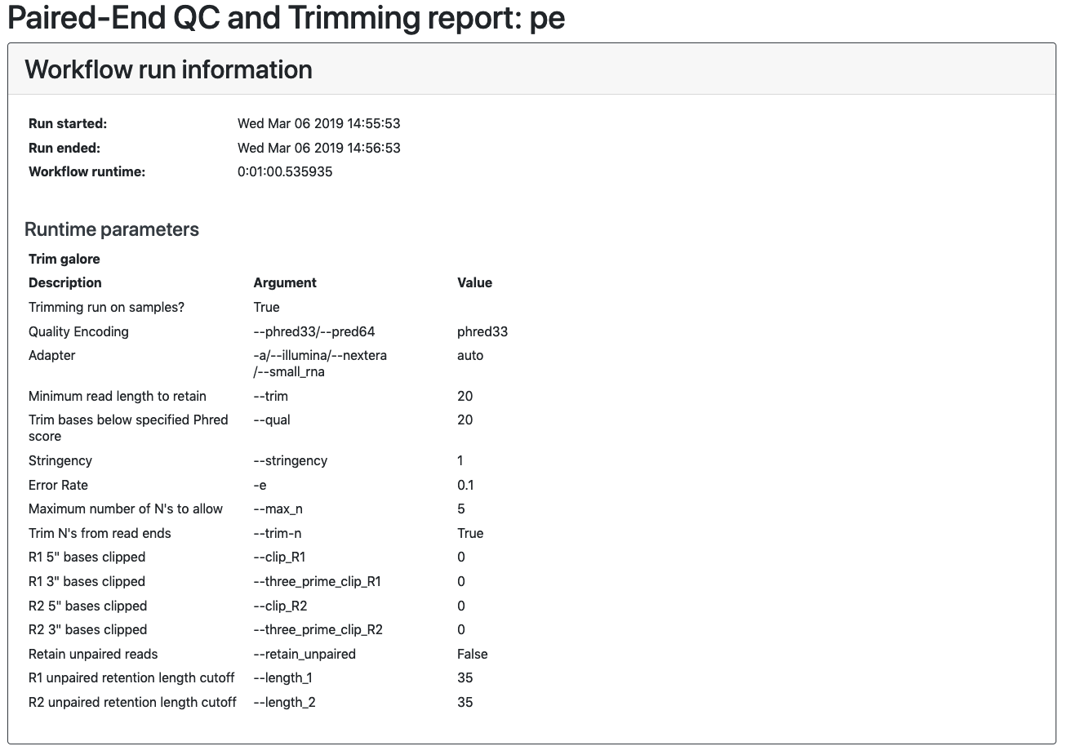

Slide 67
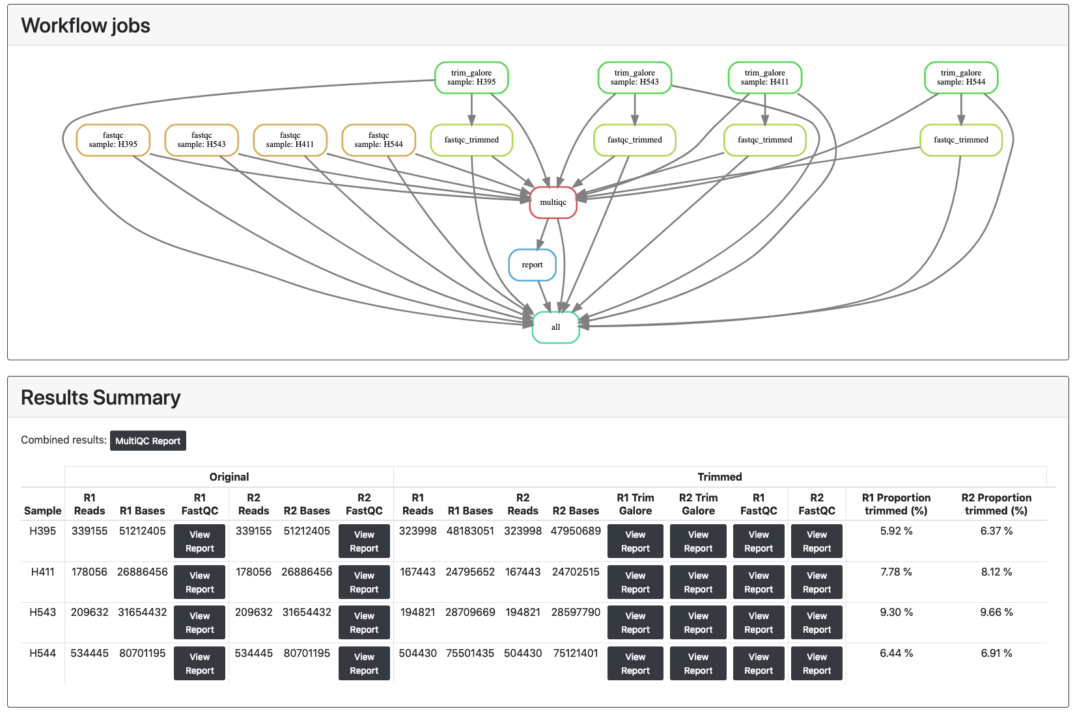

Slide 68
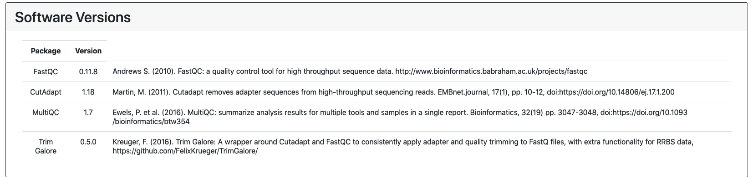

Slide 69
The Sequence Read Archive

Slide 70
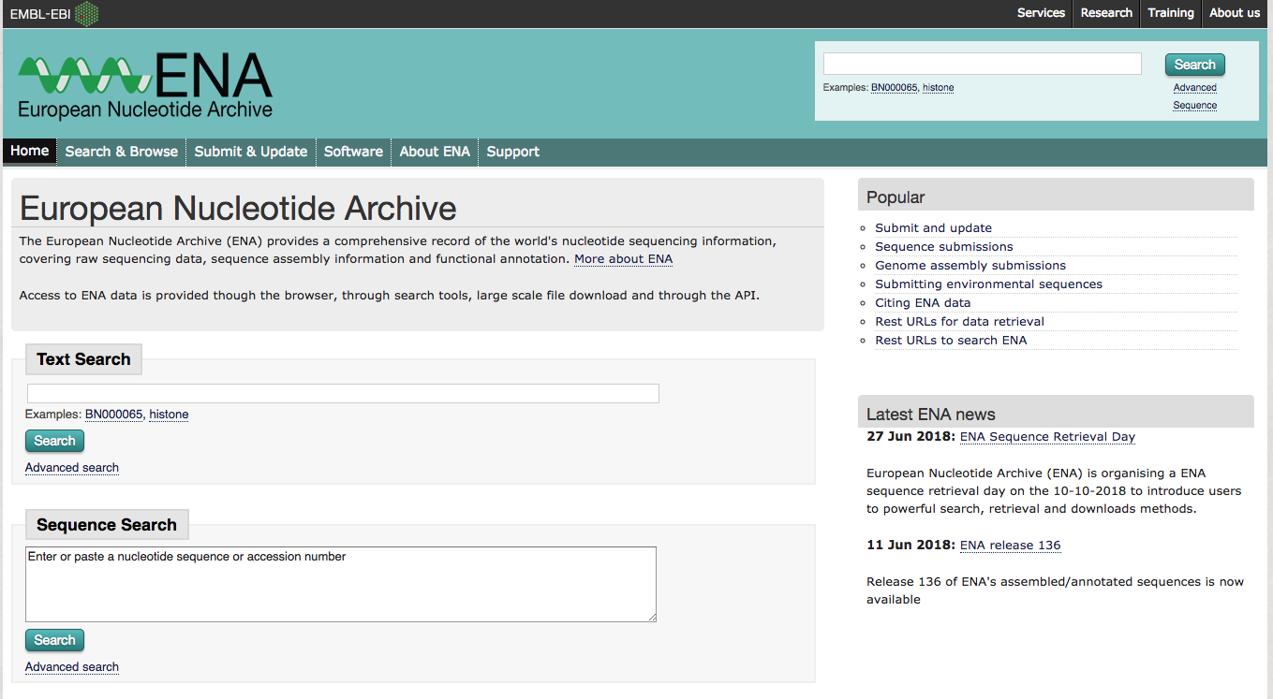
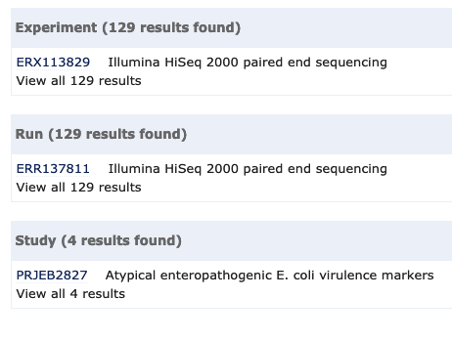
The Sequence Read Archive
Subsection of European Nuclotide Archive (ENA)
Public repository of raw sequence reads
Data freely available for reanalysis
http://www.ebi.ac.uk/ena
Select domain: ‘read’
Taxon name: ’eschericia’
Instrument platform: ‘ILLUMINA’
Library Strategy: ‘WGS’
  Click ‘search’

Slide 71
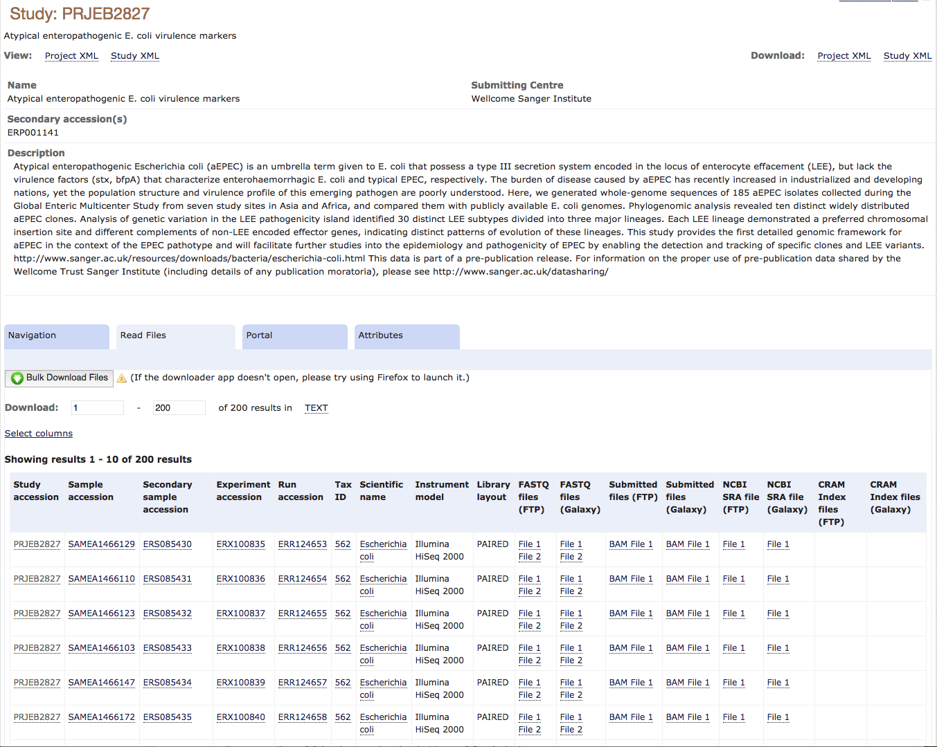
SRA Study Details
Notes:
NB – Study accession should be in published manuscripts to help you find the data you are interested in

Slide 72
Summary
We have covered:
Different approaches to sequencing
Library types (Single end/Paired end/Mate pair)
Sequence base quality
Sequence file formats
Sequence quality assessment
Remedial work for problematic sequences
  Read trimming
  Subsampling
  Duplicate removal
Using DAG workflows for sequence QC
Finding publicly accessible sequence data from the SRA

Slide 73
Any Questions?

