Slide 1
The HPC Cluster
Data Analysis Group
Based on slides by Chris Cole

Slide 2
Key to slides….
Descriptive text
Example commands – black monospaced text: ls /tmp
Commands to try – red monospaced text
Prompts/STDOUT/STDERR – green monospaced text
e.g.
-bash-4.1 $ echo $USER
jabbott
[ENTER] – press enter key
[username] – your username, not '[username]'

Slide 3
Desktop Computing
A single computer
A single user – usually
Exclusive access – not usually remotely
May be switched off – not necessarily intentionally
Expansion is limited
Lower Spec Memory and CPU
Mainly Windows or Mac – rarely Linux
Data, hardware back-up?

Slide 4
Cluster computing
Many ‘computers’ - nodes
Many users
Shared access – only remotely via a login ‘node’
Always on – subject to maintenance, etc
Expandable to suit any type of computation
High spec memory and CPU – server grade
Almost universally Linux/Unix
Redundant hardware
Robust backups

Slide 5
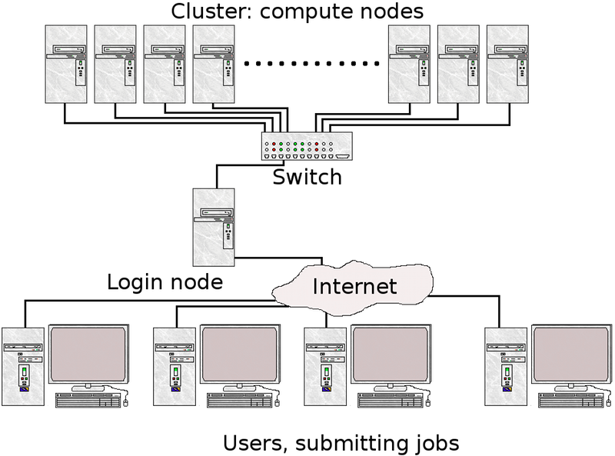
Cluster computing
https://www.hpc2n.umu.se/support/beginners_guide

Slide 6
“With great power...
...comes great responsibility.”
Use all parts to best effect.
Poor use of the cluster can make processes run more slowly than on a desktop!
This is a shared resource, you can impact on others
Need to understand all aspects
Hardware
Filesystem
Software
Queuing system

Slide 7
Hardware

Slide 8
The Hardware
Compute Nodes
Mixed economy of Intel Xeons or AMD Opterons and GPUs
2-8 CPUs, 4-16 cores per CPU
8-128 cores per node
32GB – 1TB RAM per node
Connectivity
Or how fast can data get to/from the nodes...
Gigabit Ethernet (1Gbps)
10 Gigabit Ethernet (10Gbps)
10 Gigabit Ethernet + Infiniband (10Gbps + low latency)

Slide 9
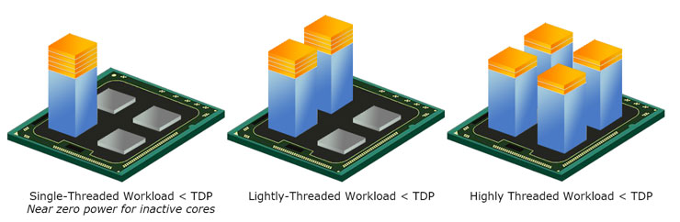
CPU vs CORES
A central processing unit (CPU) is a physical object.
Cores are an architectural design found within a CPU.
Can increase power with more CPUs or cores or both.
Each core has a small amount of cache memory
https://www.guru3d.com/articles-pages/core-i5-750-core-i7-860-870-processor-review-test,2.html

Slide 10


Nodes
Simplest computing unit
Fixed amount of accessible:
CPU cores
RAM
Local disk
Important to consider this when submitting jobs

Slide 11

Parallel Computing
Task
Total time = t
Notes:
One thread, One machine

Slide 12
Parallel Computing
Task 1
Task 2
Task 3
Task 4
t₁
t₂
t₃
t₄
Total time = t₁ + t₂ + t₃ + t₄
Notes:
Four tasks running in parallel on one machine
More threads than cores? Timeslicing and task switching…inefficient

Slide 13
Parallel computing
Task 1
Task 2
Task 3
Task 4
t₁
t₂
t₃
t₄
Total time = longest of t₁, t₂, t₃, t₄
Notes:
Four tasks running in parallel on four machines
‘Embarrassingly parallel’ processing

Slide 14

Parallel computing
Task
Pthreads
OpenMP
Java threads
Total time = t
Notes:
One task running four threads in parallel on 4 cores on one machine
Good for tightly coupled parallel jobs

Slide 15
Parallel computing – multiple nodes
Task
Software needs to be adapted to work like this. – e.g. MPI
Total time = t/4
Simplistic. Can be bottlenecks or overheads
Notes:
One task running in parallel on four machines - MPI

Slide 16

Multi-threading
A process runs on an execution thread
A multi-threaded process can run on multiple execution threads simultaneously

Slide 17
Accessing the cluster
Need a Life Sciences username/password
Need a Cluster account – raise a ticket with IT
Need an SSH client
PuTTY/git-bash on Windows
Terminal/iTerm2 on Mac OSX
Terminal/Xterm/Konsole/etc on Linux
See ‘Intro To Linux’ notes …
Remember to start Xming before logging in if you want to use a GUI text editor
Try logging into the cluster:
Hostname: login.cluster.lifesci.dundee.ac.uk
Username/Password: Life Sciences Directory credentials
Now copy some files we’ll need later:
-bash-4.1$ cp –R /tmp/cluster_intro ~
-bash-4.1$ cd cluster_intro

Slide 18
Filesystem

Slide 19

Filesystems
Cluster nodes have two file systems
Local
Disk
Nodes
Spectrum Scale (aka GPFS)
/homes

Slide 20
Spectrum Scale/GPFS
Accessible by all nodes on the cluster
High capacity (440TB)
High performance and robust
Mixture of SSD (metadata and top-tier) and HDD (slower data pools)
Very fast for dealing with large files
Not efficient with small files - *do not* create directories full of small files
Backed up
Use NOBACK directories for temporary/scratch/downloaded data
Use of NOBACK being reviewed by IT – this may change

Slide 21
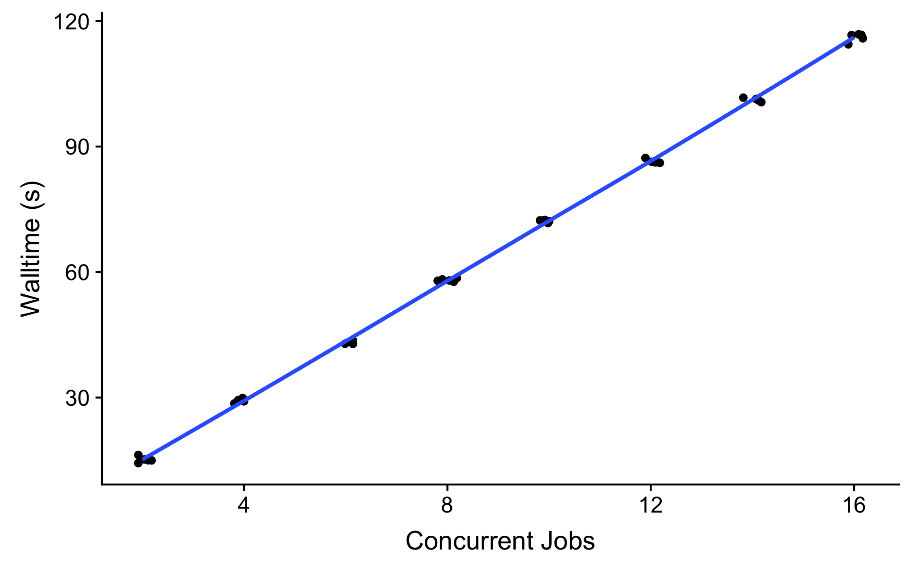
Spectrum Scale/GPFS Performance
Cluster file system gets slower the more concurrent jobs are accessing it…

Slide 22
Local disk
Only accessible to jobs on a node
Temporary – files automatically deleted when job finishes
Limited capacity (100-900GB)
Shared between jobs on node
Offers more consistent (and generally faster) performance than GPFS
Accessible via $TMPDIR environment variable

Slide 23
An aside – environmental variables
An environment variable is a dynamic-named value that can affect the way running processes will behave on a computer. (Wikipedia)
Some are set on login:
$HOME – path to your home directory
$USER – your username
Values can be viewed with ‘echo’
-bash-4.1 $ echo $USER
jabbott
Can be ‘interpreted’ within commands
-bash-4.1 $ cd $HOME
The TMPDIR variable is set within the environment of a job executing through Grid Engine

Slide 24
Relative performance
Access speeds vary to different storage types
Cache memory: 1-5ns
Main memory: 50-150 ns
Local disk: 10-15 ms, 300MB/s
Network disk: 50-100ms, 125MB/s (Gigabit ethernet)
Aim to keep active data as close to CPU as possible
Avoid writing data to disk where possible
High IO jobs – use local disk rather than cluster filesystem
Copy input files to $TMPDIR at start of job
Copy output files from $TMPDIR to cluster filesystem at end of job

Slide 25
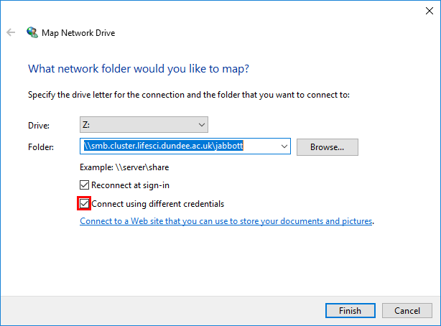
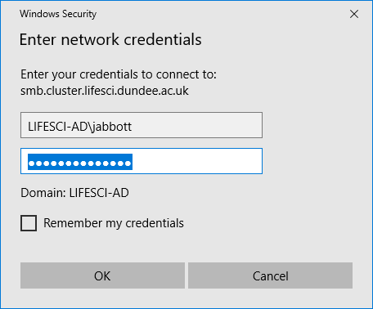
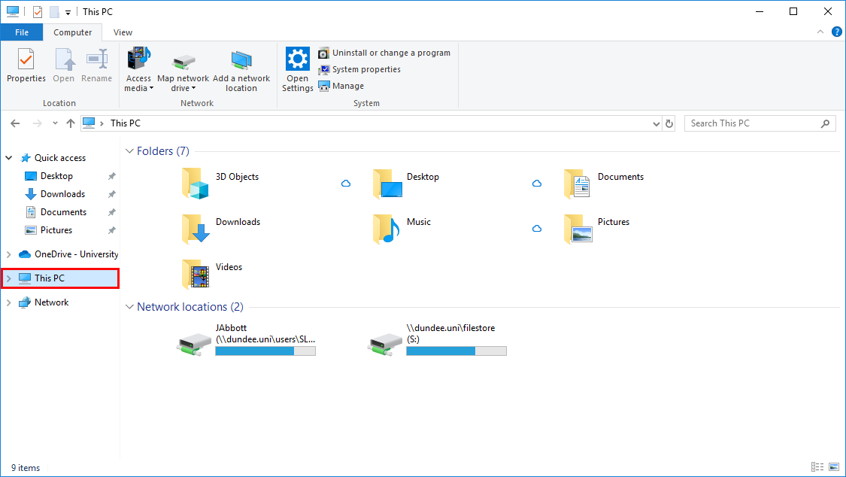
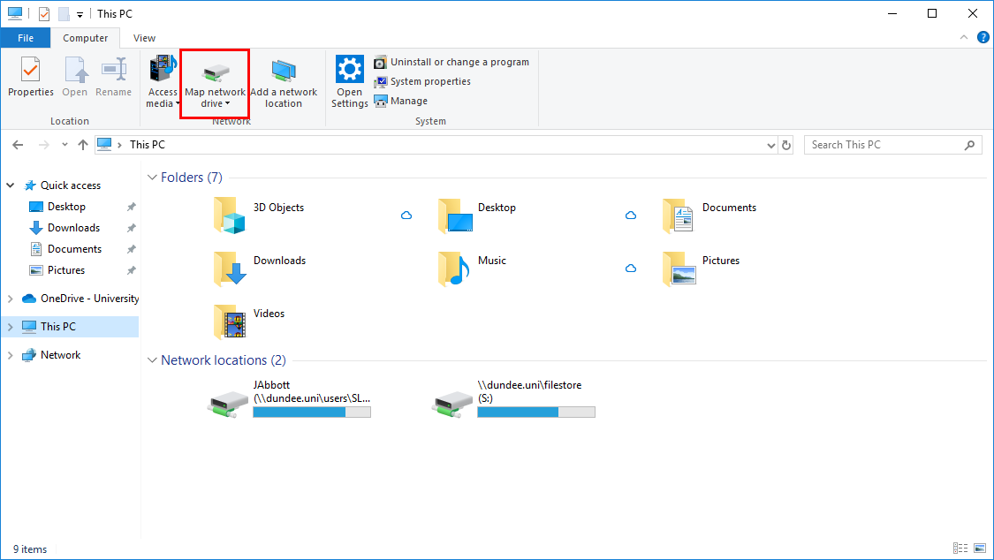
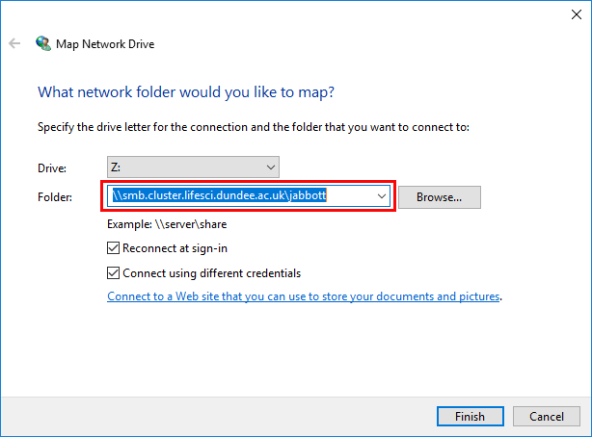
Accessing files: CIFS
The cluster filesystem can be mounted as a network drive
Open file explorer
Select 'This PC'
Click 'Map network drive'
Enter '\\smb.cluster.lifesci.dundee.ac.uk\[username]
Click 'Connect using different credentials'
Click 'Finish'
Enter credentials – LIFESCI-AD\username
You can now drag and drop files to the cluster

Slide 26
Accessing files: other OS
Mac: Finder -> ‘Connect to Server’
smb://smb.cluster.lifesci.dundee.ac.uk/[username]
Linux (you’ll need root/sudo access):
sudo mount –t cifs ‘\\smb.cluster.lifesci.dundee.ac.uk\[username]’ -o username=[username] /mnt/cluster
Only works within UoD network. Use VPN if external.

Slide 27
Quotas
Everyone has a limited amount disk allocated to them & their group
managed storage is expensive
Plan ahead when generating a lot of data. Your jobs will die, if you exceed your quota.
It’s your responsibility to manage your disk space efficiently
Compress large files with gzip/bzip2. Many programs can work with compressed files natively.
Quotas mainly assigned to groups rather than users
SpectrumScale group quotas reported by df
-bash-1.4 $ df –h /cluster/[groupspace]
ningal:~ $ df -h /cluster/gjb_lab/
Filesystem Size Used Avail Use% Mounted on
cluster 120T 92T 29T 77% /cluster
ningal:~$ df -h /cluster/db
Filesystem Size Used Avail Use% Mounted on
cluster 1.5T 708G 829G 47% /cluster

Slide 28
Software

Slide 29
Centralised software installations
Historically: Environment Modules
Globally accessible software packages
Managed by IT
No longer supported…not available on all nodes
Now: Conda
Install packages you require directly into your specified directory
Bioconda repository hosts >3000 bioinformatics packages: https://bioconda.github.io/
Supports multiple environments
Enhances reproducibility
Not everything you need may already be packaged
Environment modules users should look to migrate ASAP

Slide 30
Installing conda
Miniconda: https://conda.io/en/master/miniconda.html
A centralised installation script is available on the cluster
-bash-4.1$
In order to continue the installation process, please review the license
agreement.
Please, press ENTER to continue
Do you accept the license terms? [yes|no]
[no] >>>
setup-miniconda-env /cluster/[groupname]/[username]/[condaname]
Group directory in /cluster
Your username
Directory name for installation
yes

Slide 31
Installing conda
installation finished.
To load the newly installed conda environment, run:
source "/cluster/gjb_lab/jabbott/conda/bin/activate"
(You might want to then run `conda init` to have conda load automatically when you log in)
ningal:~ $
ningal:~ $ source "/cluster/gjb_lab/jabbott/conda/bin/activate"
(base) ningal:~ $
(base) ningal:~ $ conda init
……[snip]……
modified /homes/jabbott/.bashrc
==> For changes to take effect, close and re-open your current shell. <==
Log out then log back in again

Slide 32
Installing conda
Conda should now be on your default path
(base) ningal:~ $ which conda
/cluster/gjb_lab/jabbott/conda/bin/conda
Conda can install packages from multiple repositories (channels)
Required channels must be added to configuration in correct order
(base) ningal:~ $ conda config --add channels defaults
(base) ningal:~ $ conda config --add channels conda-forge
(base) ningal:~ $ conda config --add channels bioconda
You're ready to go

Slide 33
Conda environments
Conda supports multiple environments
Allow different packages/versions to be installed in isolated sandbox
Create separate environments for different projects/tasks
Different versions of package? No problem…
By default packages installed in ‘base’ environment
Create a new environment with current python version:
(base) ningal:~ $ conda create --name myenv
Need a different python version?
conda create --name myenv python=2.7

Slide 34
Conda environments
Once created, need to ‘activate’ an environment to use it
(base) ningal:~ $ conda activate myenv
(myenv) ningal:~ $
To deactivate environment:
(myenv) ningal:~ $ conda deactivate
(base) ningal:~ $
To see the environments you have:
(base) ningal:~ $ conda env list
# conda environments:
#
base * /homes/jabbott/conda
myenv /homes/jabbott/conda/envs/myenv
Reactivate your 'myenv' environment

Slide 35
Conda: Finding packages
(myenv) ningal:~ $
Loading channels: done
No match found for: clustal. Search: *clustal*
# Name Version Build Channel
clustalo 1.2.3 0 bioconda
clustalo 1.2.4 0 bioconda
clustalo 1.2.4 1 bioconda
clustalo 1.2.4 hfc679d8_2 bioconda
clustalw 2.1 0 bioconda
clustalw 2.1 1 bioconda
clustalw 2.1 h2d50403_2 bioconda
clustalw 2.1 h6bb024c_3 bioconda
conda search clustal

Slide 36
Conda: Installing packages
conda install clustalo
(myenv) ningal:~ $
The following NEW packages will be INSTALLED:
argtable2 2.13-h14c3975_1001 conda-forge
clustalo 1.2.4-hfc679d8_2 bioconda
libgcc-ng 7.3.0-hdf63c60_0 conda-forge
libstdcxx-ng 7.3.0-hdf63c60_0 conda-forge
Proceed ([y]/n)?
Did it work?
(myenv) ningal:~ $ clustalo --version
Need a specific version?
(myenv) ningal:~ $
The following packages will be DOWNGRADED:
clustalo 1.2.4-hfc679d8_2 --> 1.2.3-0
(myenv) ningal:~ $ clustalo --version
1.2.3
y
conda install clustalo=1.2.3
Notes:
If you need different versions of the same package, put them in separate environments
Highlighted packages show automated dependency installation

Slide 37
Updating conda
==> WARNING: A newer version of conda exists. <==
current version: 4.7.5
latest version: 4.7.8
Please update conda by running
$ conda update -n base conda
(base) ningal:~ $ conda update -n base conda
The following packages will be UPDATED:
bzip2 1.0.6-h14c3975_1002 --> 1.0.8-h516909a_0
certifi 2019.6.16-py37_0 --> 2019.6.16-py37_1
conda 4.7.5-py37_0 --> 4.7.8-py37_0
conda-package-han~ 1.3.10-py37_0 --> 1.3.11-py37_0
Proceed ([y]/n)?
y

Slide 38
Updating packages
(myenv) ningal:~ $ conda update clustalo
The following NEW packages will be INSTALLED:
_libgcc_mutex pkgs/main/linux-64::_libgcc_mutex-0.1-main
argtable2 conda-forge/linux-64::argtable2-2.13-h14c3975_1001
libgcc-ng pkgs/main/linux-64::libgcc-ng-9.1.0-hdf63c60_0
libstdcxx-ng pkgs/main/linux-64::libstdcxx-ng-9.1.0-hdf63c60_0
The following packages will be UPDATED:
clustalo 1.2.3-0 --> 1.2.4-hfc679d8_2
……[snip]……
(myenv) ningal:~ $ clustalo --version
1.2.4

Slide 39
An exercise…
We'll use the program 'sambamba' later in the workshop
Search for sambamba and see which versions are available.
Find out more details about the latest version
'conda search packagename=version --info'
Which package dependencies will be installed along with sambamba?
Now install sambamba into your environment

Slide 40
Saving a conda environment
After project finished, environment can be removed to save space
May want to save state of environment
Share with others
Recreate environment for further work
(myenv) ningal:~ $ conda env export –n myenv > myenv.yaml
YAML file is plain text format describing environment – keep this safe
Finished with an environment?
(myenv) ningal:~ $ conda deactivate
(base) ningal:~ $ conda env remove --name myenv
BEWARE: there is no y/n prompt!
(base) ningal:~ $ conda env list

Slide 41
Recreating a conda environment
Environment can be recreated from yaml file
(base) ningal:~ $ conda env create –f myenv.yaml
(base) ningal:~ $ conda activate myenv
List the packages in the environment
(myenv) ningal:~ $ conda list
Everything you previously installed should be available again
(myenv) ningal:~ $ clustalo --version
(myenv) ningal:~ $ sambamba --version

Slide 42
Cluster Middleware

Slide 43



Univa Grid Engine
Software managing jobs and cluster resources
Cluster contains different types of node:
Submit host
Qmaster (scheduler)
Execution host
Jobs are run in queues
Queues assigned to particular nodes
Have different resource availability
May have different maximum runtimes
Qmaster
asseses job requirements
assigns to queue
Job executed on node when sufficient resources available
login.cluster.lifesci.dundee.ac.uk
bigmem.q
c6120.q
Notes:
Login to submit host
Qmaster runs scheduler
Execution hosts run jobs…

Slide 44
Queues
The Cluster is subdivided into queues
By architecture: CPU vs GPU
By computing type: memory vs CPU intensive
By responsiveness: fast vs slow
Etc.
Not all users have access to all queues
All jobs must run in a queue
Any intensive jobs running on the login node will be killed
Selection of appropriate queue generally best left to scheduler
We just need to specify resources required

Slide 45
Example Queues
queue | available to… | excluded… | nodes | slots | h_vmem
all.q | gjb,gre,admin,gs,lifesci | webservices | 23 | 28 | 256Gb
c6100.q | gjb_lab,cnaplab,admin,hic_genomics,ezp_lab,admin,webservices |  | 76 | 12 | 47Gb
m600.q | gjb,lifesci,webservices,gre,scills,admin |  | 12 | 8

Slide 46
Viewing queue status
Display cluster queue summary: (base) ningal:~ $ qstat –g c
CLUSTER QUEUE CQLOAD USED RES AVAIL TOTAL aoACDS cdsuE
--------------------------------------------------------------------------------
64bit-pri.q 0.12 0 0 0 8 0 8
all.q 0.09 54 0 530 676 0 144
c6100-inf.q 0.05 0 0 852 900 0 48
c6100.q 0.05 4 0 848 900 0 48
c6145-inf.q 0.02 0 0 384 384 0 0
c6145.q 0.02 8 0 376 384 0 0
long-cpu.q 0.07 0 0 508 530 0 22
long-gpu-cpu.q 0.07 0 0 556 580 0 24
long-gpu.q 0.05 0 0 138 140 0 2

Slide 47
Viewing queue status - qstat
View all users jobs: (base) ningal:~ $ qstat –u "*"
job-ID prior name user state submit/start at queue jclass slots ja-task-ID
-------------------------------------------------------------------------------------------------------------------------------------------
1181066 0.60000 pbmpi.sh kkin r 05/21/2018 18:12:54 all.q@c6320-4-1.cluster.lifesc inf.c7 26
1181085 0.60000 pbmpi.sh kkin r 05/21/2018 18:14:56 all.q@c6320-4-2.cluster.lifesc inf.c7 26
1208952 0.59200 muthis_kcl gtamburrino r 05/25/2018 09:15:49 short-gpu-cpu.q@gpu-20.cluster 24
1209398 0.59200 muthis_kcl gtamburrino r 05/25/2018 10:30:06 short-gpu-cpu.q@gpu-09.cluster 24
1209319 0.56000 act_K jabuerencala r 05/25/2018 10:22:15 t630-long-cpu.q@gpu-27.cluster 16
1203293 0.54400 equi_mut_2 egwhitehead r 05/24/2018 14:04:39 short-gpu-cpu.q@gpu-01.cluster 12
1203296 0.54400 equi_mut_2 egwhitehead r 05/24/2018 14:04:53 short-gpu-cpu.q@gpu-04.cluster 12
Job ID
Job name
State
r,t,T,qw,Eqw,d
Start time
Queue
Node
Slots

Slide 48
Qstat output
Important to regularly monitor the queues.
Job states:
r – running. All good
t – transferring. OK.
qw – queuing. Be patient.
T – job has been suspended either because of a higher priority queue or requesting too many resources. Should restart in time.
d – job is being deleted. Worry, if it wasn’t by you!
Eqw – job has errored. Investigate. More later...

Slide 49
Univa Grid Engine
Main commands to know:
qstat – show status of jobs and queus
qsub – submit a batch job to the scheduler
qalter – modify the requirements of (queuing) job
qrsh – submit an interactive job to the scheduler
qhost – show resources available on each node
qdel – delete a job
(base) ningal:~ $ qstat # view status of your jobs
(base) ningal:~ $ qstat –u "*" # view status for all jobs
(base) ningal:~ $ qstat –u auser # view status for a user’s jobs
(base) ningal:~ $ qstat –j 12345 # view details for specific job

Slide 50
Let’s write a test script
A script needs to be:
Plain text file
Readable and executable
Open your editor of choice (gedit?)
Enter the following:
#!/bin/bash
sleep 30
hostname
Save the script as 'sleep.sh'
Now make the script executable:
(myenv) -bash-4.1$ chmod +x sleep.sh
Try running it directly
(myenv) -bash-4.1$ ./sleep.sh
'shebang' line – tells shell which interpreter to use to run the following commands
Blank line at the end is required – indicates there is a newline at the end of the last command

Slide 51
Now, submit your script to the cluster…
(myenv) ningal:~ $ qsub sleep.sh
Your job 3654325 ("sleep.sh") has been submitted
Check the job status with qstat
job-ID prior name user state submit/start at queue jclass slots ja-task-ID
---------------------------------------------------------------------------------------------------------------------3654345 0.50000 sleep.sh jabbott r 02/11/2019 14:04:03 m600.q@fc-007.cluster.lifesci. 1
Where is the job output?
By default, jobs run in your home directory, and create output files there…
Look for a ~/sleep.o[jobid] file and view the contents
(myenv) ningal:~ $ cat ~/sleep.sh.o3654345
fc-007

Slide 52
Job submission options
Submit with a 4Gb memory requirement
-bash-4.1$ qsub –l mfree=4G sleep.sh
Submit with requirement for 50Gb local disk space
-bash-4.1$ qsub –l local_free=50G sleep.sh
Submit job needing >24 hours runtime
-bash-4.1$ qsub –jc inf –l mfree=4G sleep.sh
Submit to a specific queue (best not to do this…)
-bash-4.1$ qsub –q c6145-long.q –l mfree=4G sleep.sh
-l: resource request list
mfree: amount of memory required
-l: resource request list
local_free: amount of free disk space required
-jc: job class
inf: infinite job class
-q: queue to run job

Slide 53
Submitting jobs
Start job from current working directory rather than ~
qsub -cwd –l mfree=4G myscript.sh
Give your job a name
qsub –cwd –N myJobName myscript.sh
Pass your environment to the job
qsub –cwd –V myscript.sh
Get email notifications
qsub –M a.user@dundee.ac.uk –m a –m b –m e
-cwd: execute job from current working directory
-N: set name of job
-V: export all environmental variables to job
-M: email address for notifications
-m: when to send notifications
-m a→ when job has aborted
-m b → when job begins
-m e→ when job ends

Slide 54
More on GridEngine Outputs
Programs report two types of output: STDOUT and STDERR
GridEngine writes these to files rather than the screen
Written to job execution directory
STDOUT, by default, is named:
<jobname>.o<jobid>
STDERR:
<jobname>.e<jobid>
Either or both can be empty, but are always created
*DO NOT* delete them without checking their contents first

Slide 55
More on GridEngine Outputs
We can change:
Where these files are written
What they are named
(myenv) ningal:~ $ qsub –o outputs/ –e errors/ sleep.sh
Writes STDOUT files to '~/outputs' directory and STERR files to '~/errors'
(myenv) ningal:~ $ qsub –cwd –o outputs/out.txt –e errors/error.txt sleep.sh
Writes STDOUT to ./outputs/out.txt and STDERR to ./errors/errors.txt
(myenv) ningal:~ $ qsub –cwd –j y –o out_and_error.txt sleep.sh
Joins STDOUT and STDERR in one file - ./out_and_error.txt

Slide 56
Writing a job script
A program can be directly submitted with qsub
qsub –b y samtools sort aligned.bam > sorted.bam
Alternatively, write a wrapper script that does everything you need
More reproducible
Allows complex logic to be applied at runtime
Allows many smaller steps to be run as one job
-b y: job is binary not script

Slide 57
Writing a job script
Take a look at the sambamba help output
(myenv) –bash-4.1$ sambamba –help
(myenv) –bash-4.1$ sambamba sort
A new script:
#!/bin/bash
#$ -cwd
#$ -V
#$ -b n
cp /homes/$USER/cluster_intro/aligned.bam $TMPDIR
sambamba sort -o $TMPDIR/sorted.bam $TMPDIR/aligned.bam
cp $TMPDIR/sorted.bam /homes/$USER/cluster_intro/
#$ – GridEngine directives…alternate to command line arguments
-V essential when using a conda environment
Notes:
If -V not used, will need to conda activate environment within script

Slide 58
Submitting the job script
Submit the script:
(myenv) –bash-4.1$ qsub myscript.sh
Equivalent to running
qsub –b y –cwd -V sambamba sort aligned.bam -o sorted.bam
But with copying to local disk
Monitor the job with qstat
Once complete, check the error and output files
Has 'sorted.bam' appeared in your directory?

Slide 59
Parallel/multi-threaded jobs
Many programs can run multi-threaded jobs
Runs on >1 core and runs quicker
Not always a linear relationship – giving a job 8 threads does not meen it will run 8x faster
Typically require '-t/--threads' or –p option – see program documentation
Use –pe smp [nthreads] qsub option
Specify both the tool’s multi-thread option and SGE PE
qsub –pe smp 4 –b y <cmd> --threads 4
Do not do:
qsub –b y <cmd> --threads 4 # oversubscription
qsub –pe smp 4 –b y <cmd> # undersubscription
When specifying memory requirements, they are per thread
qsub –pe smp 4 –l mem=4G –b y ... # 16G total
Common cause of endless job waiting
Check with qstat –j [jobid]

Slide 60
Parallelising your job script
#!/bin/bash
#$ -cwd
#$ -V
#$ -b n
#$ -pe smp 4
cp /homes/username/cluster_training/aligned.bam $TMPDIR
sambamba sort –t 4 -o $TMPDIR/sorted.bam $TMPDIR/aligned.bam
cp $TMPDIR/sorted.bam /homes/username/cluster_training/
Request SMP parallel environment with 4 slots
Tell program to execute using 4 threads
Notes:
Argument for specifying threads will vary with program…-t, --threads, -num_threads….read the manual

Slide 61
Submit the parallel script
(myenv)-bash-4.1$ qsub myscript.sh
Check the job with qstat…
job-ID prior name user state submit/start at queue jclass slots ja-task-ID
-------------------------------------------------------------------------------------------------------------------------
1302401 0.52200 myscript.s jabbott r 06/08/2018 11:24:46 all.q@c6320-3-4.cluster.lifesc 4
Now allocated 4 slots…

Slide 62
Interactive Jobs
Say, you want to test a command on a cluster node
Submit an ‘interactive’ job with qrsh
(myenv) –bash-4.1$ qrsh
(base) –bash-4.1$ hostname
c6100-19-3.cluster.lifesci.dundee.ac.uk
(base) – bash-4.1$ exit
DO NOT run any jobs on login node!
Always use the interactive queues for testing
NOTE: Interactive sessions have time limits. (typically 24 hours)
N.B. Conda environment was not passed through to executing job.

Slide 63
Array Jobs
Many bioinformatics jobs are ‘embarrassingly parallel’
Carry out same job many times on different data
Array jobs allow single job to be submitted with multiple ’tasks’
Submitted script run once for each task
Task identified at runtime by $SGE_TASK_ID environmental variable
Easier to manage: single job id for hundreds of tasks
Script needs to identify data to analyse from $SGE_TASK_ID
Simplest way: file naming…
input.$SGE_TASK_ID.fasta → input.1.fasta, input.2.fasta
output.$SGE_TASK_ID.bam → output.1.bam, output.2.bam
Beware of
clobbering outputs from other tasks
mail notifications

Slide 64
Submitting and managing array jobs
Array jobs submitted by specifying number of tasks to be run
-t n-m[:s]
n = starting id
m = ending id
s = step (default:1)
Current cluster configuration: up to 75000 tasks per job
qsub –cwd –t 1-4 myscript.sh
-bash-4.1$ qstat
job-ID prior name user state submit/start at queue jclass slots ja-task-ID
------------------------------------------------------------------------------------------------------------------
1253013 0.50500 myscript.s jabbott r 05/31/2018 14:25:13 all.q@c6320-6-3.cluster.lifesc 1 1
1253013 0.50333 myscript.s jabbott r 05/31/2018 14:25:13 all.q@c6320-4-1.cluster.lifesc 1 2
1253013 0.50250 myscript.s jabbott r 05/31/2018 14:25:13 all.q@c6320-5-3.cluster.lifesc 1 3
1253013 0.50200 myscript.s jabbott r 05/31/2018 14:25:13 all.q@c6320-2-2.cluster.lifesc 1 4
Good idea to test with –t 1-1 first…

Slide 65
Common Problems
‘command not found’
Is the right conda environment active?
Pass through environment with ‘-V’
Job in ‘Eqw’ state?
qstat –j <jobid>
qstat –explain E
Job never leaving ‘qw’ state?
Check queue availability with qstat –g c
Are you requesting a lot of RAM and/or slots? Try the ‘-R y’ flag to reserve resources.
Are you requesting ‘impossible’ requirements?
qalter –w v [jobid]
Notes:
Qalter –w v lists reasons why a job can not be despatched – assumes consumable resources are available

Slide 66
Common Problems
Job never finishing?
Many potential reasons.
Using idle queue and cluster is very busy.
Undersubscribed RAM and going into swap
Oversubscribed resources and regularly going into ‘T’ state.
Other job(s) sharing node behaving badly

Slide 67
Troubleshooting
Job aborted/died?
Could be a scheduler problem or a program problem.
Check your email. You set ‘-m a’, right?
No mail? Try ‘qacct –j [jobid]’
Check SGE error output
*Always* read documentation of programs you’re using.
Ask for help on cluster mailing list: cluster@compbio.dundee.ac.uk
Visit a DAG drop-in session
Check the wiki for help: https://wiki.lifesci.dundee.ac.uk/cluster/sge/howto
Conda? https://wiki.lifesci.dundee.ac.uk/cluster/conda
Report (serious) problems to IT.

Slide 68
Reporting Problems
Raise a ticket with Help4U
What is the expected behaviour?
What actually happens?
Are there any errors reported in the STDERR file
Does the job go to an error state?
qstat –explain E –j job_id|grep reason
How did you submit the job? Include the qsub command you used
What is the Job ID of the problem job

Slide 69
Homework
Write a parallel (threaded) job script to:
sort all the bam files in 'exercise' directory using sambamba
report some statistics of each bam file to a different output file for each bam file using the 'sambamba flagstat' command
The script should be run as an array job

