Slide 1
Small Genome Assembly
Dr. James Abbott
j.abbott@dundee.ac.uk

Slide 2
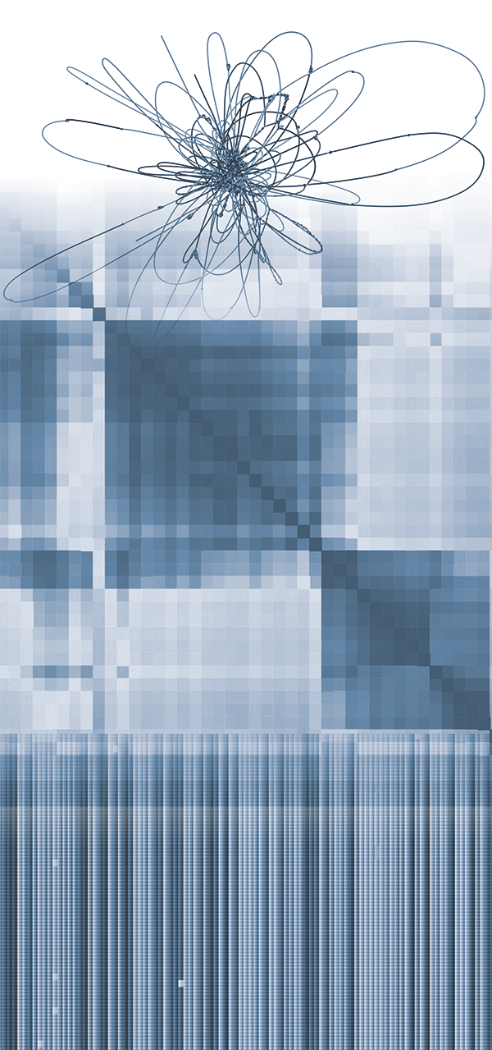
Overview
What is assembly?
Assembly approaches
Short-read assembly
Long-read assembly
Hybrid assembly
Validation
Annotation

Slide 3
Small Genome Assembly session setup
From your home directory, run the following command:
[jabbott@login2 ~]$ wget https://dag.compbio.dundee.ac.uk/workshops/downloads/assembly.sh
Now run
[jabbott@login2 ~]$ bash assembly.sh
You should now have an assembly directory - change into this…
[jabbott@login2 ~]$ cd assembly
Install mamba
[jabbott@login2 assembly] conda install -n base mamba
Create a conda environment for the session
[jabbott@login2 assembly] conda create -n assembly
[jabbott@login2 assembly] conda activate assembly

Slide 4
What is assembly?

Slide 5
Genome Assembly
Sequencing process involves fragmenting genome
Sequence of fragments obtained (reads)
Fragments mixed up during sequencing
Reads are shorter than genomes!
Assembly is process of combining reads into representation of original genome
Aim to recover as much of genome as possible
…and hopefully in the right order…
Ideal - 1 sequence per chromosome
de-novo assembly - uses no prior information

Slide 6
What is a small genome?
Essentially, genomes with
Low repetitive sequence content
Generally haploid
Approaches discussed appropriate for:
bacteria
viruses
some fungi
Much is relevant to more complex genomes
Additional considerations and complexity
https://en.wikipedia.org/wiki/Genome_size#/media/File:Tree_of_life_with_genome_size.svg
Notes:
'Small' genome is essentially my term to describe anything where the assembly is relatively tractable from a single sequence library
The dark blue organisms in this tree are bacteria, while the green are archaea and these are all good candidates for these approaches

Slide 7
Some terminology…
Term | Meaning
Assembly | Set of sequences representing genome
Component | Genomic sequence used to build genome (i.e. read pair)
Contig | Contiguous sequence created from set of components. Should contain no gaps
Scaffold | Ordered and oriented set of contigs. May contain gaps
Unlocalised sequence | Sequence in assembly associated with chromosome which can not be correctly positioned
Unplaced sequence | Unplaced sequence: sequence not associated with chromosome

Slide 8
Assembly Metrics
Metric | Meaning
Contig number | Total number of contigs
Scaffold number | Total number of scaffolds
Assembly length | Total number of bases in assembly
Total scaffold length | Sum of lengths of scaffolds
Largest contig | Length of longest contig
Largest scaffold | Length of longest scaffold
N50 | Length of shortest contig length to cover 50% of the genome
L50 | Number of contigs >= N50
N50 | Length of shortest contig length to cover 50% of the genome
L75/L90 | Number of contigs >= N75/N90
1
2
3
4
5
6
1
2
3
50%
2
N50
Notes:
N50 meaning is that half the genome is covered by contigs of length N50 or greater - essentially a weighted median. Calculated by sorting contigs by length and locating the contig containing the midpoint of the assembly - the length of this contig is the N50.

Slide 9
Coverage
Average of how many times a specific nucleotide represented in an assembly
10x coverage = each base included in 10 reads
Require multiple observations of sequence to obtain reliable base call
Reads cover genome in non-uniform manner
sampling of genome is random
Bases
Coverage

Slide 10
Lander/Waterman equation
$α= \frac{LN}{G}$ 1988 Genomics 2(3): 231-239
Assumes random read distribution across genome
Identified that coverage should follow Poisson distribution
Based on pre-NGS approaches
still broadly holds…
If we want 20x coverage of E.coli (3.6Mbp) using 2 x 100 bp reads
What if we use 2 x 250bp MiSeq reads?
$$α=coverage$$
$$N=read count$$
$$L=read length \\ G=haploid genome length$$
$$N=\frac{αG}{L}$$
$N=\frac{{3.6×10}^{6} × 20}{\left(2 × 100\right)}$ = 360000
$N=\frac{{3.6×10}^{6} × 20}{\left(2 × 250\right)}$ = 144000
Notes:
Lander/Waterman theory also allows for predicting gap number in an assembly but this is less used these days.

Slide 11
Sequencing Approaches

Slide 12
How do you eat an elephant?
In the old days…BAC-based sequencing
Many genomes too large to handle in one go…
Map-based sequencing
BAC library of overlapping 150kb fragments
Library 'fingerprinted' to identify common landmarks
Set of overlapping BACs identified which cover genome
Each BAC split into ~1.5kb fragments in M13 library
Sequence and assemble M13 library
Join overlapping BAC sequences

Slide 13
Whole Genome Shotgun (WGS) sequencing
Map-based sequencing very time consuming
Craig Venter (1996): WGS sequencing
Genome randomly fragmented into 2kb and 10kb plasmid libraries
500bp from both ends of each library fragment sequenced
Resulting pieces assembled computationally
Much more complex assembly than map-based
Now standard approach for genomic sequencing

Slide 14
Assembler types
2 major classes of contig assembler
Overlap-Layout-Consensus (OLC)
de Bruijn graph (DBG)
Other less common variants exist
String graph, Repeat graph
Sequence split at unresolvable repetitive sequences
OLC assemblers use overlaps to extend sequences
DBG initially assemblers reduce sequence to much smaller k-mers
Resulting contigs can then be scaffolded
Overlap
Error Correction
Layout
de Bruijn graph
Consensus
Refinement

Slide 15
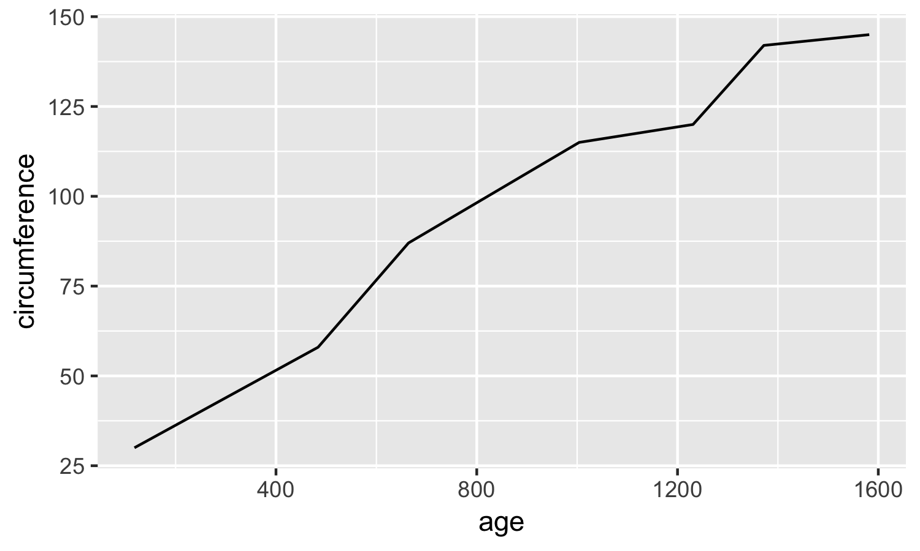
Graphs?
What to graphs have to do with this?
In graph theory, a graph
is a mathematical structure modelling relations between objects
consists of nodes representing objects
which are joined by edges, representing relationships
May be directed with asymmetric edges
E
A
C
D
B
F
This Photo by Unknown Author is licensed under CC BY-SA

Slide 16
Overlap-Layout-Consensus Assemblers
GGCGATGTTGACGACGTGTGCGATGTTGA
Pairwise identification of overlaps between reads
Read length = 10 bp
ATGTTGACGA
TGACGACGTG
ATGT
CGA
ATGTTGACGA
ATGTTGACGA
Overlap
GTTGACGACG
TGTGCGATGT
CGA
CGACGTGTGC
CGA
ATGT
ATGT
Layout
Consensus
Notes:
Generating overlaps may be done my pairwise all vs. all alignments, or faster techniques such as suffix trees.

Slide 17
Overlap-Layout-Consensus Assemblers
GGCGATGTTGACGACGTGTGCGATGTTGA
Pairwise identification of overlaps between reads
Read length = 10 bp
Layout overlap graph
Models all overlaps in one structure
Minimum overlap = 3 bp
Hamiltonian path created
ATGTTGACGA
GTTGACGACG
Overlap
TGACGACGTG
CGACGTGTGC
ATGTTGACGA
TGTGCGATGT
ATGTTGACGA
Layout
6
ATGTTGACACGA
TGACGACGTG
7
3
Consensus
CGACGTGTGC
8
8
GTTGACGACG
4
5
5
TGTGCGATGT
Notes:
Generating overlaps may be done my pairwise all vs. all alignments, or faster techniques such as suffix trees.
Hamiltoniant path visits each node once,based on edge weights

Slide 18
Overlap-Layout-Consensus Assemblers
GGCGATGTTGACGACGTGTGCGATGTTGA
Pairwise identification of overlaps between reads
Read length = 10 bp
Layout overlap graph
Models all overlaps in one structure
Minimum overlap = 3 bp
Hamiltonian path created
Consensus created
i.e. multiple sequence alignment
ATGTTGACGA
GTTGACGACG
Overlap
TGACGACGTG
ATGTTGACGACGTGTGCGATGT
CGACGTGTGC
TGTGCGATGT
Layout
Consensus
Notes:
OLC approaches were developed initially for use with Sanger-based sequencing projects. The sheer number of reads involved in a short-read NGS sequencing project make the scale of computation required to compute the overlaps untenable, while with short reads insufficient novel overlaps are created in repetitive regions for good contig assembly. As NGS reads have become longer these assemblers have gained more traction again.

Slide 19
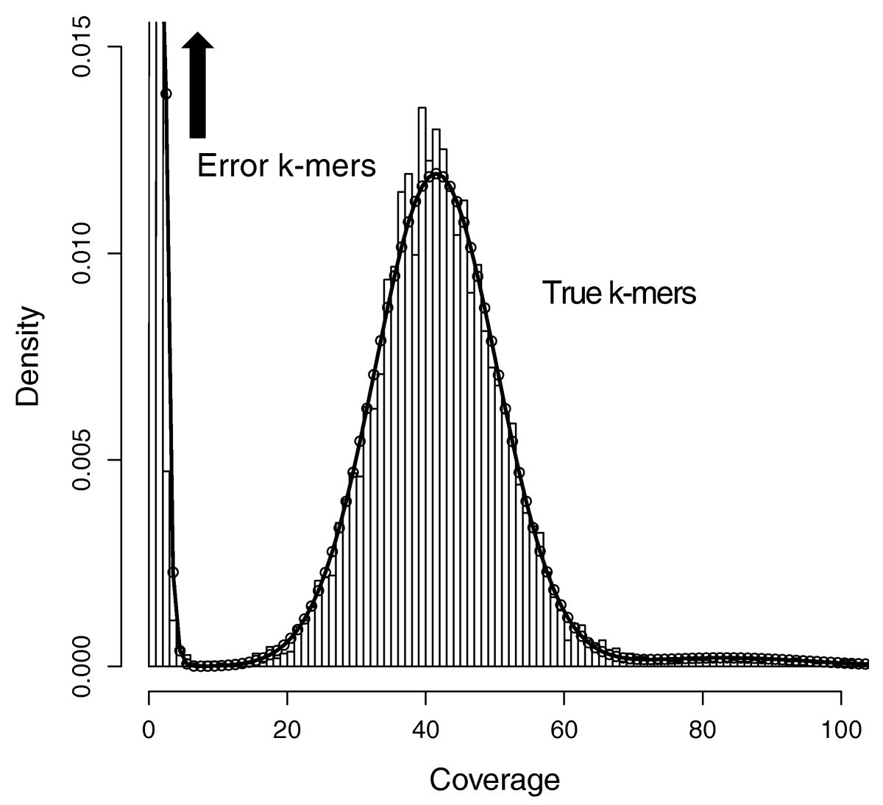
De Bruijn Graph (DBG) Assemblers
Directed graph representing overlaps of sequences
Use substrings of length k - k-mers
Error Correction
ATGTTGACGACGTGTCGTGTGT
ATGTT
TGTTG
GTTGA
TTGAC
TGACG
de Bruijn graph
GACGA
k=5
ACGAC
CGACG
GACGT
ACGTG
Refinement
CGTGT
GTGTC
TGTCG
GTCGT
TCGTG
CGTGT
GTGTG
TGTGT

Slide 20
De Bruijn Graph (DBG) Assemblers
k-mer split into 2 x k-1-mers - left and right
k-1-mers form nodes of graph
Directed edge between left and right k-1-mer
represents k-mer
ATGT
TGTT
GTTG
TTGA
ATGT
Error Correction
TGAC
ATGTT
TGTT
TGTTG
TGTT
GACG
GTTGA
GTTG
ACGA
TTGAC
de Bruijn graph
TGACG
ACGT
GACGA
CGAC
ACGAC
CGAC
CGACG
GACGT
GACG
TCGT
CGTG
ACGTG
Refinement
CGTGT
GTGTC
GTCG
TGTCG
TCGT
GTCGT
GTGT
TGTG
TCGTG
CGTG
CGTGT
CGTG
CGTG
GTGTG
TGTG
TGTC
GTGG
TGTG
TGTGT
GTGG

Slide 21
De Bruijn Graph (DBG) Assemblers
k-mer split into 2 x k-1-mers - left and right
k-1-mers form nodes of graph
Directed edge between left and right k-1-mer
represents k-mer
Graph walked following Eulerian path
Visits each edge once
Counter-intuitive approach
Initially reduces contiguity
Avoids pairwise sequence comparisons
ATGT
TGTT
GTTG
TTGA
Error Correction
TGAC
GACG
ACGA
de Bruijn graph
ACGT
CGAC
TCGT
CGTG
Refinement
GTCG
GTGT
TGTG
TGTC

Slide 22
De Bruijn Graph (DBG) Assemblers
Sequencing errors introduce noise
Tips
Cause premature graph termination
Contain correct and incorrect k-mers
Traced back to point of divergence
Removed if below threshold length
Bubbles
Path can reconnect with main graph
May be caused by sequencing error
Start of bubble identified
All paths through bubble walked
Lowest coverage path removed
Error Correction
n = 8
de Bruijn graph
n = 1
Refinement

Slide 23
DBG Assemblers: Choice of k-mer size
k-mers should be an odd length
Even length k-mer can form palindromes (own reverse complement)
Choice of k-mer length is a compromise
Repeats >k in length cause contig breaks
so longer is better
Longer k-mers
more likely to have errors
overlapping reads of <k do not share an edge: coverage gap breaks contig
so shorter is better…
Ideal k-mer also dependent upon read length
Also depends upon the genome you are assembling
Error Correction
de Bruijn graph
Refinement

Slide 24
Effect of changing k-mer length
Streptococcus pyogenes M1 GAS
Genome size ~ 2.1 Mbp
Illumina 2 x 250 bp paired end reads
Trimmed to Q30, min length 100 bp
Coverage ~ 250 x
Assembled with velvet
k = 51-191

Slide 25
k-mer coverage
DBG assemblers may report coverage for a contig
k-mer coverage not read coverage…
Where
$C_{k}$ is k-mer coverage
$C$ is read coverage
$k$ is k-mer size
$L$is read length
If
$C_{k}$ = 20
$L$ = 150
k = 99
$$C_{k}=C\left(\frac{L−k+1}{L}\right)$$
$$C=\frac{C_{k}}{\left(\frac{L−k+1}{L}\right)}$$
$$C=\frac{20}{\left(\frac{150−99+1}{150}\right)}$$
$=57.69$

Slide 26
Comparison of assembler types
 | OLC | DBG
Graph nodes | Reads | k-1-mers
Graph edges | Overlaps | k-mers
Path walking | Hamiltonian (NP hard) | Eulerian (linear time)
Computational barriers | Overlap generation - CPU intensive Path walking | Potentially high memory requirement
Better for | Longer reads at lower coverage | Shorter reads at higher coverage
Repeat handling | lower sensitivity to repeats | Higher sensitivity to repeats
Examples | Arachne, Celera Assembler, CANU | Velvet, SOAP de-novo, SPAdes

Slide 27
Short Read Assembly

Slide 28
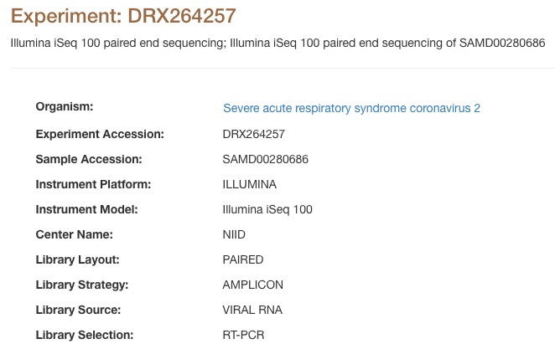
Short read assembly
Illumina data…
MiSeq offers 2 x 300 bp reads
Single library
We will start with a viral genome
Very small (30402 bp)
Quick to assemble
QC results:
https://dag.compbio.dundee.ac.uk/workshops/assembly/sars-cov2QC/sars-cov2QC.report.html
[jabbott@login1 ~]$ ls -1 sars-cov2 DRR274673_1.fastq.gz DRR274673_2.fastq.gz MN908947.fa MN908947.gff
Paired fastq reads
Genome sequence
GFF format annotations
Notes:
More complex genomes benefit from multiple libraries with different insert sizes, up to and including mate-pairs (although these are largely being replaced by long reads now).
These reads have been trimmed to Q20

Slide 29
A first assembly: velvet
Velvet: First DBG assembler to produce useful results
[jabbott@login1 ~]$ qrsh -pe smp 8
[jabbott@c6320-3-4 ~]$ cd assembly
[jabbott@c6320-3-4 assembly]$ mamba install velvet assembly-stats quast
Runs in two stages
velveth: prepares data for specified kmer size
[jabbott@c6320-3-4 assembly]$ velveth velvet 99 -shortPaired \ -fastq sars-cov2/DRR274673_1.fq.gz \ sars-cov2/DRR274673_2.fq.gz
velvetg: De bruijn graph construction and manipulation
[jabbott@c6320-3-4 assembly]$ export OMP_NUM_THREADS=8
[jabbott@c6320-3-4 assembly]$ velvetg velvet -ins_length 180
[jabbott@c6320-3-4 assembly]$ ls velvet/
contigs.fa Graph LastGraph Log PreGraph Roadmaps Sequences stats.txt
Assembly directory
Read type
k-mer size
Fastq files
Assembly directory
Insert size of library
Assembly: results/sars-cov2/velvet

Slide 30
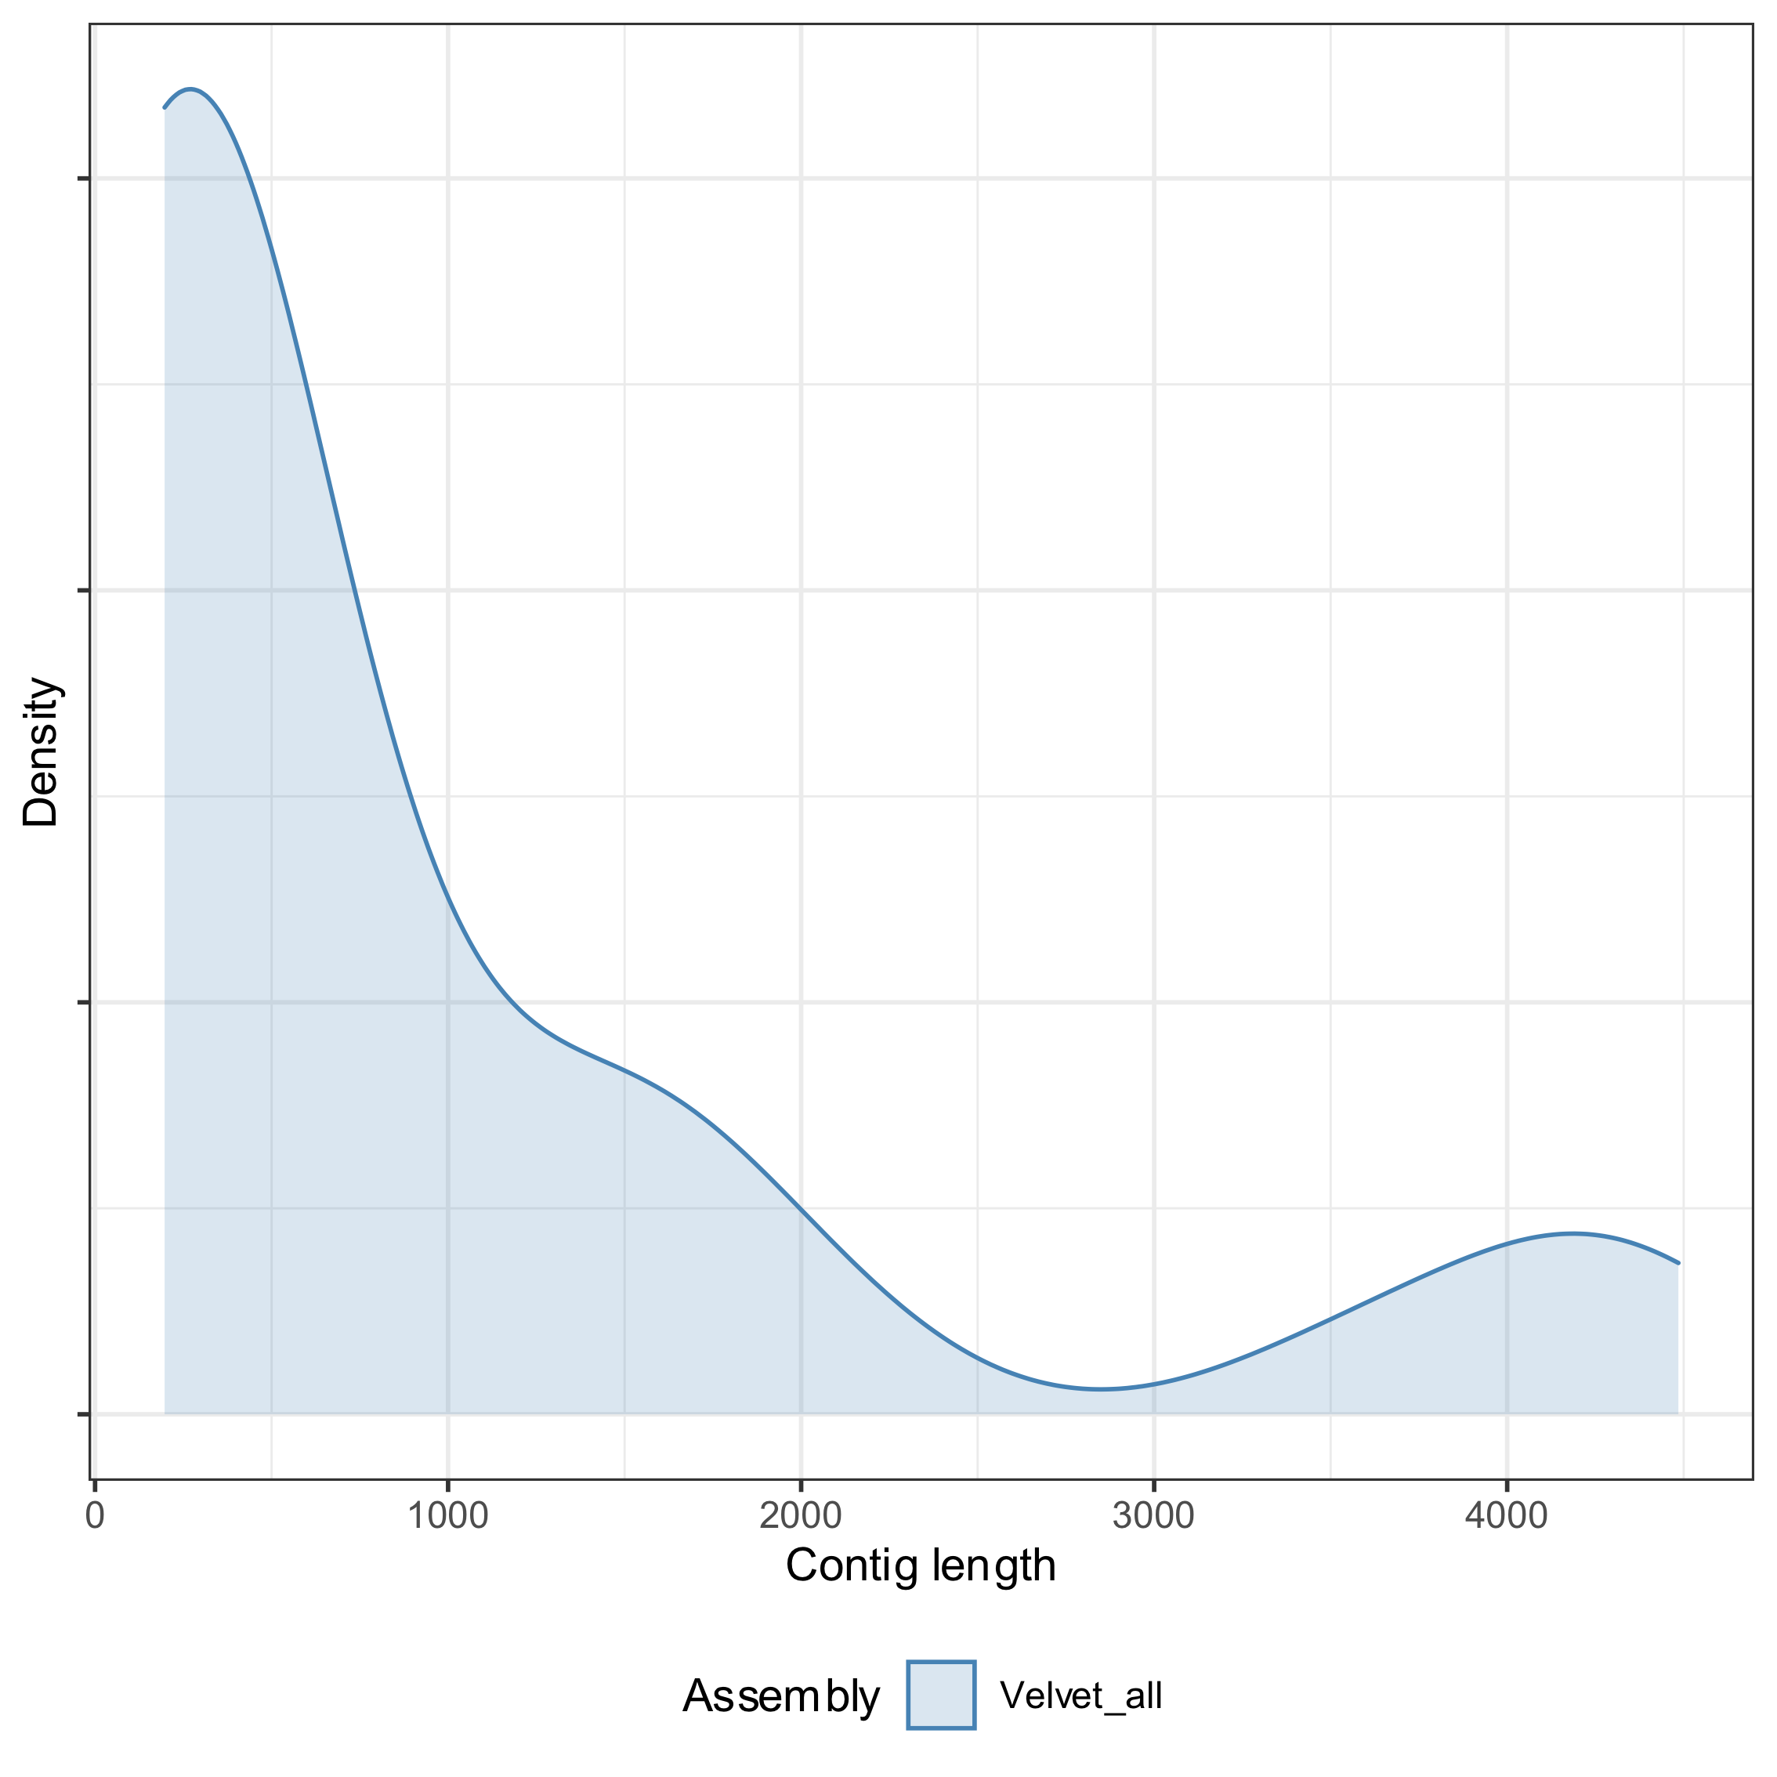
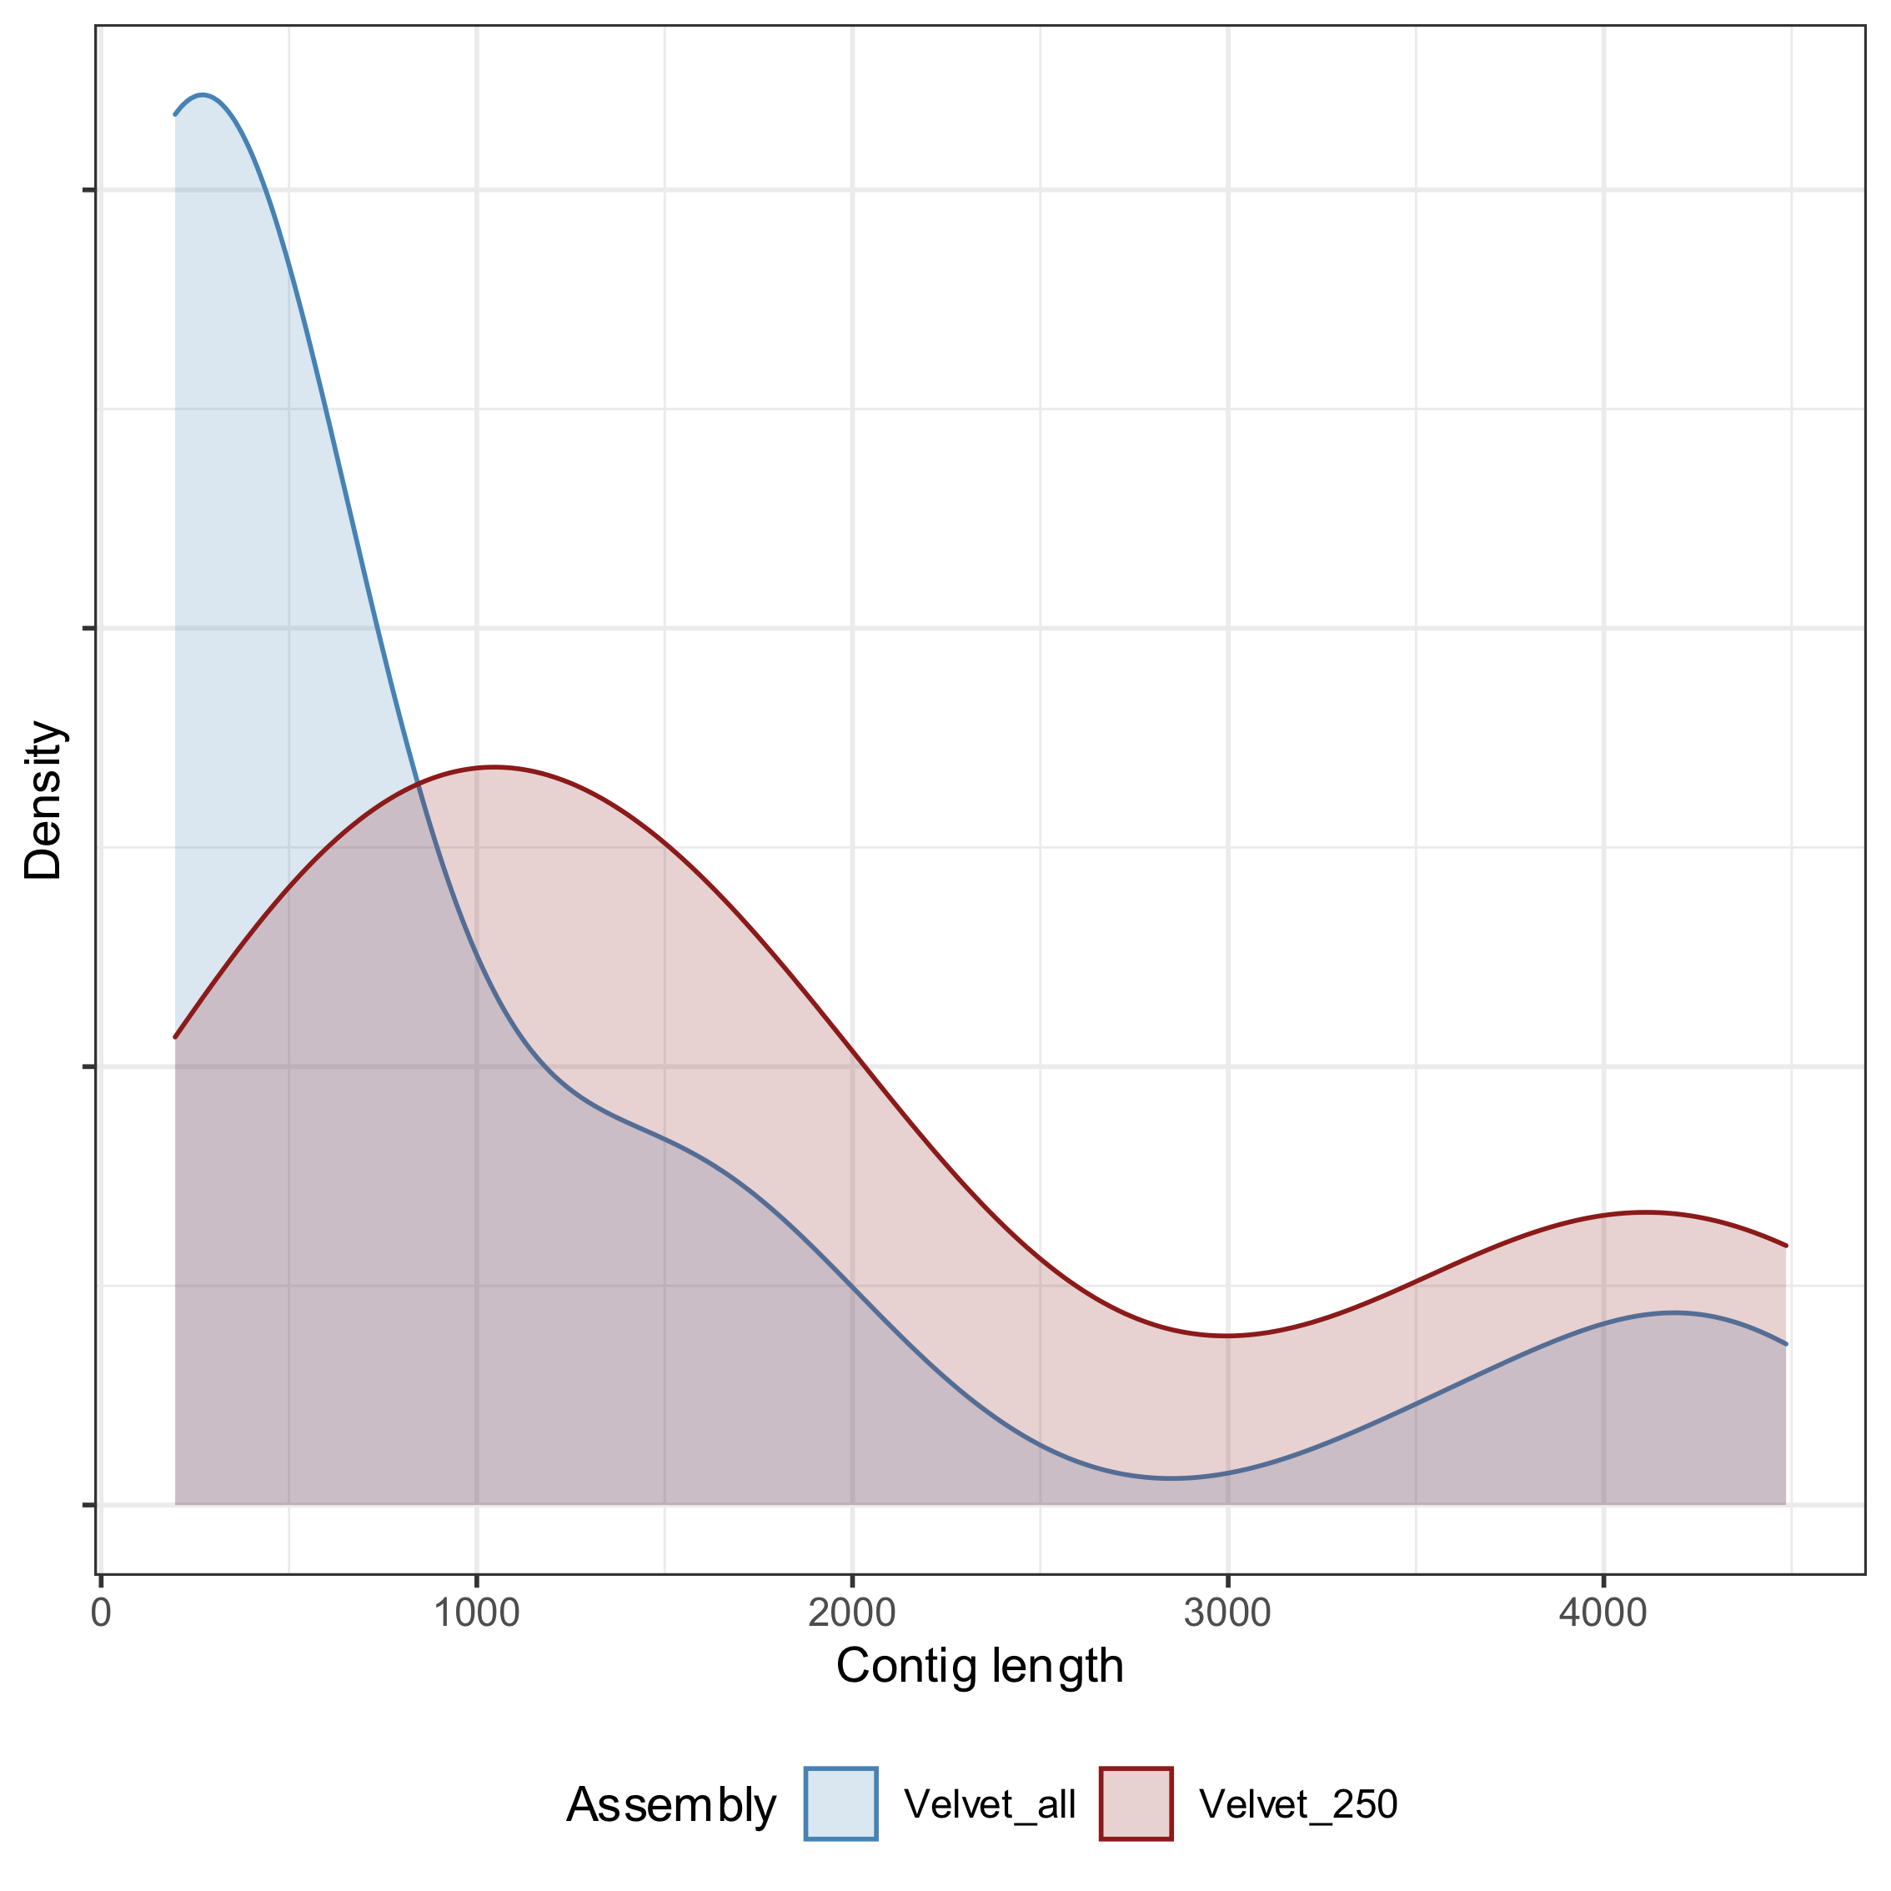
Velvet assembly: Some statistics
We can get some basic stats on our assembly:
[jabbott@c6320-3-4 assembly]$ assembly-stats velvet/contigs.fa stats for velvet/contigs.fa sum = 32324, n = 29, ave = 1114.62, largest = 4262 N50 = 2134, n = 5 N60 = 2071, n = 7 N70 = 1574, n = 9 N80 = 1199, n = 11 N90 = 636, n = 15 N100 = 197, n = 29 N_count = 0 Gaps = 0
Rerun velvetg adding -min_contig_lgth
[jabbott@c6320-3-4 assembly]$ velvetg velvet -ins_length 180 \ -min_contig_lgth 250
[jabbott@c6320-3-4 assembly]$ assembly-stats velvet/contigs.fa stats for velvet/contigs.fa sum = 29743, n = 16, ave = 1858.94, largest = 4262 N50 = 2134, n = 5 N60 = 2081, n = 6 N70 = 1753, n = 8 N80 = 1452, n = 10 N90 = 914, n = 12 N100 = 406, n = 16 N_count = 0 Gaps = 0
Notes:
Thought has to go into trimming short contigs, and at what stage to do it. I would tend to wait until after all scaffolding and finishing has been completed. ENA/NCBI do not accept contigs <200bp so these can be discarded. Depending on what you are doing you may consider trimming up to a 1kb threshold.

Slide 31
Assembly assessment: QUAST
Produces many assembly statistics
Standard metrics
Gene content
Potential misassembles (reference required)
Allows comparison of multiple assemblies
[jabbott@c6320-3-4 assembly]$ quast --glimmer -t 4 -o quast \ -r sars-cov2/MN908947.fa -g sars-cov2/MN908947.gff velvet/contigs.fa
Run gene finding with glimmer
Use 4 threads
Output directory
Fasta format genome sequence
GFF format annotations
Assembled contigs
Results: https://dag.compbio.dundee.ac.uk/workshops/assembly/sars_cov2_velvet_quast/report.html

Slide 32
SPAdes
Current small genome assembler of choice
Initial error correction stage (BayesHammer)
Supports multiple k-mers with automatic k-mer selection
Benefits from both short and long k-mers
Successive k-mer sizes add info to graph
Variants for
metagenomics (metaSPAdes)
plasmid recovery (plasmidSPAdes)
transcriptome assembly (rnaSPAdes)
Faster and more contiguous assembly
with high coverage bacterial or viral samples
Coverage cutoff
Output directory
[jabbott@c6320-3-4 assembly]$ mamba install spades
[jabbott@c6320-3-4 assembly]$ spades.py --isolate --cov-cutoff 100 -o spades -t 8 \ -1 sars-cov2/DRR274673_1.fq.gz \ -2 sars-cov2/DRR274673_2.fq.gz
Run 8 threads
Read 1 fastq file
Read 2 fastq file
Assembly: results/sars-cov2/spades
Notes:
--isolate argument actually disables bayeshammer, and enables --careful

Slide 33
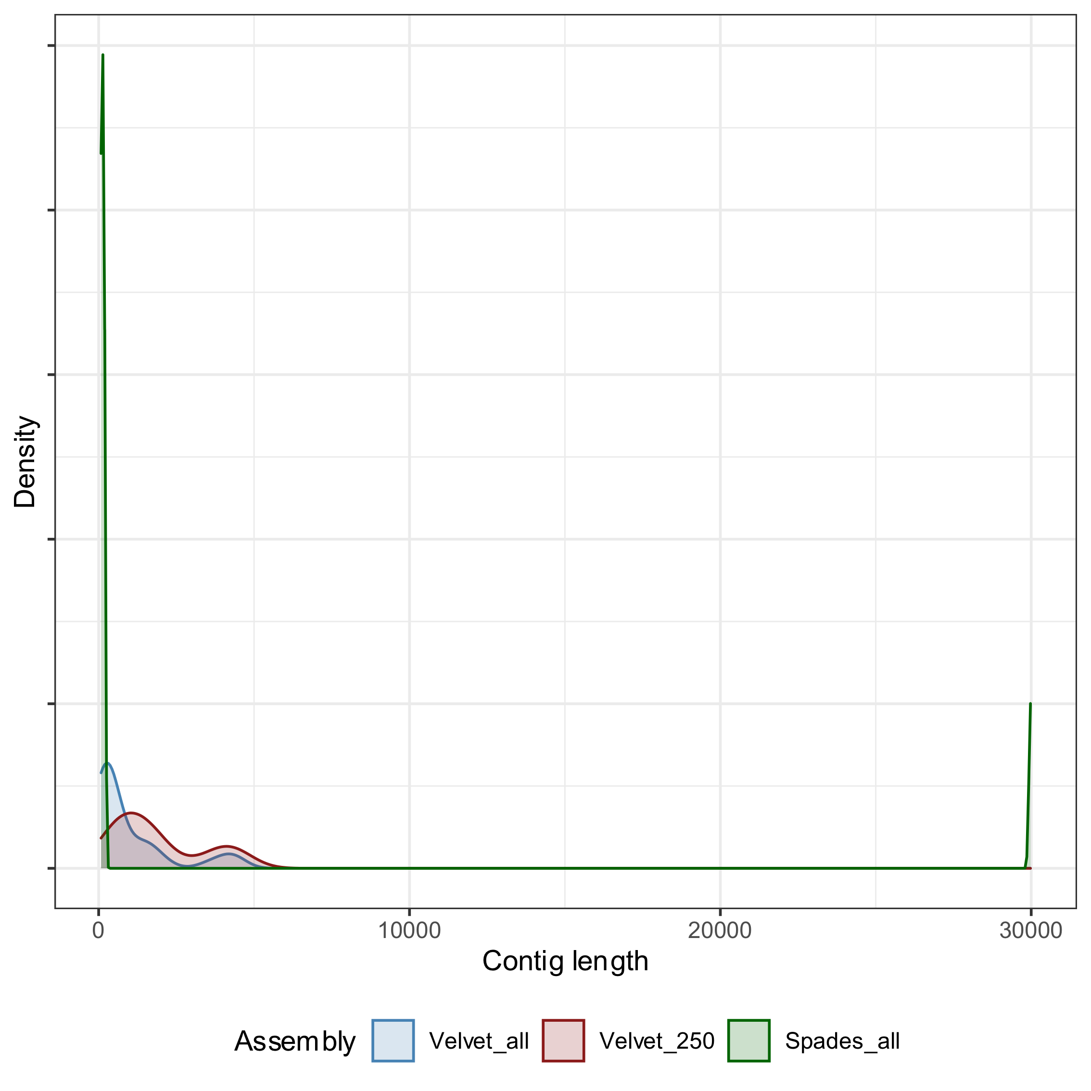
SPAdes assembly statistics
[jabbott@c6320-3-4 assembly]$ assembly-stats spades/contigs.fasta
assembly-stats spades/contigs.fasta stats for spades/contigs.fasta sum = 30825, n = 8, ave = 3853.12, largest = 29976 N50 = 29976, n = 1 N60 = 29976, n = 1 N70 = 29976, n = 1 N80 = 29976, n = 1 N90 = 29976, n = 1 N100 = 78, n = 8 N_count = 0 Gaps = 0
[jabbott@c6320-3-4 assembly]$ scripts/trim_contigs_to_len.py \ --contigs spades/contigs.fasta --min_len 250 \ --out spades/contigs_250.fasta [jabbott@c6320-3-4 assembly]$ assembly-stats spades/contigs_250.fasta stats for spades/contigs_250.fasta sum = 29976, n = 1, ave = 29976.00, largest = 29976 N50 = 29976, n = 1
Notes:
Remember velvet sum = 32324, n = 29, ave = 1114.62, largest = 4262 N50 = 2134, n = 5
250 bp trimmed:
sum = 29743, n = 16, ave = 1858.94, largest = 4262 N50 = 2134, n = 5

Slide 34
Graph Visualisation
Many DBG assembler output assembly graph
*.fastg, *.gfa
These can be used to view the assembly graph
Allows associations not represented in contigs to be explored
abg: produces html files
bandage: interactive GUI tool http://rrwick.github.io/Bandage/
SPAdes contigs.path file contains nodes incorporated in each contig
Notes:
Demo with spades sars-cov2 assembly

Slide 35
Today's Bug: Flavibacterium psychrophilum
Flavibacterium psychrophilum
Genome size ~ 2.7 Mbp
GC content ~ 33 %
Illumina 2 x 250 bp paired end reads
Trimmed to Q30, min length 100 bp
Coverage ~ 250 x
ONT MinIon data
2 flowcells
Coverage ~150 x

Slide 36
A bacterial SPAdes assembly
#!/bin/env bash
#$ -j y #$ -o job_logs/$JOB_NAME.$JOB_ID #$ -cwd #$ -pe smp 32 #$ -mods l_hard mfree 24
cp -v Flavobacterium/Illumina/SRR7447097_*gz ${TMPDIR}
spades.py -1 ${TMPDIR}/SRR7447097_1.fastq.gz -2 ${TMPDIR}/SRR7447097_2.fastq.gz \ --isolate -t 32 -m 24 --cov-cutoff auto -o ${TMPDIR}/Flavobacterium_spades
cp -Rv ${TMPDIR}/Flavobacterium_spades .
scripts/spades.sh
Notes:
Note that we set a memory threshold to stop it overrunning the requested job resource limit.
This should take about 5 minutes to run…we'll come back to it in a minute…

Slide 37
Assembly Assessment: BUSCO
How complete is the gene representation in your assembly?
Missing genes?
Fragmented genes?
Illumina bacterial assemblies:
Contig breaks tend to be in rRNA/tRNA clusters
Gene space tends to assemble well
"evolutionarily-informed expectations of gene content of near-universal single-copy orthologs"
Automatic lineage detection…
…but quicker if you can give it a clue…
[jabbott@c6320-3-4 assembly]$ conda create -n busco
[jabbott@c6320-3-4 assembly]$ conda activate busco
[jabbott@c6320-3-4 assembly]$ mamba install busco

Slide 38
Assembly assessment: BUSCO
[jabbott@c6320-3-4 assembly]$ busco -i [SEQUENCE_FILE] -l [LINEAGE] -o [OUTPUT_NAME] -m [MODE]
#!/bin/env bash
#$ -cwd #$ -j y #$ -o job_logs/$JOB_NAME.$JOB_ID #$ -pe smp 8
set -e
assembly=$1 outdir=$2
if [[ -z "${assembly}" ]] || [[ -z "${outdir}" ]]; then echo "Usage: $0 fasta_file outdir" exit 1 fi
if [[ ! -e "${assembly}" ]]; then echo "Specified fasta file (${assembly}) does not exist" exit 1 fi
busco -c 8 -l flavobacteriales_odb10 -i ${assembly} -o ${outdir} -m geno
[jabbott@c6320-3-4 assembly]$ qsub scripts/busco.sh spades/contigs.fa busco_spades
Assembled contigs
geno|tran|prot
See 'busco --list-datasets' for available lineages
--------------------------------------------------
|Results from dataset flavobacteriales_odb10 |
--------------------------------------------------
|C:99.5%[S:99.5%,D:0.0%],F:0.3%,M:0.2%,n:733 |
|729 Complete BUSCOs (C) |
|729 Complete and single-copy BUSCOs (S) |
|0 Complete and duplicated BUSCOs (D) |
|2 Fragmented BUSCOs (F) |
|2 Missing BUSCOs (M) |
|733 Total BUSCO groups searched |
--------------------------------------------------
scripts/busco.sh

Slide 39
Scaffolding

Slide 40
Scaffolding
Process of ordering and orientating contigs
Scaffolds may contain gaps ('NNNNN')
Contig placement information may come from:
Read pairs
Long read sequences
Reference sequence alignment
Many assemblers incorporate scaffolding
Single short insert library?
Number scaffolds ≈ Number contigs
Require source of info on larger scale organisation
Sequence multiple libraries
Use existing closely related sequence
risk of biasing assembly

Slide 41
Scaffolding with RagTag
[jabbott@c6320-3-4 assembly]$ conda create -n ragtag [jabbott@c6320-3-4 assembly]$ conda activate ragtag [jabbott@c6320-3-4 assembly]$ mamba install ragtag
Aligns contig sequences against reference genome
choice of algorithms: default - minimap2
Identifies correct contig placing and orientation
Produces 'N' gapped scaffolds
No sequence changes to contigs
Unplaced contig sequences added as separate scaffolds
#!/bin/bash
#$ -cwd #$ -j y #$ -o job_logs/$JOB_NAME.$JOB_ID
cp -v Flavobacterium_spades/contigs.fasta ${TMPDIR} cp -v Flavobacterium/NZ_CP007206.1.fa ${TMPDIR}
ragtag.py scaffold -r -o ragtag_spades \ ${TMPDIR}/NZ_CP007206.1.fa \ ${TMPDIR}/contigs.fasta
Output directory
Infer gap sizes
Reference fasta file
Assembled contig fasta file
scripts/ragtag_spades.sh

Slide 42
RagTag scaffolding results
[jabbott@c6320-3-4 assembly]$ less ragtag_spades/ragtag.scaffold.stats placed_sequences placed_bp unplaced_sequences unplaced_bp gap_bp gap_sequences 31 2299632 369 930262 525283 30
Remember:
Use existing closely related sequence
risk of biasing assembly
Hmm…
Sequenced isolate:
Reference:
GTDBTK classification of assembly: Flavobacterium columnare (3.2-3.4Mbp)
Try again with 3.26Mbp F. columnare genome
placed_sequences placed_bp unplaced_sequences unplaced_bp gap_bp gap_sequences
93 2985558 307 244336 179280 92
Use reference based scaffolding at your own risk!
????
Results: results/Flavobacterium/ragtag/
Notes:
These sequences were identified as F.psychrophilium by the depositors, but it looks like they misidentified them. GTDBTK reckons they are F. columnare (as do random blast searches I've done), which has a genome size of between 3.2. and 3.4 Mbp, which sits better with the assembly sizes we are seeing.
Rescaffolding using an F.columnare reference improves things but there are still a chunk of unplaced sequences and gaps.

Slide 43
AGP Format
Accessioned Golden Path Format (https://www.ncbi.nlm.nih.gov/assembly/agp/AGP_Specification/)
Long-standing format for describing assembly structure
Tab-delimited format
## agp-version 2.1 # AGP created by RagTag v2.0.0 NZ_CP007206.1_RagTag 1 13282 1 W NODE_50_length_13282_cov_83.686887 1 13282 - NZ_CP007206.1_RagTag 13283 109263 2 N 95981 scaffold yes align_genus NZ_CP007206.1_RagTag 109264 164783 3 W NODE_15_length_55520_cov_91.759392 1 55520 + NZ_CP007206.1_RagTag 164784 164883 4 U 100 scaffold yes align_genus
Linkage evidence with previous line? (gap lines)
Gap type (gap lines)
Type of linkage evidence (gap lines)
Header
Gap length (gap lines)
Component ID (non-gap lines)
Component orientation (non-gap lines)
End position of component
Component type
Component start (non-gap lines)
Object (i.e. scaffold) ID
Start position of component
Component number within object
Component types
W: WGS contig
U: Gap of unknown size
N: Gap of specified size
Component end (non-gap lines)
Notes:
Unknown gaps are given a length of 100bp by convention

Slide 44
Long Read Assembly

Slide 45
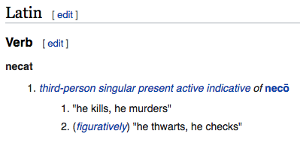
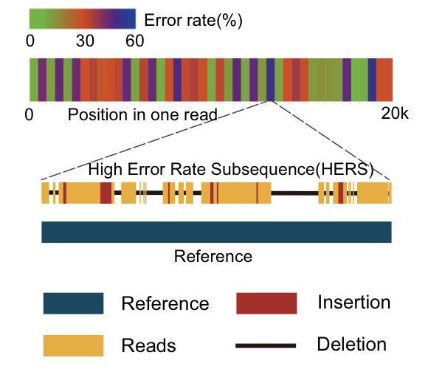
Long Read Assembly
Long reads have higher error rates
Overlap-based methods preferred
Two main approaches
Assemble contigs then correct errors
i.e. Flye, Raven
Correct reads then assemble contigs
i.e. CANU, Falcon
Generally more time consuming
NECAT
High-error rate subsequences normally trimmed
Reduces effective read length
Two stage error correction with two stage assembly
????
Chen et al (2021) https://doi.org/10.1038/s41467-020-20236-7

Slide 46
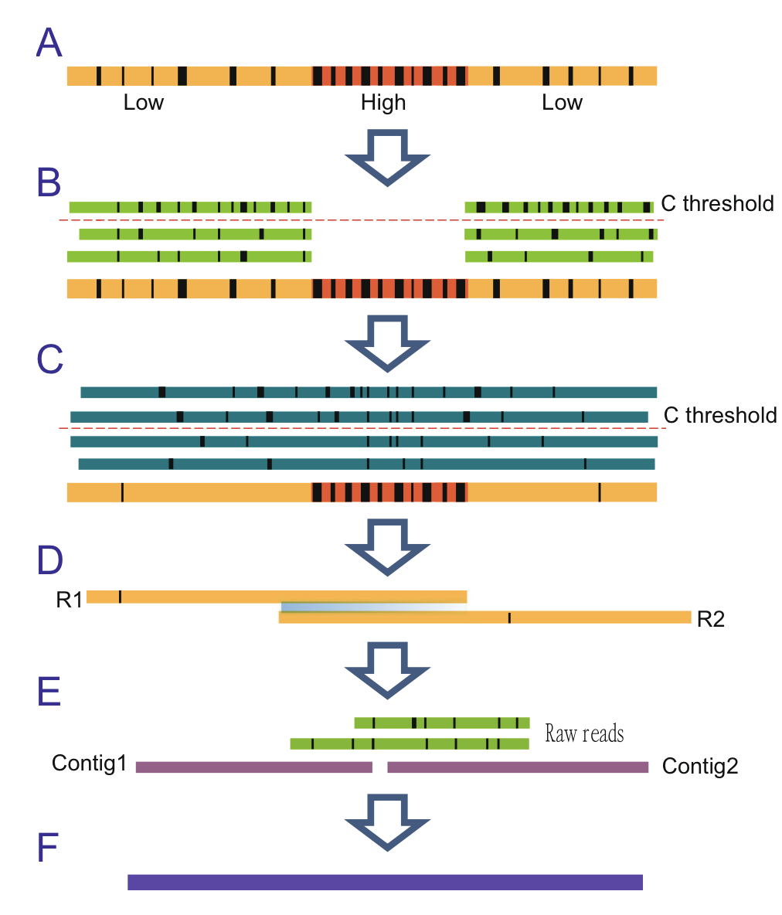
Long Read Assembly with NECAT
Reads contain regions of higher error
Not correlated with genomic location
For a read:
Supporting reads identified within error-rate threshold and aligned
Low-error rate sub-sequences corrected
More low-error rate sequences available
Corrected reads used to correct HERS
Read may be split at uncorrectible loci
Progressive assembly
Create high quality contigs from corrected reads
Bridge resulting contigs with long, uncorrected reads
Chen et al (2021) https://doi.org/10.1038/s41467-020-20236-7
Notes:
Identified that 12 supporting reads sufficient to fully correct low-error rate subsequences, so coverage threshold used to minimise alignment required

Slide 47
Running NECAT
[jabbott@c6320-3-4 assembly]$ conda install necat
Uses config file rather than arguments
[jabbott@c6320-3-4 assembly]$ mkdir necat [jabbott@c6320-3-4 assembly]$ cd necat [jabbott@c6320-3-4 necat]$ necat config \ flavobacterium.cfg
Edit the config file
PROJECT=flavobacterium ONT_READ_LIST=reads.txt GENOME_SIZE=2700000 THREADS=48
Create 'reads.txt' file
ls -1 ../Flavobacterium/MinIon > reads.txt
#!/bin/env bash
#$ -cwd #$ -j y #$ -o job_logs/$JOB_NAME.$JOB_ID #$ -pe smp 48
cp -R necat/* ${TMPDIR} cp Flavobacterium/MinIon/*gz ${TMPDIR} cd ${TMPDIR}
necat correct flavobacterium.cfg necat assemble flavobacterium.cfg necat bridge flavobacterium.cfg
cd - cp -R ${TMPDIR} necat
scripts/necat.sh
Notes:
Runtime is about 8 minutes

Slide 48
NECAT results
Final contigs:
flavobacterium/6-bridge_contigs/polished_contigs.fasta
[jabbott@c6320-3-4 assembly]$ assembly-stats polished_contigs.fasta
stats for polished_contigs.fasta sum = 3338042, n = 1, ave = 3338042.00, largest = 3338042 N50 = 3338042, n = 1 N60 = 3338042, n = 1 N70 = 3338042, n = 1 N80 = 3338042, n = 1 N90 = 3338042, n = 1 N100 = 3338042, n = 1 N_count = 0 Gaps = 0
Quast results
https://dag.compbio.dundee.ac.uk/workshops/assembly/necat_quast/report.html
Busco analysis
-------------------------------------------------- |Results from dataset flavobacteriales_odb10 | -------------------------------------------------- |C:0.8%[S:0.8%,D:0.0%],F:9.7%,M:89.5%,n:733 | |6 Complete BUSCOs (C) | |6 Complete and single-copy BUSCOs (S) | |0 Complete and duplicated BUSCOs (D) | |71 Fragmented BUSCOs (F) | |656 Missing BUSCOs (M) | |733 Total BUSCO groups searched | --------------------------------------------------
Results: results/Flavobacterium/necat/

Slide 49
Assembly Polishing

Slide 50
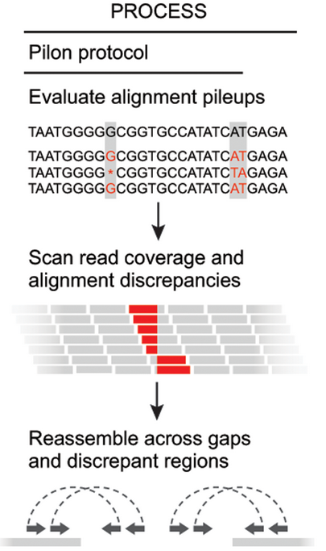
Assembly Polishing
Realignment of reads against assembly
Allows correction of assembly errors
Correction for ONT INDELs with Illumina data
PILON:
Requires BWA/Bowtie-2 BAM alignment
Can also call variants against reference
Attempts to close gaps in scaffolds
Corrects errors through local reassembly
[jabbott@c6320-3-4 assembly]$ mamba install bwa samtools pilon
Walker et al (2014) https://doi.org/10.1371/journal.pone.0112963

Slide 51
Running Pilon…
#!/bin/bash
#$ -cwd #$ -pe smp 16 #$ -mods l_hard mfree 32G #$ -j y #$ -o job_logs/$JOB_NAME.$JOB_ID
set -e
cp -v necat/flavobacterium/6-bridge_contigs/polished_contigs.fasta ${TMPDIR} cp -v Flavobacterium/Illumina/SRR7447097_* ${TMPDIR}
cd ${TMPDIR}
bwa index -p contigs polished_contigs.fasta bwa mem -M -t 16 contigs SRR7447097_1.fastq.gz SRR7447097_2.fastq.gz | \ samtools view -b -o assembly.bam -
samtools sort -@ 16 -o assembly.sorted.bam assembly.bam samtools index -@ 16 assembly.sorted.bam
pilon -Xmx32g --genome polished_contigs.fasta --frags assembly.sorted.bam --outdir pilon
cd - cp -v ${TMPDIR}/pilon/pilon.fasta necat
scripts/pilon_necat.sh
Notes:
Runtime is ~

Slide 52
PILON results from NECAT assembly
Job log:
Confirmed 3203257 of 3338042 bases (95.96%) Corrected 4194 snps; 1 ambiguous bases; corrected 41899 small insertions totaling 48918 bases, 5476 small deletions totaling 8708 bases
Assembly Stats
Before PILON Correction:
sum = 3338042, n = 1
After PILON Correction:
sum = 3379642, n = 1
Busco Analysis
------------------------------------------------- |Results from dataset flavobacteriales_odb10 | --------------------------------------------------|C:82.0%[S:82.0%,D:0.0%],F:13.6%,M:4.4%,n:733 | |601 Complete BUSCOs (C) | |601 Complete and single-copy BUSCOs (S) | |0 Complete and duplicated BUSCOs (D) | |100 Fragmented BUSCOs (F) | |32 Missing BUSCOs (M) | |733 Total BUSCO groups searched | --------------------------------------------------
Results: results/Flavobacterium/necat/pilon.fasta
Notes:
Assembly is 41600 bases shorter following correction due to the high number of insertions which were corrected.
Busco stats look much better now, but still not as good as from SPAdes assembly

Slide 53
Hybrid Assembly

Slide 54
Hybrid assembly
Combines multiple sequencing technologies
Typically mix of long and short reads
Build structure with long reads
Obtain accuracy from short reads
Many different approaches
Some combine methods we've looked at
Early approaches created per-technology assemblies then merged these
Higher cost
Need to sequence same isolate with multiple approaches
SPAdes supports hybrid assemblies
Just provide additional libraries
#!/bin/env bash
#$ -j y #$ -o job_logs/$JOB_NAME.$JOB_ID #$ -cwd #$ -pe smp 32 #$ -mods l_hard mfree 24
set -e
cp -v Flavobacterium/Illumina/SRR7447097_*gz ${TMPDIR} cp -v Flavobacterium/MinIon/*gz ${TMPDIR}
spades.py -1 ${TMPDIR}/SRR7447097_1.fastq.gz \ -2 ${TMPDIR}/SRR7447097_2.fastq.gz \ --nanopore ${TMPDIR}/SRR7447098_1.fastq.gz \ --nanopore ${TMPDIR}/SRR7449788_1.fastq.gz \ --isolate -t 32 -m 24 --cov-cutoff auto \ -o ${TMPDIR}/Flavobacterium_spades_hybrid
cp -Rv ${TMPDIR}/Flavobacterium_spades_hybrid .
scripts/spades_hybrid.sh
Notes:
Runtime: 11.5 mins

Slide 55
Hybrid SPAdes outputs
Illumina only assembly-stats output:
sum = 3229894, n = 400, ave = 8074.73, largest = 306449 N50 = 62334, n = 13
Contigs trimmed to 1000 bp
sum = 3149697, n = 98, ave = 32139.77, largest = 306449 N50 = 66010, n = 12
BUSCO output -------------------------------------------------- |Results from dataset flavobacteriales_odb10 | -------------------------------------------------- |C:99.5%[S:99.5%,D:0.0%],F:0.3%,M:0.2%,n:733 | |729 Complete BUSCOs (C) | |729 Complete and single-copy BUSCOs (S) | |0 Complete and duplicated BUSCOs (D) | |2 Fragmented BUSCOs (F) | |2 Missing BUSCOs (M) | |733 Total BUSCO groups searched | --------------------------------------------------
Hybrid assembly-stats output:
sum = 3373060, n = 103, ave = 32748.16, largest = 1647309 N50 = 746636, n = 2
Contigs trimmed to 1000 bp
sum = 3353968, n = 8, ave = 419246.00, largest = 1647309 N50 = 746636, n = 2
BUSCO output -------------------------------------------------- |Results from dataset flavobacteriales_odb10 | -------------------------------------------------- |C:99.6%[S:99.5%,D:0.1%],F:0.1%,M:0.3%,n:733 | |730 Complete BUSCOs (C) | |729 Complete and single-copy BUSCOs (S) | |1 Complete and duplicated BUSCOs (D) | |1 Fragmented BUSCOs (F) | |2 Missing BUSCOs (M) | |733 Total BUSCO groups searched | --------------------------------------------------
Results: results/Flavobacterium/spades_hybrid

Slide 56
Unicycler
Constructs initial DBG graph with SPAdes at range of k-mer sizes
Each graph scored based on contig number and dead-ends
Best selected
Contig multiplicity determined
How many times is each contig represented?
Based on read depth and contiguity
Short read bridges join single copy contigs
Paired-read information from SPAdes graph identifies additional bridges
Wick et al. (2017) https://doi.org/10.1371/journal.pcbi.1005595
Notes:
Multiplicity - read-depth varies with copy number i.e. plasmids. Repeat contigs generally have multiple graph connections, while single copy contigs are connected once. Short

Slide 57
Unicycler
Long reads aligned to single copy contigs
Consensus sequence of aligned reads found
Identifies long read based bridges between contigs
Identified bridges scored then applied to graph
Overlapping contig ends removed
Assembly polished with PILON
Three modes:
Conservative
Normal
Bold
Can take a looooong time (comparatively…)
Wick et al. (2017) https://doi.org/10.1371/journal.pcbi.1005595
Notes:
Quality scores assigned to each bridge based upon number of reads supporting bridge, alignment quality between read consensus and graph path, length of contigs bridged, and read depth consistency between contigs. An ideal long-read bridge there- fore connects two long contigs of the same depth, is supported by many reads with long alignments to the contigs, and has a graph path in close agreement with the read sequences.
Bridges then applied in order of decreasing quality before assembly graph finalised. SPAdes contigs may overlap at ends, so these overlaps between neighbours are removed. Circular replicons should now be single contig with link between start and end. dnaA or repA genes identified to indicate replication origin. Finally, pilon used to polish assembled contigs and reduce error.
Different run modes offer choice between bridge quality cutoffs.
Conservative mode least likely to produce complete assembly, but also unlikely to produce misassemblies: Good where accuracy important
Bold mode most likely to produce complete assembly, at risk of introducing misassemblies - use if contiguity important
Normal mode offers a best-of-both-worlds approach.

Slide 58
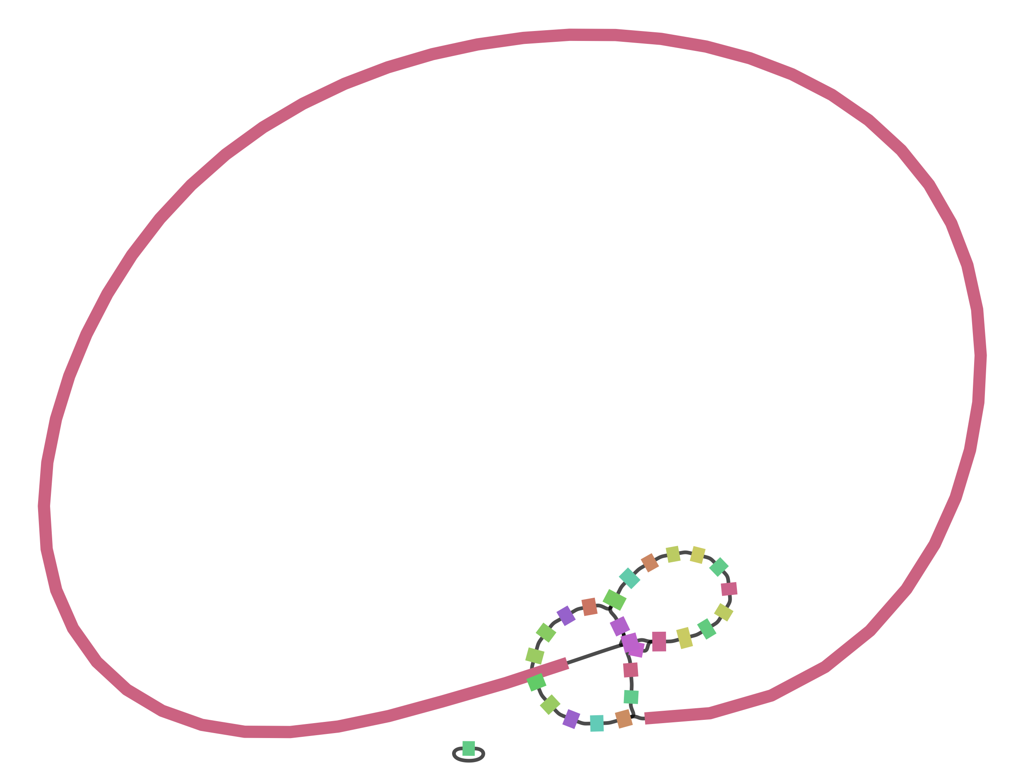
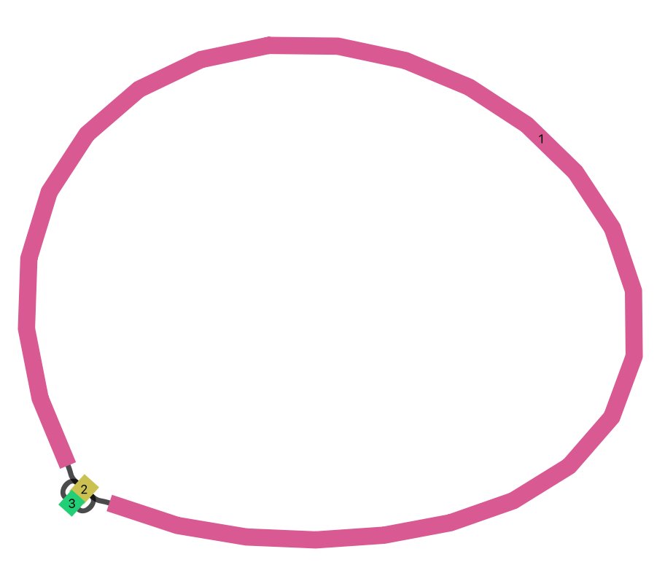
Running Unicycler
[jabbott@c6320-3-4 assembly]$ conda create -n unicycler
[jabbott@c6320-3-4 assembly]$ conda activate unicycler
[jabbott@c6320-3-4 assembly]$ mamba install unicycler
Normal mode
stats for Flavobacterium_unicycler/assembly.fasta
sum = 3339132, n = 18, ave = 185507.33, largest = 3323406 N50 = 3323406, n = 1
Bold mode
sum = 3351088, n = 3, ave = 1117029.33, largest = 3344008 N50 = 3344008, n = 1
#!/bin/bash
#$ -cwd #$ -pe smp 24 #$ -mods l_hard mfree 16G #$ -j y #$ -o job_logs/$JOB_NAME.$JOB_ID
mkdir ${TMPDIR}/reads cp -v Flavobacterium/Illumina/* ${TMPDIR}/reads
for file in $(ls Flavobacterium/MinIon/*gz); do cat ${file} >> ${TMPDIR}/reads/MinIon.fastq.gz done
unicycler -1 ${TMPDIR}/reads/SRR7447097_1.fastq.gz \ -2 ${TMPDIR}/reads/SRR7447097_2.fastq.gz \ -l ${TMPDIR}/reads//MinIon.fastq.gz -t 24 \ -o ${TMPDIR}/Flavobacterium_unicycler
cp -Rv ${TMPDIR}/Flavobacterium_unicycler .
scripts/unicycler.sh Results: results/Flavobacterium/unicycler
Notes:
I've hit some dependancy conflicts with other tools we've used today, so install unicylcer in a separate environment.
Much longer runtime: 7.5 hours!

Slide 59
Annotation

Slide 60
Prokka
Automated annotation
Coding gene identification: Prodigal
tRNA identification: Aragorn
rRNA identification: Barrnap
ncRNA similarity searching: Infernal
Coding gene functional annotation:
Initial BLAST
Unidentified proteins? HMMER
Annotation terms 'cleaned' for ENA/NCBI submission
#!/bin/bash
#$ -cwd #$ -j y #$ -o job_logs/$JOB_NAME.$JOB_ID #$ -pe smp 8
prokka --outdir prokka --addgenes --cpus 8 \ --rfam Flavobacterium_unicycler/assembly.fasta
Extension | Content
.faa | Predicted protein sequences (fasta)
.ffn | Predicted transcripts (fasta)
.gbk | Genbank format annotated genome records
.gff | GFF3 format annotated features
scripts/prokka.sh Results: results/Flavobacterium/prokka
Notes:
Annotation can be view using artemis:demo

Slide 61
Take-home messages for bacterial assembly
Illumina based SPAdes assembly (single library):
Most accurate contigs
Some unresolvable repeats
Nanopore alone:
Great contiguity
Reduced BUSCO coverage due to INDELs
Errors remain following polishing
Best overall: Hybrid ONT/Illumina assembly
Some final manual cleaning required
Reference based scaffolding:
You are at the mercy of your reference sequences…

