Slide 1
Read Mapping
Dr. James Abbott
j.abbott@dundee.ac.uk

Slide 2
Read Mapping session setup
From your home directory, run the following command:
    [jabbott@login2 ~]$ wget https://dag.compbio.dundee.ac.uk/workshops/downloads/read_mapping.sh
Now run
    [jabbott@login2 ~]$ bash read_mapping.sh
  You should now have a read_mapping directory - change into this…
    [jabbott@login2 ~]$ cd read_mapping
  Create a conda environment for the session
    [jabbott@login2 read_mapping] conda create -n read_mapping
    [jabbott@login2 read_mapping] conda activate read_mapping

Slide 3
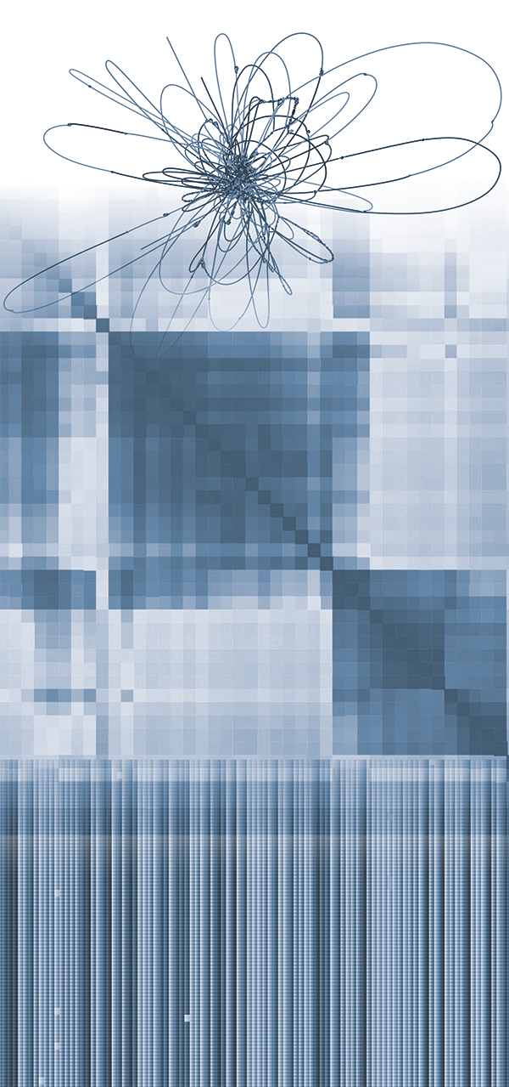
Overview
Alignment basics
NGS alignment issues
Reference sequences
BWA
Minimap2
File formats
Post-processing
Viewing alignments in genome browsers
Multi-mapping reads
DAG Workflows for alignment

Slide 4
Why map reads?
Sequence reads represent isolated regions of sequence out of context
Many analysis approaches require knowledge of
  Read locations on reference sequence
  Differences between reads and reference sequence

Slide 5
Sequence Alignment

Slide 6
Sequence alignment basics
Alignment of two sequences originally carried out…
  To identify subsequences which are positionally similar
  To uncover evolutionary relationships
First optimal alignment of two sequences: Needleman and Wunsch (1970)
  Dynamic programming
  Global alignment:
    optimal alignment of full length of sequences
    Attempt to align every base between sequences
    Conserved domains may not be aligned
  --T—-CC-C-AGT—-TATGT-CAGGGGACACG—A-GCATGCAGA-GAC
  | || | || | | | ||| || | | | || |
  AATTGCCGCC-GTCGT-T-TTCAG----CA-GTTATG—T-CAGAT--C
Notes:
Dynamic programming relates optimal alignment of two sequences to optimal alignment of shorter substrings. Subproblems ordered to avoid repeated computation of same data.
Global alignment useful when sequences similar in entirety…local similarities may be missed

Slide 7
Local alignments
Optimal alignment of substring within sequences
Useful for identifying locally conserved regions
ACTACTAGATTACTTACGGATCAGGTACTTTAGAGGCTTGCAACCA
|||| |||||| |||||||||||||||
TACTCACGGATGAGGTACTTTAGAGGC
Smith-Waterman (1981) modification of Needleman-Wunsch

Slide 8

Alignment scoring
How do you asses if one alignment is better than another?
Scoring – reward similarity, penalise differences
    GCATCATCTCCG
    || |||| ||||
    GCTTCATGTCCG
i.e. (from BLAST):
  Match: score +1
  Mismatch: score -2
10 matches and 2 mismatches = $\left(10 × 1\right)+\left(2 × −2\right)=6$

Slide 9
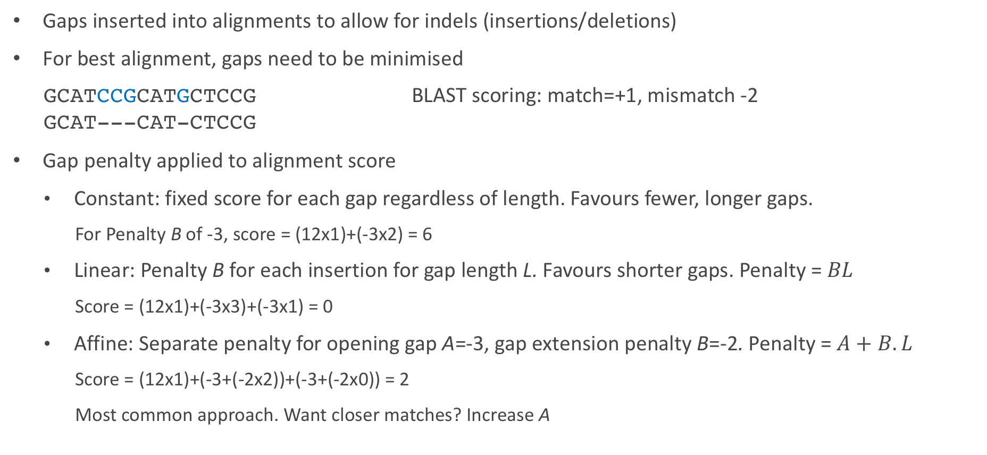
Gap penalties
Gaps inserted into alignments to allow for indels (insertions/deletions)
For best alignment, gaps need to be minimised
    GCATCCGCATGCTCCG BLAST scoring: match=+1, mismatch -2
    GCAT---CAT-CTCCG
Gap penalty applied to alignment score
  Constant: fixed score for each gap regardless of length. Favours fewer, longer gaps.
    For Penalty B of -3, score = (12x1)+(-3x2) = 6
  Linear: Penalty B for each insertion for gap length L. Favours shorter gaps. Penalty = $BL$
    Score = (12x1)+(-3x3)+(-3x1) = 0
  Affine: Separate penalty for opening gap A=-3, gap extension penalty B=-2. Penalty = $A+B.L$
    Score = (12x1)+(-3+(-2x2))+(-3+(-2x0)) = 2
    Most common approach. Want closer matches? Increase A

Slide 10
k-tuple/word algorithms
Dynamic programming (DP) computationally expensive
Database searching requires better performance
Heuristic algorithms:
  not guaranteed to find optimal solution
  exclude large parts of database from DP comparison
  Identify candidates with short stretches of similarity of length k
  Only carry out DP on candidate sequences

Slide 11
NGS Alignments

Slide 12
NGS arrives…
Requirement to align many millions of reads against databases
Existing approaches far too slow
Fresh approaches required
Now >70 NGS read aligners
These differ in
  Speed
  Accuracy
  Approach
  Purpose
Choosing which to use not always straightforward

Slide 13
The Mapping Problem
?
Notes:
Aim of mapping is to determine location in a reference sequence from which read originates, <click> in this case looking at a paired-end reads.
In most cases, we aren't looking for an exact match between the read and the reference sequence, as a result of natural sequence variation, and needing to allow for sequencing error. We therefore need to allow for small number of mismatches, insertions and deletions
<click> We also have to consider repeat regions, which may result in the multiple potential mapping loci

Slide 14
The Mapping Problem
Fragment size
Notes:
In the case of paired reads, we need to consider if the mapped pair of reads are
An appropriate distance apart
On the correct strands
In the correct orientation
…and if not is this due to mismapping, or structural variation?

Slide 15
The Mapping Problem
Exon 1
Exon 2
Transcript
Notes:
In the case of RNA-Seq, reads may also span splice sites so the aligner will need to cope with long gaps in the alignment

Slide 16
Approximate string matching
Want: all approximate matches between sequences where similarity score above threshold, or distance measure below a threshold
Similarity score: defined by optimal alignment which minimises number (or weight) of edits, or has maximum score
Distance threshold between two sequences
  Hamming distance: number of positions at which symbols are different (substitutions only)
  Levenshtein/edit distance: Number of single character deletions, insertions or substitutions required to transform one string into another
  Weighted edit distance: Different penalties for indels and substitutions
AACTAGA-AC-TACTGA
AA-TACAGACTTAC-GA
Matches: Black (12)
Insertions/Deletions (INDELs): Blue (4)
Mismatches: Red (1)
Hamming distance = 1
  Edit distance = 5
  Different technologies need different scoring
Example from Canzar and Salzberg (2017) http://doi.org/10.1109/JPROC.2015.2455551
Notes:
Illumina has a higher frequency of substitutions to indels, whereas pacbio and nanopore show greater numbers of indels than substitutions

Slide 17
Approximate string matching: scaling up
Need to handle billions of reads
Two approaches:
  Filtering:
    exclude large sections of reference where no approximate match
    i.e. find matches of perfect seed of length k match and ignore remainder of reference (k-tuple/word match)
  Indexing:
    Pre-process reference, or reads, or both
      Suffix array – linear time in relation to reference length
      FM-index/Burrows-Wheeler Transform - linear time in relation to reference length, economic memory usage
  Gruesome details: Reinert et al (2015) https://doi.org/10.1146/annurev-genom-090413-025358
  Canzar and Salzberg (2017) https://doi.org/10.1109/JPROC.2015.2455551

Slide 18
Choosing a read mapper
What is the best mapper?
There isn't one…
Many options with different capabilities
  Paired ends?
  Read length?
  Gapped alignment?
  Use quality scores?
  Splice aware?
Choice should be guided by your experiment
General recommendations:
  WGS/Exome alignment: BWA,Bowtie2
  Long reads: minimap2
  Bisulphite sequencing: bismarck
  RNA-Seq analysis: STAR, HISAT2
  Structural variation analysis: mrFAST
Basic process similar for most mappers
  We'll use BWA today for genomic alignments

Slide 19
Preparing your reference sequence

Slide 20
Choosing a reference sequence
What to align your reads to…
  Genome? Transcriptome?...it depends…
  Think about your experiment
  Include full range of sequences likely to be in samples
    EBV? Host genome?
Your sample will almost never be identical to the reference sequence
  What is the closest related sequence?
  Is this the most useful? How complete is it?
Starting point is a fasta formatted representation of your reference
Beware of different genome versions
  Version and source should be reported in publications

Slide 21
Genome Reference Consortium
Maintenance of major reference genomes
Major releases
  Infrequent
  Affect co-ordinates
  Moving results between releases requires co-ordinate 'lift-over'
    See https://www.biostars.org/p/65558/
Patch releases
  More frequent
  Allow fixes to be applied without affecting co-ordinates
Naming convention: GRCx00.p0
Genome | GRC Name | Alternative | UCSC
Human | GRCh37 GRCh38 | b37 b38 | hg19 hg38
Mouse | GRCm38 NCBI37 |  | mm10 mm9
Zebrafish | GRCz11 |  | danRer11
Chicken | GRCg6a |  | galGal6
Major version number
Patch number
h=human m=mouse z=zebrafish g=chicken

Slide 22
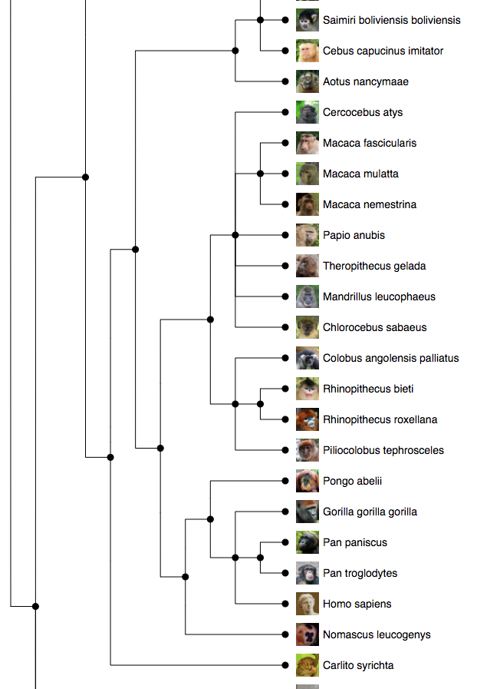
Where to find reference sequences
GRC: https://www.ncbi.nlm.nih.gov/grc
Ensembl: http://www.ensembl.org
  Wide range of annotated genomes
  Non-vertebrates: http://ensemblgenomes.org
  FTP downloads: http://www.ensembl.org/info/data/ftp/index.html
  Many options:
    'dna' – unmasked genomic DNA sequence
    'dna_rm' – Repeats and low complexity regions masked with 'N'
    'dna_sm' – Repeats and low complexity regions in lower case
    'toplevel' – chromosomes, unplaced scaffolds, alternate haplotypes
    'primary assembly' – as above without alternate haplotype
    i.e. Homo_sapiens.GRCh37.dna.toplevel.fa.gz
ENA: http://www.ebi.ac.uk/ena

Slide 23
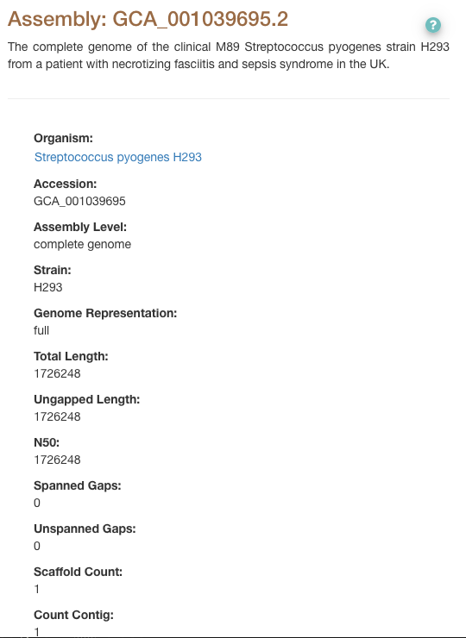
Our reference: S. pyogenes H293
https://www.ebi.ac.uk/ena/browser/view/GCA_001039695.2
Data in 'reference' directory is from Ensembl
  H293.fa: fasta formatted genome sequence
  H293.gff3: GFF3 formatted annotations

Slide 24
Creating a BWA index
First…we need to install BWA
[jabbott@login2 ~]$ qrsh
[jabbott@c6320-3-4 ~]$ cd read_mapping/reference
[jabbott@c6320-3-4 ~]$ conda install bwa
BWA has multiple subcommands…
[jabbott@c6320-3-4 ~]$ bwa index
Usage: bwa index [options] <in.fasta>
Options: -a STR BWT construction algorithm: bwtsw, is or rb2 [auto]
-p STR prefix of the index [same as fasta name]
[jabbott@login2 ~]$ bwa index –p H293 H293.fa
This is a small genome so indexing is very quick
[jabbott@c6320-3-4 reference] $ ls
H293.fa H293.fa.amb H293.fa.ann H293.fa.bwt H293.fa.pac H293.fa.sa H293.gff3

Slide 25
Further indexes…
Some programs need indexes of the fasta file in different formats
Two different formats: fai and dict
Can be created by samtools
[jabbott@ c6320-3-4 reference]$ conda install samtools
Run 'samtools' for a list of available subcommands
Run 'samtools [commandName]' for help on a command
    [jabbott@ c6320-3-4 reference]$ samtools faidx H293.fa
    [jabbott@ c6320-3-4 reference]$ samtools dict –o H293.dict H293.fa
    Check directory contents with 'ls' after running each command
    Both .dict and .fai indexes are plain text, so can be viewed with 'less’
    [jabbott@ c6320-3-4 reference]$ exit
Notes:
Fasta index format:
NAME Name of this reference sequence
LENGTH Total length of this reference sequence, in bases
OFFSET Offset within the FASTA file of this sequence's first base
LINEBASES The number of bases on each line
LINEWIDTH The number of bytes in each line, including the newline

Slide 26
BWA

Slide 27
BWA
Not recommended for sequences with error rate > 2%
Three different algorithms
  BWA Backtrack (aln)
    Illumina reads <100bp
    Two stage process – find coordinates of read, followed by generation of alignments (either SE or PE)
  BWA-SW
    Outputs alignments directly
    Suitable for reads from 70bp upwards
  BWA-MEM
    Reads from 70bp – 1Mbp
    Considerably faster than BWA-SW
    Normally method of choice…

Slide 28
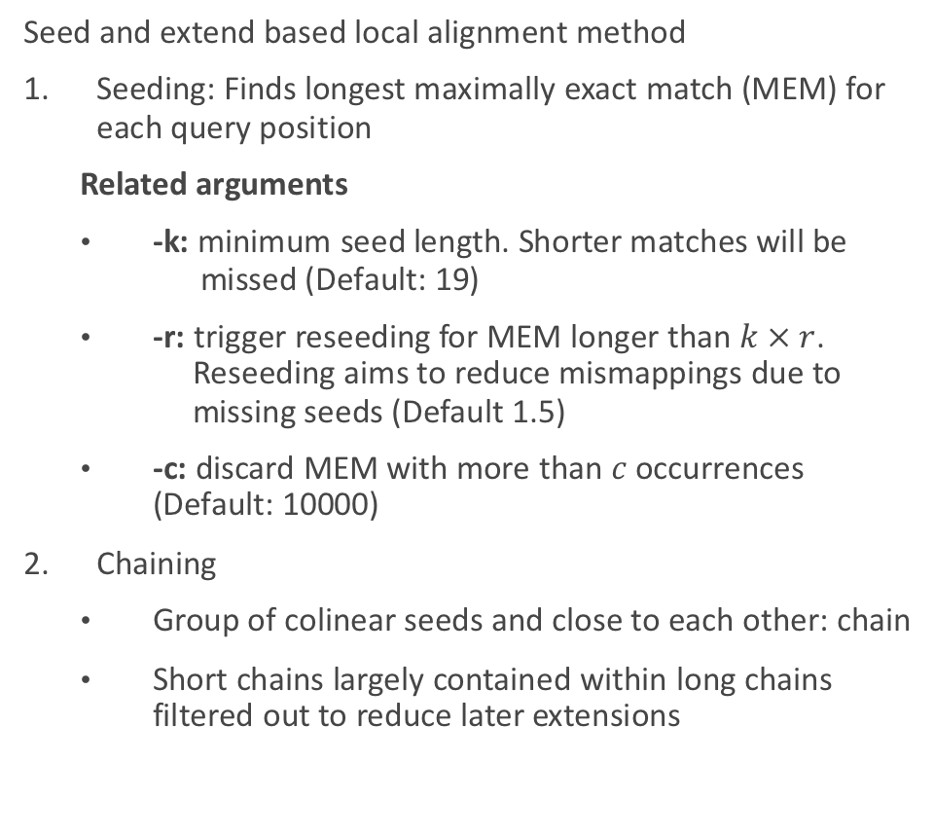
BWA-MEM: How it works…
Seed and extend based local alignment method
Seeding: Finds longest maximally exact match (MEM) for each query position
  Related arguments
  -k: minimum seed length. Shorter matches will be missed (Default: 19)
  -r: trigger reseeding for MEM longer than $k × r$.
  Reseeding aims to reduce mismappings due to missing seeds (Default 1.5)
  -c: discard MEM with more than $c$ occurrences (Default: 10000)
Chaining
  Group of colinear seeds and close to each other: chain
  Short chains largely contained within long chains filtered out to reduce later extensions

Slide 29
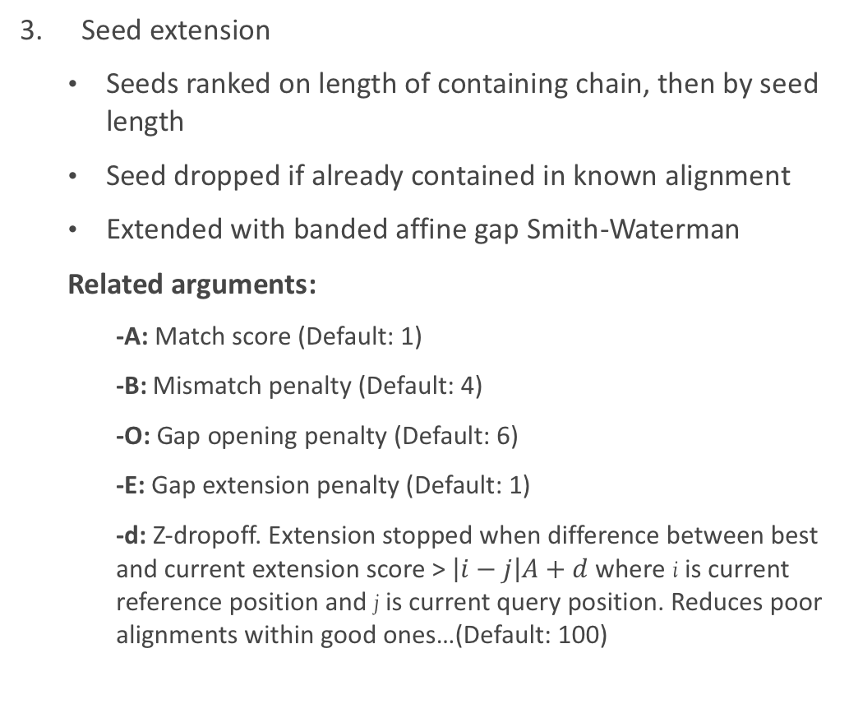
BWA-MEM: How it works
Seed extension
  Seeds ranked on length of containing chain, then by seed length
  Seed dropped if already contained in known alignment
  Extended with banded affine gap Smith-Waterman
  Related arguments:
    -A: Match score (Default: 1)
    -B: Mismatch penalty (Default: 4)
    -O: Gap opening penalty (Default: 6)
    -E: Gap extension penalty (Default: 1)
    -d: Z-dropoff. Extension stopped when difference between best and current extension score > $\left|i−j\right|A+d$ where i is current reference position and j is current query position. Reduces poor alignments within good ones…(Default: 100)

Slide 30
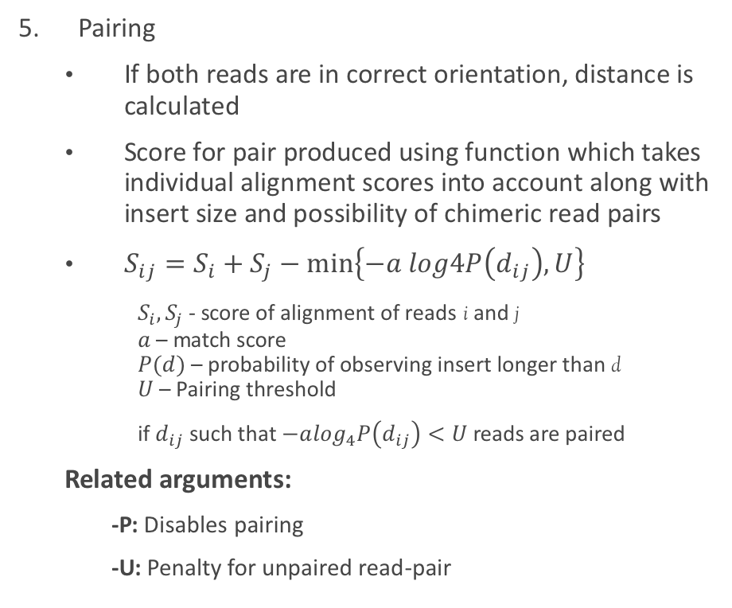
BWA MEM: How it works
Paired end rescue
  In the event that one read of pair maps and second doesn't, rescue of unpaired read attempted using Smith-Waterman alignment, forcing alignment of poorly aligned read
  Related arguments:
    -S: skip mate rescue
Pairing
  If both reads are in correct orientation, distance is calculated
  Score for pair produced using function which takes individual alignment scores into account along with insert size and possibility of chimeric read pairs
  $S_{ij}=S_{i}+S_{j}−min\left\{−a log4P\left(d_{ij}\right),U\right\}⁡$
  $S_{i},S_{j}$ - score of alignment of reads i and j
  $a$ – match score
  $P(d)$ – probability of observing insert longer than d
  $U$ – Pairing threshold
  if $d_{ij}$ such that $−a\log_{4}P\left(d_{ij}\right)<U$reads are paired
  Related arguments:
    -P: Disables pairing
    -U: Penalty for unpaired read-pair
Notes:
Log4 is result of interpreting SW score as odds ratio

Slide 31
BWA-MEM: Other arguments
-t: Number of threads (default: 1)
-p: Input is interleaved fastq
-T: Don't output alignments with score < T (default: 30)
-a: Output all found alignments for single-end/unpaired reads
-M: Mark shorter split hits as secondary alignments.
  Results from using local alignment so may produce multiple alignments for different regions of read.
  Required for compatibility with some tools (i.e. picard)

Slide 32
BWA-MEM: Putting it all together
bwa mem help output:
    bwa mem [-aCHMpP] [-t nThreads] [-k minSeedLen] [-d zDropoff]
    [-r seedSplitRatio] [-c maxOcc] [-A matchScore] [-B mmPenalty]
    [-O gapOpenPen] [-E gapExtPen] [-U unpairPen] db.prefix reads.fq [mates.fq]
So a simple command would look like:
    bwa mem –t 8 –M reference/H293 reads/xxx.fq.gz reads/yyy.fq.gz
  Changing some default parameters:
    bwa mem –t 8 –M –k 25 –O 8 –E 2 reference/H293 reads/xxx.fq.gz reads/yyy.fq.gz
  No output file name argument?
    Output written to STDOUT
    Need to redirect to a file
Prefix specified during indexing

Slide 33
A BWA script…
#!/bin/bash
#$ -cwd
#$ -pe smp 8
#$ -j y
#$ -o job_logs/$JOB_NAME.$JOB_ID
cp -v reference/H293.* ${TMPDIR}
cp -v Streptococcus/H395_?.fq.gz ${TMPDIR}
bwa mem -t 8 -M ${TMPDIR}/H293 ${TMPDIR}/H395_1.fq.gz ${TMPDIR}/H395_2.fq.gz \
> ${TMPDIR}/H395.sam
cp -v ${TMPDIR}/H395.sam .
Save your script as 'bwa_1.sh'
Submit it to the cluster: 'qsub bwa.sh'
Monitor your job with qstat
Did it work?
  Do you have an H395.sam file in your directory?
  What do the jobs output logs show?
scripts/bwa_1.sh

Slide 34
Minimap2 - Long read alignments

Slide 35
Minimap2
Designed to cope with long, noisy reads
Similar overall strategy seed - chain - align procedure as BWA
Performance optimisation through skipping alignment in repetitive regions
Provides presets optimised for particular tasks
  Preset:
  -x STR preset (always applied before other options; see minimap2.1 for details) []
  - map-pb/map-ont - PacBio/Nanopore vs reference mapping
  - ava-pb/ava-ont - PacBio/Nanopore read overlap
  - asm5/asm10/asm20 - asm-to-ref mapping, for ~0.1/1/5% sequence divergence
  - splice/splice:hq - long-read/Pacbio-CCS spliced alignment
  - sr - genomic short-read mapping
Can generates indexes on-the-fly
[jabbott@c6320-3-4 ~]$ conda install minimap2
Usage: minimap2 [options] <target.fa>|<target.idx> [query.fa] [...]

Slide 36
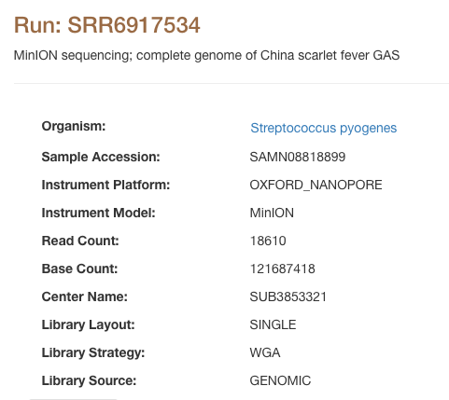
Running minimap2
'minion/SRR6917534_1.fastq.gz'
#!/bin/bash
#$ -cwd
#$ -pe smp 8
#$ -j y
#$ -o job_logs/$JOB_NAME.$JOB_ID
cp -v reference/H293.fa ${TMPDIR}
cp -v minion/SRR6917534_1.fastq.gz ${TMPDIR}
minimap2 -t 8 -a -x map-ont -o ${TMPDIR}/SRR6917534.sam ${TMPDIR}/H293.fa \ ${TMPDIR}/SRR6917534_1.fastq.gz
cp -v ${TMPDIR}/SRR6917534.sam .
Output in SAM format
Use ONT mapping preset
Run 8 threads
Output filename
Reference sequence
Query sequences
scripts/minimap.sh

Slide 37
Alignment file formats

Slide 38
Formats
Three main formats used for storing alignments
SAM (Sequence Alignment Map)
  Plain text
  Uncompressed
BAM (Binary Alignment Map)
  Binary equivalent of SAM
  Compressed
  Can be indexed to allow random access
CRAM
  Uses Reference-based compression
  45-50% space saving over BAM
  Not currently as well supported by tools

Slide 39
SAM Format
Official definition document: https://samtools.github.io/hts-specs/SAMv1.pdf
File contains two sections: header (optional) and alignments
Human readable(ish) text format
Header lines start with an '@'
H395.sam contains two header lines:
@SQ SN:Chromosome LN:1726248
@PG ID:bwa PN:bwa VN:0.7.17-r1188 CL:bwa mem -v 0 -t 8 -M H293 H395_1.fq.gz H395_2.fq.gz
SQ: Reference sequence dictionary
SN: Sequence name
LN: Sequence length
Two letter record type code
PG:Program
PN: Program name
CL: Command line
ID:Unique identifier
VN: Program Version

Slide 40
SAM Format: Other headers
@HD: The header line – must be first line in file
  @HD VN:1.0 SO:coordinate
@CO: One line text comment. Multiple @CO lines allowed
@RG: Read Group…more on these later
Many other tags may be found for lines described
See format specification for details
Tag | Description | Valid values
VN | Format version (required) | Number i.e. 1.0
SO | Sort order | unknown, unsorted, coordinate, queryname

Slide 41
SAM format: Alignment section
M00368:16:000000000-A0JCH:1:1:15079:1345 83 Chromosome 322231 60 151M = 322032 -350 CACAA C@CCA NM:i:0 MD:Z:151 MC:Z:151M AS:i:151 XS:i:0
Each line represents alignment of segment
11 (or more) tab-delimited fields
Beware 1-based vs 0-based coordinates…
Additional optional fields
Field | Type | Description
QNAME | String | Query template name
FLAG | Integer | bitwise flag – more later
RNAME | String | Reference sequence name
POS | Integer | 1-based leftmost mapping position
MAPQ | Integer | Mapping quality
CIGAR | String | CIGAR string – more later
RNEXT | String | Ref name of paired read
PNEXT | Integer | Position of paired read
TLEN | Integer | Template length
SEQ | String | Segment sequence
QUAL | String | Sequence quality (Phred)
Coordinate comparison figure by Obi Griffith, Biostars
Notes:
MAPQ: Phred scaled probability mapping position is wrong
Template length is number of bases from left most mapped base to right most mapped base

Slide 42
SAM Format: SAM Flags
A diversion in binary and bitwise operations…
A byte stores 8 bits of data allowing a value up to 255 to be stored
Why am I telling you this?
SAM flag field is combination of 12 bitwise flags…
Allows alignments to be filtered to isolate reads meeting particular criteria
128 | 64 | 32 | 16 | 8 | 4 | 2 | 1 | Decimal value
0 | 0 | 0 | 0 | 0 | 1 | 0 | 1 | 4+1=5
1 | 0 | 1 | 0 | 1 | 0 | 1 | 1 | 128+32+8+2+1=171
1 | 1 | 1 | 1 | 1 | 1 | 1 | 1 | 128+64+32+16+8+4+2+1=255

Slide 43
SAM Format: SAM flags
Bit | Description
1 | Read paired
2 | Read mapped in proper pair
4 | Read unmapped
8 | Mate unmapped
16 | Read on reverse strand
32 | Mate on reverse strand
64 | First in pair
128 | Second in pair
256 | Secondary alignment
512 | Does not pass filters i.e. QC
1024 | PCR/optical duplicate
2048 | Supplementary alignment
First read on our SAM file: Flag is 83
Only one way to make 83
64+16+2+1=83
Read is paired, mapped in a proper pair, on the reverse strand and is first in pair
Next read (pair): Flag is 163
128+32+2+1=163
Read is paired, mapped in a proper pair, is on the reverse strand and is second in pair
Fortunately: samtools flags
2048 | 1024 | 512 | 256 | 128 | 64 | 32 | 16 | 8 | 4 | 2 | 1 | value
0 | 0 | 0 | 0 | 0 | 1 | 0 | 1 | 0 | 0 | 1 | 1 | 83
0 | 0 | 0 | 0 | 1 | 0 | 1 | 0 | 0 | 0 | 1 | 1 | 163

Slide 44
SAM Format: CIGAR string
CIGAR string defines how read compares with reference
Concise Idiosyncratic Gapped Alignment Report
Sequence of count and operators combined
    151M: 151 matches
  CACGATCA**GACCGATACGTCCGA
  CGATCAGAGA*CGATA
    Cigar string: 6M2I2M1D5M
  Limit of 65535 operations
    Minimap2 -L argument stores CIGAR as supplementary tag
Operator | Description | Consumes query | Consumes reference
M | Alignment match | Yes | Yes
I | Insertion to reference | Yes | No
D | Deletion from reference | No | Yes
N | Skipped region from reference | No | Yes
S | Soft clipping | Yes | No
H | Hard clipping | No | No
P | Padding | No | No
= | Sequence match | Yes | Yes
X | Sequence mismatch | Yes | Yes

Slide 45
SAM Format: CIGAR string
Clipped alignments
Local alignments may not be aligned for full length of sequence
Subsequences at end may be clipped off
GCTTAATGCGTGTGACAGTCGATGTACTGAC
gtaGCGTGTGACAGTCGATca
CIGAR string: 3S16M2S
Spliced alignments
cDNA to genomic alignments need to differentiate spanning introns from deletions
N: Skipped region from reference
GCTTAATGCGTGTGACAGTCGATGTACTGAC
AATG.........GTCGAT
CIGAR string: 4M9N6M

Slide 46
SAM Format: Additional tags
NM:i:0 MD:Z:151 MC:Z:151M AS:i:151 XS:i:0
Additional fields can be appended to each alignment line
Take the format of TAG:Type:Value
Tag is string of two letters
Standard tag definitions:
https://samtools.github.io/hts-specs/SAMtags.pdf
Type | Description
A | Character
B | Array
f | Real number
H | Hexadecimal array
i | Integer
Z | String
Tag | Description
NM | Edit distance
MD | String for mismatching positions
MC | CIGAR string for mate
AS | Alignment score
XS | Score of second best alignment (BWA specific tag)

Slide 47
SAM Format: Read groups
Read groups allow combination of reads from different sources within one file
Map individual reads to e.g. sample
Required by some tools
Entry in header for each read group
Additional RG tag on each alignment mapping to read group i.e. RG:Z:1
@RG ID:1 PL:ILLUMINA PU:1 BC:CGCTCAGTTC SM:H293
@RG ID:2 PL:ILLUMINA PU:1 BC:TATCTGACCT SM:H355
Tag | Description
ID | Unique identifier
PL | Platform
PU | Platform unit i.e. lane
BC | Barcode
SM | Sample

Slide 48
Adding read groups to a SAM file
Read groups can be added by some aligners at run-time
BWA: -R argument
    bwa –R "@RG\tID:1\tSM:H395\tPL:ILLUMINA\tPU:1" H293 H395_1.fq.gz H395_2.fq.gz
  Picard tools: set of utilities for manipulating NGS data
    [jabbott@login2 read_mapping]$ qrsh -pe smp 4
    [jabbott@lc6320-6-3 ~]$ cd read_mapping
    [jabbott@c6320-6-3 read_mapping]$ conda install picard
    [jabbott@c6320-6-3 read_mapping]$ picard
    [jabbott@c6320-6-3 read_mapping]$ picard AddOrReplaceReadGroups
    [jabbott@c6320-6-3 read_mapping]$ picard AddOrReplaceReadGroups I=H395.sam \
    O=H395_RG.sam RGID=1 RGLB=Lib1 RGPL=ILLUMINA RGSM=H395 RGPU=1

Slide 49
BAM Format
Binary equivalent of SAM
Much more compact – should always be used in preference to SAM
Not human readable
samtools view can be used to convert SAM/BAM/CRAM files
[jabbott@c6320-6-3 read_mapping]$ samtools view
[jabbott@c6320-6-3 read_mapping]$ samtools view -b -o H395_RG.bam -@ 4 H395_RG.sam
[jabbott@c6320-6-3 read_mapping]$ du –h H395_RG.*
124M H395_RG.bam
325M H395_RG.sam
Samtools view outputs on STDOUT by default
Can be used to view BAM files as SAM
  Everything: [jabbott@c6320-6-3 read_mapping]$ samtools view –h H395_RG.bam
  Headers only: [jabbott@c6320-6-3 read_mapping]$ samtools view –H H395_RG.bam
  Alignments: [jabbott@c6320-6-3 read_mapping]$ samtools view H395_RG.bam
Output filename
Output bam format
Run 4 threads

Slide 50
BAM Format
samtools can also read from STDIN
Can pipe SAM output from BWA straight to samtools
Update your bwa script:
#!/bin/bash
#$ -cwd
#$ -pe smp 8
#$ -j y
#$ -o job_logs/$JOB_NAME.$JOB_ID
cp -v reference/H293.* ${TMPDIR}
cp -v Streptococcus/H395_?.fq.gz ${TMPDIR}
bwa mem -t 8 -M ${TMPDIR}/H293 ${TMPDIR}/H395_1.fq.gz ${TMPDIR}/H395_2.fq.gz | samtools view -b -o ${TMPDIR}/H395.bam -
cp -v ${TMPDIR}/H395.bam .
Now rerun it and look for your H395.bam file appearing
Take a look at this with ‘samtools view’
‘-’ in place of input filename - read from STDIN
scripts/bwa_2.sh

Slide 51
Post-processing

Slide 52
BAM files: sorting and indexing
BAM files generally need to be sorted by co-ordinate
Output of aligners will not generally be sorted
Coordinate sorted file sorted first by reference name followed by base position
  [jabbott@login1 read_mapping]$ qrsh
  [jabbott@c6320-6-3 ~]$ cd read_mapping
  [jabbott@c6320-6-3 read_mapping]$ samtools sort
  [jabbott@c6320-6-3 read_mapping]$ samtools sort --threads 4 –o H395.sorted.bam H395.bam
  Check the headers of H395.bam and H395.sorted.bam
  [jabbott@c6320-6-3 read_mapping]$ samtools view –H H395.bam
  [jabbott@c6320-6-3 read_mapping]$ samtools view –H H395.sorted.bam
  Now look at the sorted alignments – pay attention to the POS column
  [jabbott@c6320-6-3 read_mapping]$ samtools view H395.sorted.bam|less

Slide 53
BAM Format: Indexing
Indexes allow software to randomly access data within a BAM file
Index is binary file with .bai filename suffix
A BAM index can be created with samtools index
    [jabbott@c6320-6-3 read_mapping]$ samtools index
    [jabbott@c6320-6-3 read_mapping]$ samtools index -@ 4 H395.sorted.bam
  Check the index is created (H395.sorted.bam.bai) with 'ls’
    [jabbott@c6320-6-3 read_mapping]$ rm H395.sorted.bam*
Update bwa.sh to sort and index our bam file as we create it…
    #!/bin/bash
    #$ -cwd
    #$ -pe smp 8
    #$ -j y
    #$ -o job_logs/$JOB_NAME.$JOB_ID
    cp -v reference/H293.* ${TMPDIR}
    cp -v Streptococcus/H395_?.fq.gz ${TMPDIR}
    bwa mem -t 8 -M ${TMPDIR}/H293 ${TMPDIR}/H395_1.fq.gz ${TMPDIR}/H395_2.fq.gz | \
    samtools sort -o ${TMPDIR}/H395.sorted.bam -
    samtools index ${TMPDIR}/H395.sorted.bam
    cp -v ${TMPDIR}/H395.sorted.* .
replace 'samtools view' command with 'samtools sort'
Add 'samtools index' command
Update copy command
scripts/bwa_3.sh

Slide 54
Some basic statistics
(ngs_tools) ningal:read_mapping $ samtools flagstat H395.sorted.bam
791395 + 0 in total (QC-passed reads + QC-failed reads)
2947 + 0 secondary
0 + 0 supplementary
0 + 0 duplicates
672450 + 0 mapped (84.97% : N/A)
788448 + 0 paired in sequencing
394224 + 0 read1
394224 + 0 read2
665336 + 0 properly paired (84.39% : N/A)
668550 + 0 with itself and mate mapped
953 + 0 singletons (0.12% : N/A)
0 + 0 with mate mapped to a different chr
0 + 0 with mate mapped to a different chr (mapQ>=5)

Slide 55
BAM files: marking duplicates
Duplicate reads may occur due to
  Optical duplicates: One cluster being called as two
  Clustering: Occupying two adjacent wells during cluster generation
  PCR duplication: from amplification in sample prep.
Duplicate reads can bias some analysis i.e. SNV identification
Don't provide any additional information
Can be either marked as duplicates (via the SAM flag 1024), or removed
[jabbott@c6320-6-3 read_mapping]$ picard MarkDuplicates I=H395.sorted.bam \ O=H395.sorted.nodup.bam M=H395.duplicate_metrics.txt
use 'samtools flagstat' to compare the H395.sorted.nodup.bam stats with H395.sorted.bam
Notes:
Optical duplicates are not a problem when using patterened flowcells
Clustering is only a problem when using patterened flowcells
PCR duplicates typically occur if there is insufficient complexity in your library which can lead to non-specific overamplification. Can be avoided by using PCR-free library preps.

Slide 56
BAM files: filtering
BAM files can be filtered to separate reads meeting particular criteria
Interested in the set of reads in your data which didn’t align?
Flags: Read unmapped = 4, Mate unmapped = 8
  Therefore to extract read pairs where neither read is mapped: 8+4=12
Samtools view can filter with the following arguments:
    -f INT only include reads with all of the FLAGs in INT present [0]
    -F INT only include reads with none of the FLAGS in INT present [0]
    -G INT only EXCLUDE reads with all of the FLAGs in INT present [0]
  We want to only include reads with our flag present…
    [jabbott@c6320-6-3 read_mapping]$ samtools view –f 12 –b –o H395.unmapped.bam H395.sorted.bam
  Check the contents of the new bam file with ‘samtools flagstat’
  We can convert these reads back to fastq format with picard
    [jabbott@c6320-6-3 read_mapping]$ picard SamToFastq I=H395.unmapped.bam \
    F=H395.unmapped_1.fq.gz F2=H395.unmapped_2.fq.gz

Slide 57
BAM files: filtering
Want to separate alignments into chunks to allow parallel analysis?
    Usage: samtools view [options] <in.bam>|<in.sam>|<in.cram> [region ...]
Region defined as
  REF – select all alignments to specified reference
  REF:start-end – select all alignments spanning coordinates on specified reference
  Select the reads from our alignment from between coordinates 1000-2000:
  [jabbott@c6320-6-3 read_mapping]$ samtools view H395.sorted.bam ‘Chromosome:1000-2000’
  See ‘samtools view’ for list of other filtering options

Slide 58
Other statistics of interest…
Picard can report stats on the library insert size distribution:
[jabbott@c6320-6-3 read_mapping]$ picard CollectInsertSizeMetrics
[jabbott@c6320-6-3 read_mapping]$ picard CollectInsertSizeMetrics H=H395.pdf \
I=H395.sorted.bam O=H395.txt
  H395.txt includes stats such as median insert size, median absolute deviation
WGS metrics (coverage)
[jabbott@c6320-6-3 read_mapping]$ picard CollectRawWgsMetrics \
R=reference/H293.fa I=H395.sorted.bam O=H395.wgs_stats.txt

Slide 59
Viewing alignments in a genome browser

Slide 60
Genome browsers
Various browsers freely available
Differ in capabilities
Popular choices
  IGV (https://software.broadinstitute.org/software/igv/)
  IGB (http://bioviz.org)
  Tablet (https://ics.hutton.ac.uk/tablet/)
Available through Apps Anywhere
Search for tablet and start it up….
Typically require:
  Reference sequence: fasta format and faidx indexed
  Reference annotations: gff3 format
  Bam format alignments

Slide 61

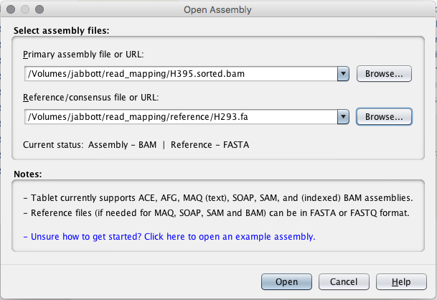
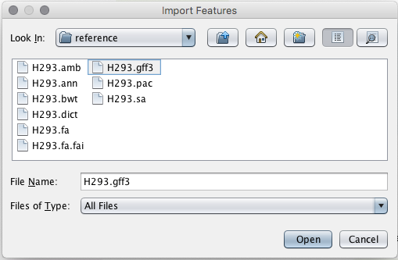

Tablet – loading your data
Indexed, sorted bam file
faidx indexed fasta reference

Slide 62
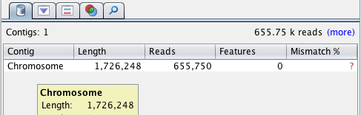
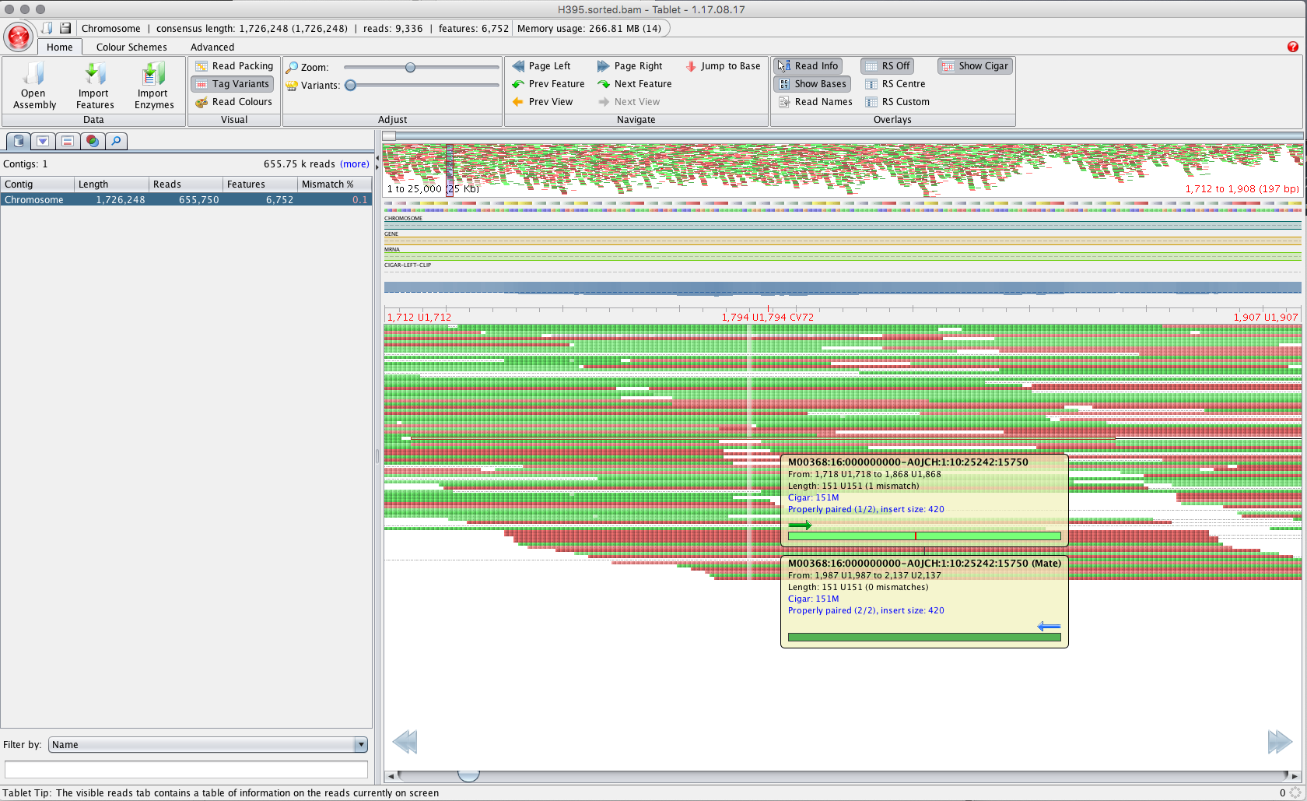
Tablet - browsing

Slide 63
Multimapping Reads

Slide 64
Sequence repeats
Interspersed repeats constitute
  ~50% of human genome
  Up to ~80% of graminae genomes
How can an aligner determine which copy of an identical repeat a read originates from?
  It can’t…
Provide measure of confidence of mapping being correct – MAPQ
  Phred-scaled likelihood
  Distinct from alignment score

Slide 65
Multimapping reads
Behavior of aligners differs when handling multimapping reads
For BWA:
  One mapping better scoring than others?
    MAPQ reduced accordingly
  Identically scoring mappings?
    MAPQ set to 0
    Additional tags added to alignment line
    Which mapping reported? Chosen at random…
HWI-ST1398:100:C43B8ACXX:7:2207:16475:95789 163 1 152276198 0 100M = 152276256 158 ACTCA ?@=A? X0:i:2 X1:i:0 XA:Z:1,+152280086,100M,0; MD:Z:100 XG:i:0 AM:i:0 NM:i:0 SM:i:0 XM:i:0 XO:i:0 MQ:i:0 XT:A:R
X0: number of best hits
XA: Alternative hits
REF,POS,CIGAR,NM;

Slide 66
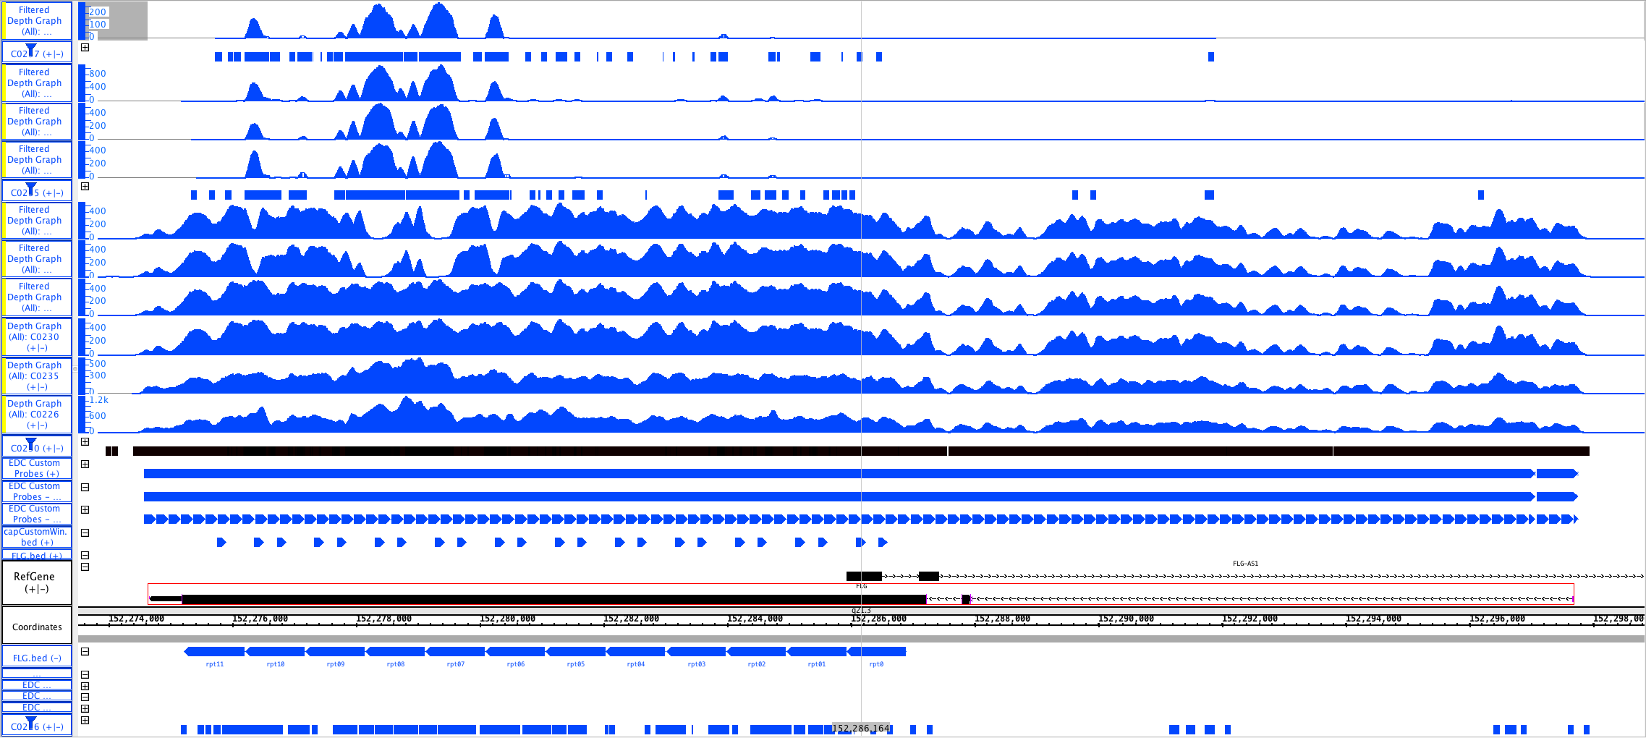
Multimapping reads: A real world example…

Slide 67
Multimapping reads: Other Aligners
Bowtie2
  Default: Search for multiple alignments, report best
    Random selection of reported alignment
  -k: Search for one to k alignments, report each
    Additional alignments flagged as secondary
    Alignments not found in particular order – not necessarily finding ‘best’ alignment before stopping
  -a: Search for and report all alignments
    Reported in descending order by alignment score
    Slow…
mrFAST:
  Designed to find all mappings as primary aim
  Works with TARDIS SV detection package

Slide 68
Mapping Workflows

Slide 69
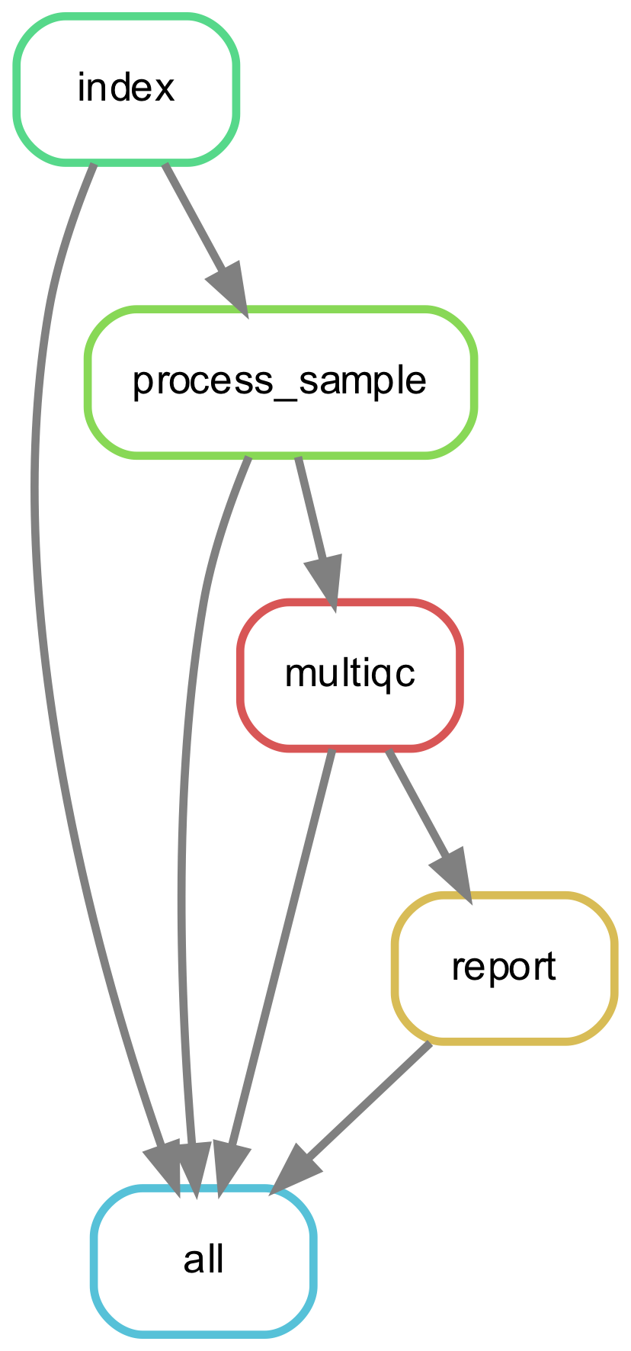
DAG Workflows: map-bwa-mem-pe
Workflow for alignment of paired-end Illumina style reads
  Creation of BWA/fasta indices
  Per-sample:
    alignment with BWA-MEM
    Duplicates marked with Picard MarkDuplicates
    Gather alignment metrics (Picard):
      AlignmentSummaryMetrics
      BaseDistributionByCycle
      GcBiasMetrics
      InsertSizeMetrics
      OxoGMetrics
      WgsMetrics
  Create MultiQC report
  Create summary HTML report

Slide 70
DAG map-bwa-mem-pe workflow setup
Directory to create for running workflow
Job name
Setting up a workflow – dag-wf-setup:
(dag-wf) ningal:read_mapping $ dag-wf-setup -i reads -d dag-wf-mapping -n Strep_mapping \
-w map-bwa-mem-pe -r reference/H293.fa
Creating dag-wf-map-bwa-mem-pe conda environment
<snip>
Populating dag-wf-mapping/fastq directory with data files...
/homes/jabbott/read_mapping/reads/H395_1.fq.gz -> dag-wf-mapping/fastq/H395_1.fq.gz
/homes/jabbott/read_mapping/reads/H395_2.fq.gz -> dag-wf-mapping/fastq/H395_2.fq.gz
/homes/jabbott/read_mapping/reads/H411_1.fq.gz -> dag-wf-mapping/fastq/H411_1.fq.gz
/homes/jabbott/read_mapping/reads/H411_2.fq.gz -> dag-wf-mapping/fastq/H411_2.fq.gz
reference/H293.fa -> dag-wf-mapping/reference/H293.fa
Please inspect the Snakefile in the 'dag-wf-mapping' directory and modify as required.
The workflow can be run by running 'cd dag-wf-mapping; dag-wf-run'
Directory containing fastq reads
Workflow required
Reference sequence fasta file

Slide 71
DAG map-bwa-mem-pe workflow: running
(dag-wf) ningal:read_mapping $ cd dag-wf-mapping
(dag-wf) ningal:dag-wf-mapping $ dag-wf-run
Typically takes ~7 mins to run
An HTML report file should be created in dag-wf-mapping
Browse to this via your network mount and double-click to open in a web browser

Slide 72
Any Questions?

